Slide 1
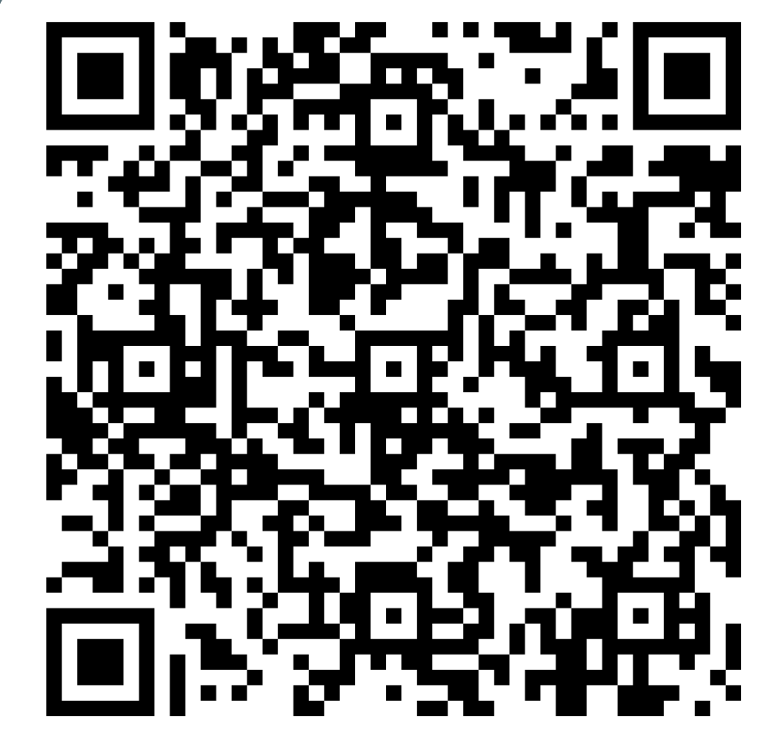
LEARNING LAB
all students welcome!
Register
Here:
MONDAYS | 4 PM | NAB 2244
Coordinated by: Ali Holtzapple, Student Disability & Academic Support Specialist
July 13 | ACCEPT & COMMIT: reaching goals Presenter: Jason Cherry, DPT Faculty
July 27 | Time management for Mortals Presenter: Ali Holtzapple, Student Affairs
August 10 | Talk Soup for the Imposter Soul Presenter: Casey Griffin, Counseling Center
August 24 | DEMYSTIFYING MULTIPLE CHOICE EXAMS Presenter: Molly Torbitt, DPT Faculty
Sept. 14 | MORAL DISTRESS: MANAGING TO MEND Presenter: Adrienne Borschuk, Bioethics Faculty
Learn Together ∞ Be Together

