Slide 1
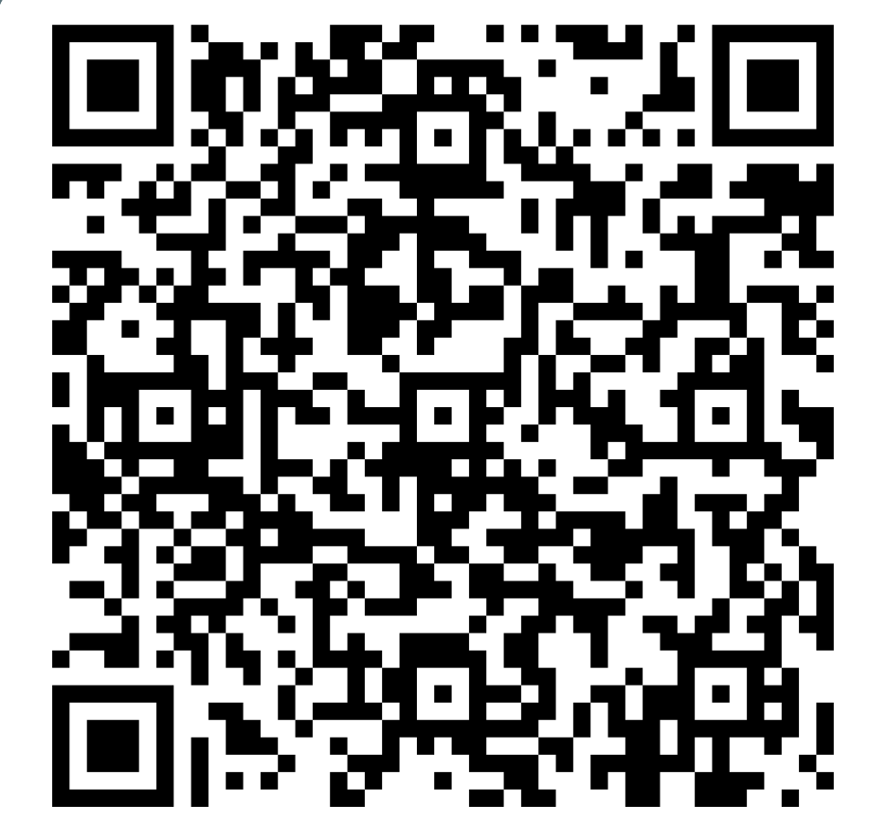
LEARNING LAB
all students welcome!
Register
Here:
MONDAYS | 4 PM | NAB 2244
Coordinated by: Ali Holtzapple, Student Disability & Academic Support Specialist
July 27 | Time management for mortals Presenter: Ali Holtzapple, Student Affairs
August 10 | Talk Soup for the Imposter Soul Presenter: Casey Griffin, Counseling Center
Sept. 14 | MORAL DISTRESS: MANAGING TO MEND Presenter: Adrienne Borschuk, Bioethics Faculty
Sept. 28 New date! | DEMYSTIFYING MULTIPLE CHOICE EXAMS Presenter: Molly Torbitt, DPT Faculty
Learn Together ∞ Be Together

