Slide 1
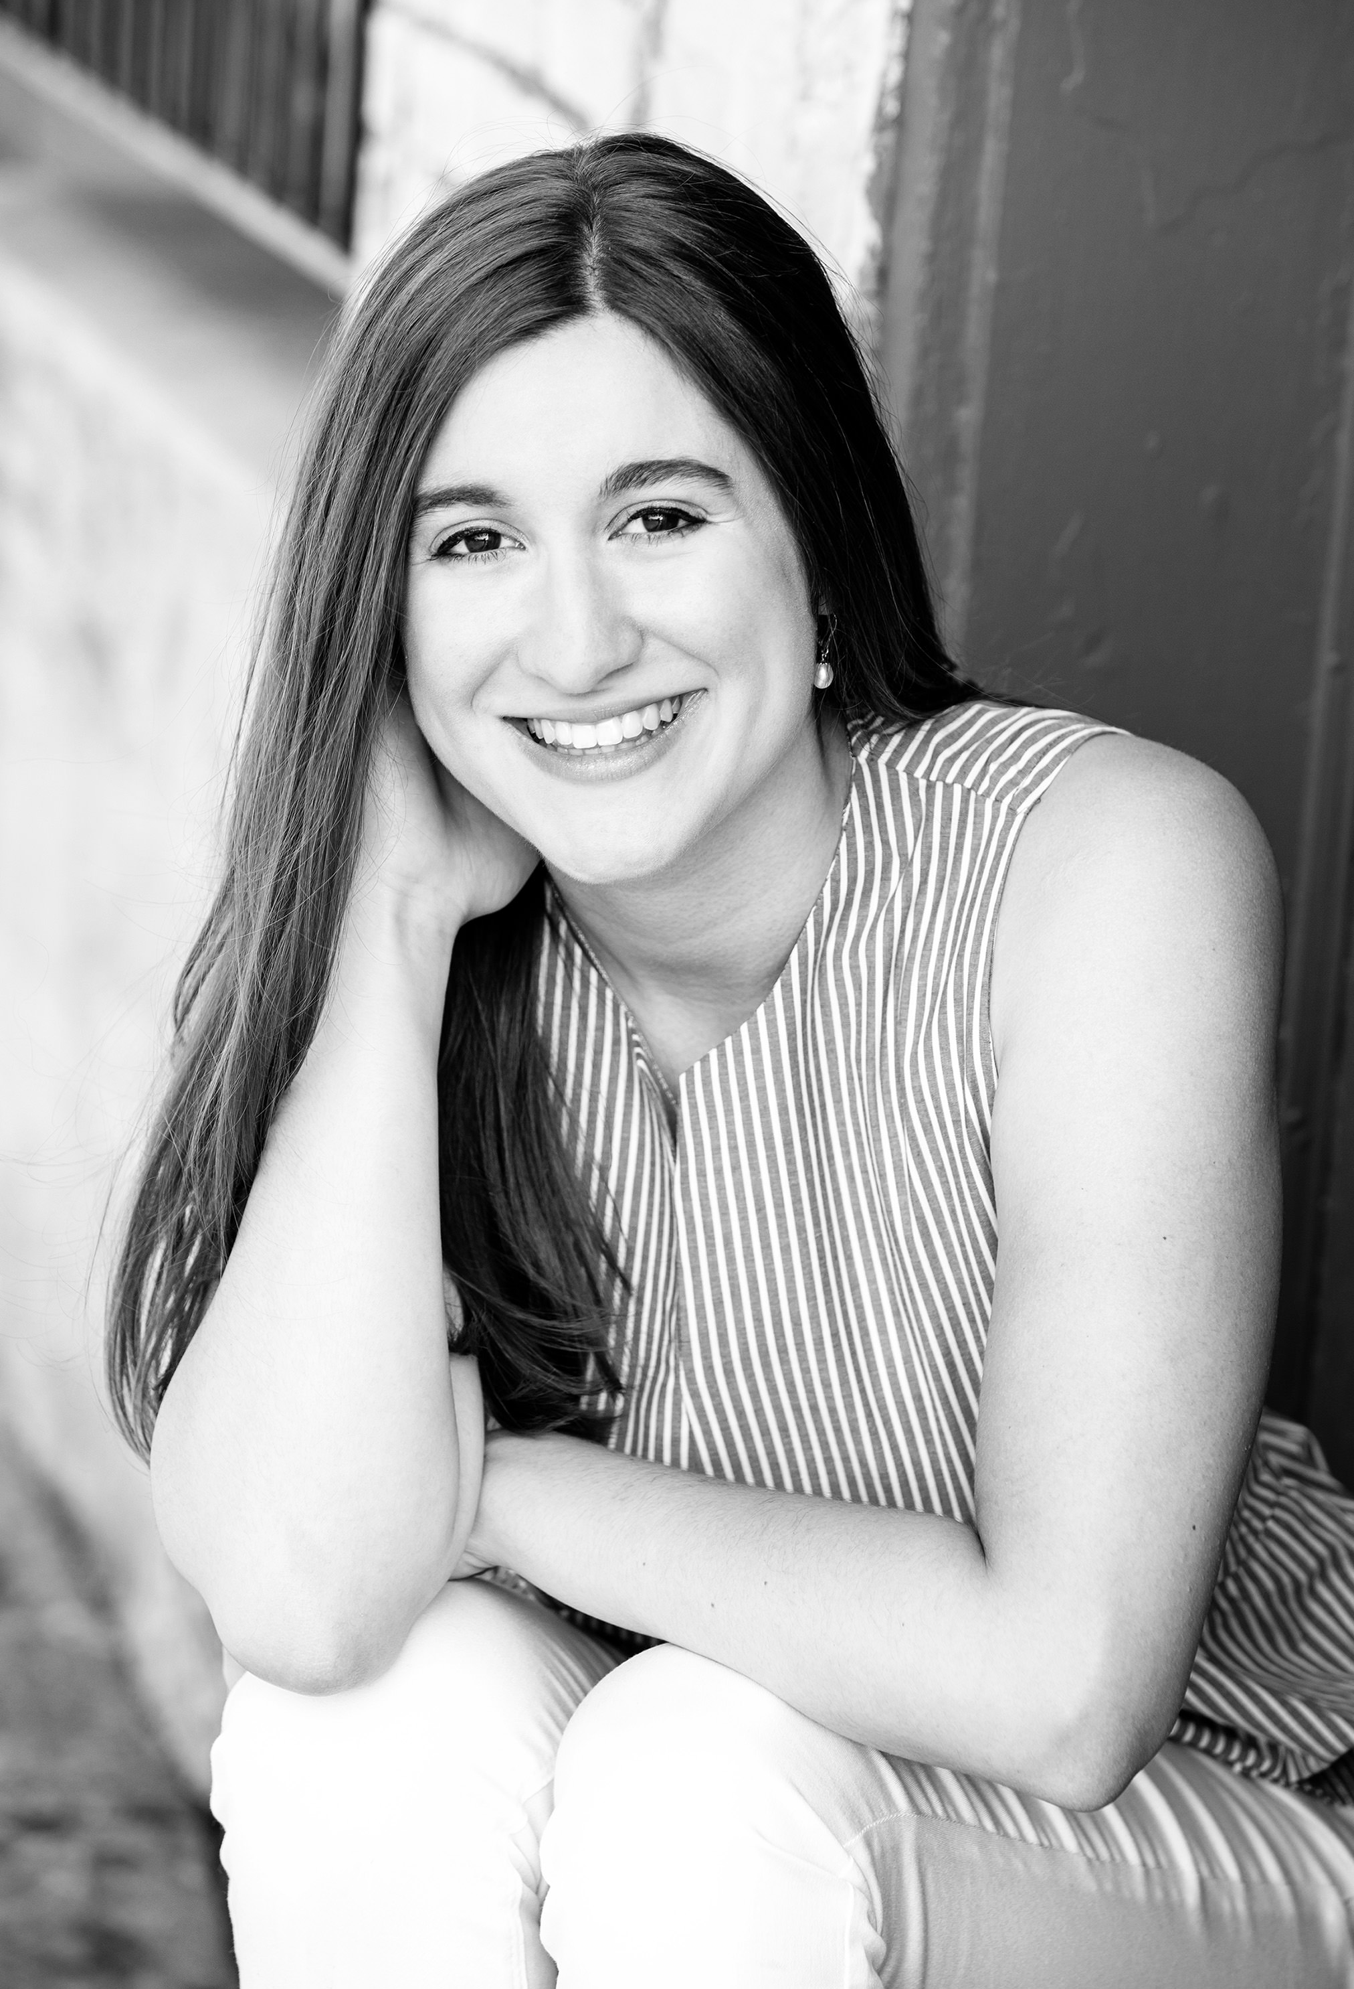
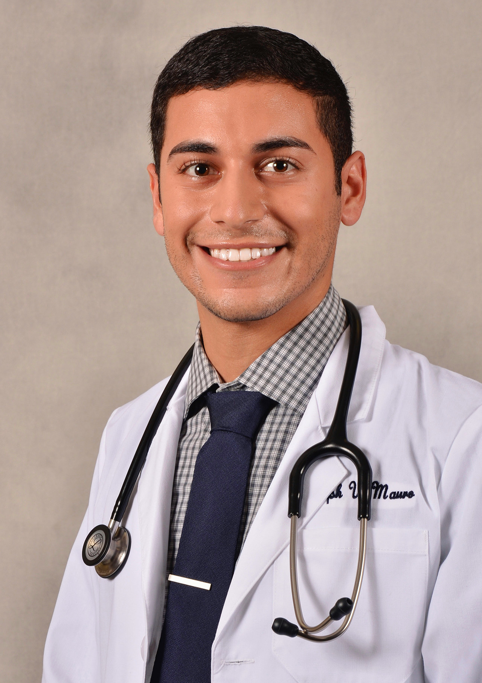
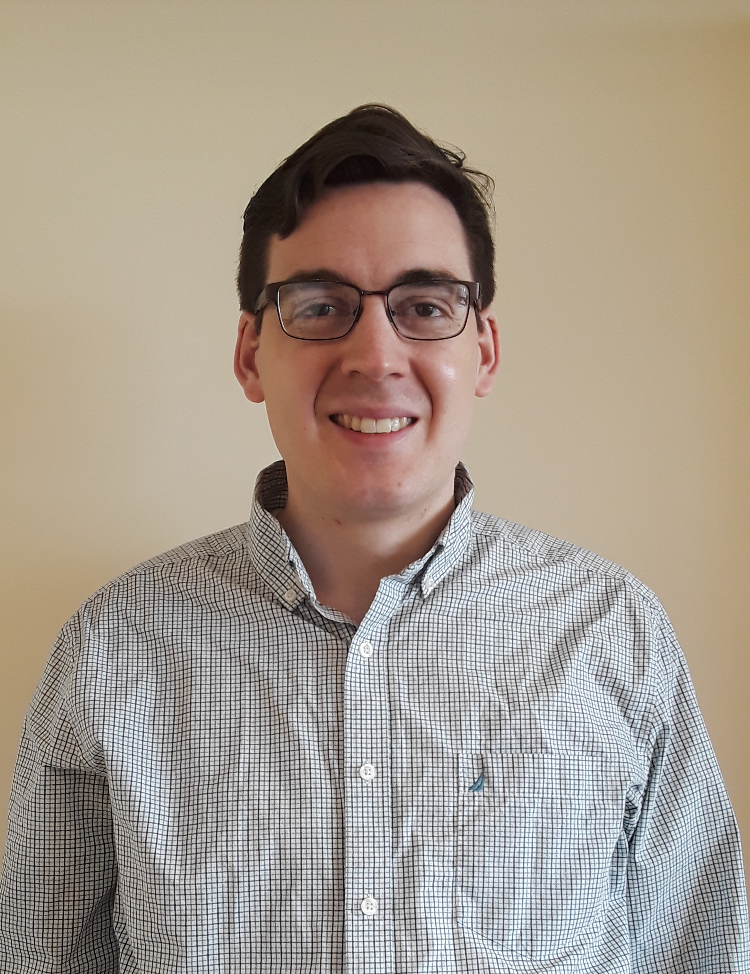
Incoming MD, PhD Students
Cora Lyon, Olivia Laniak, Joseph Mauro, Samuel Garrard

