Slide 1
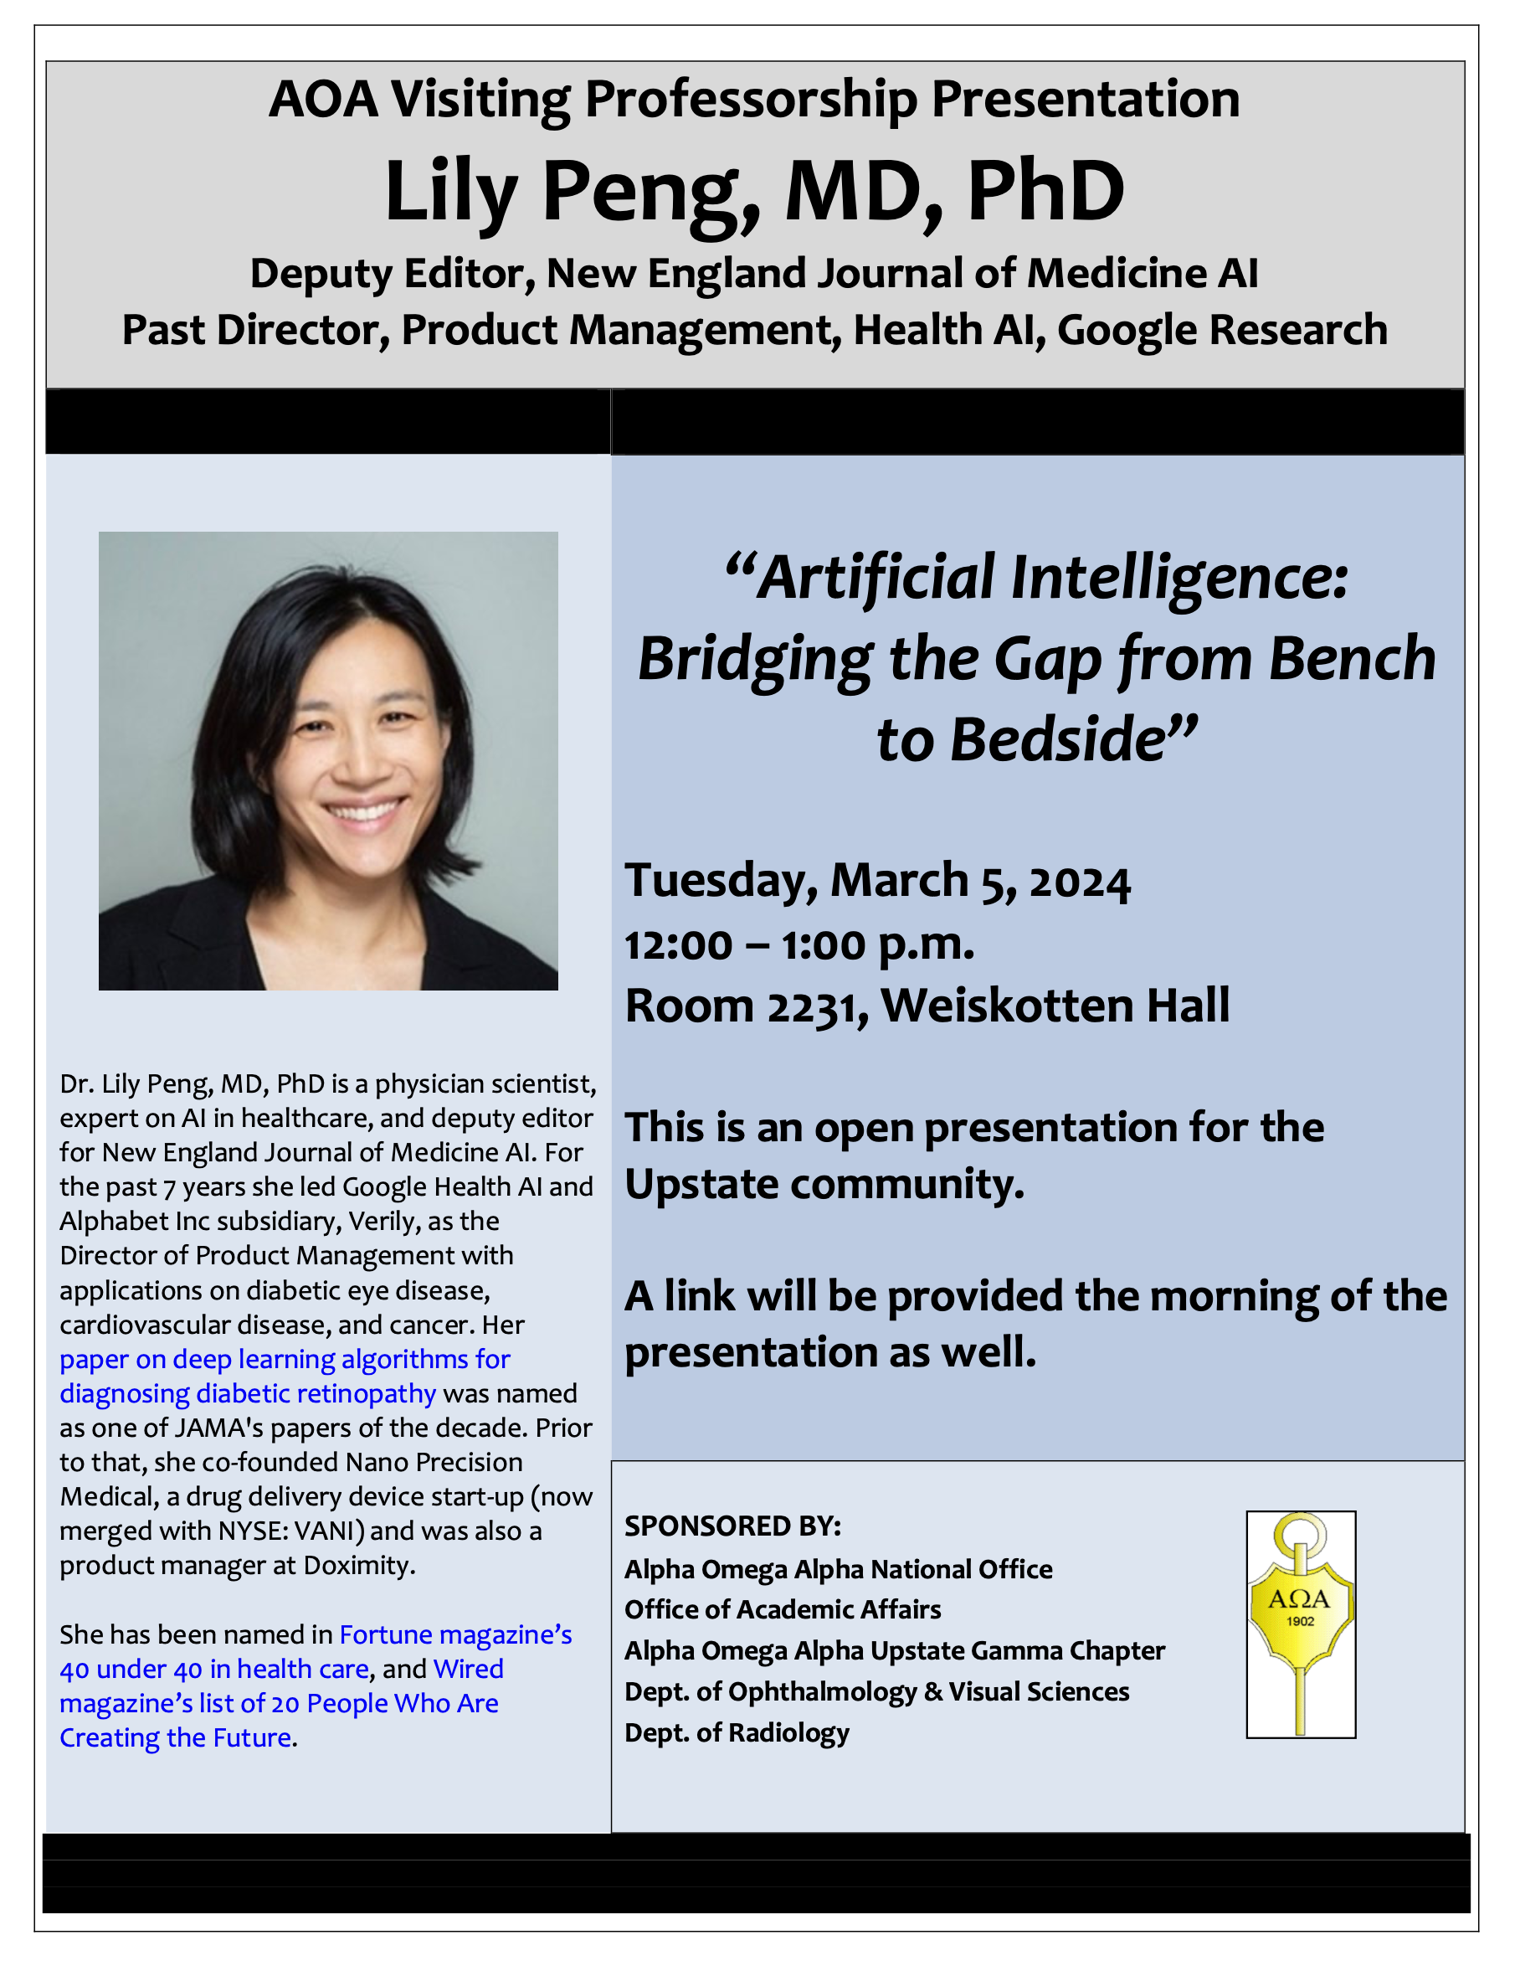
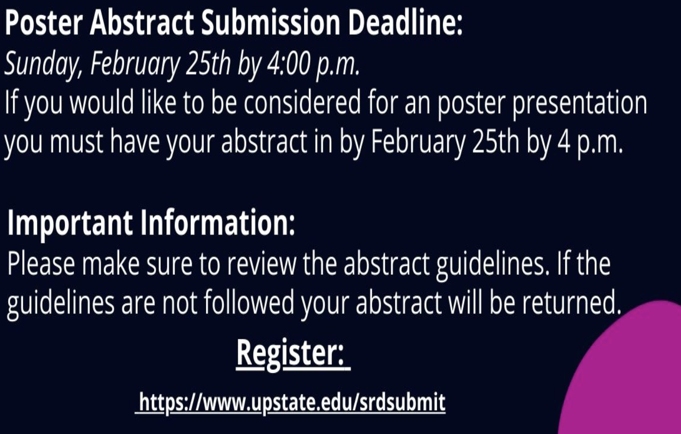
Andrea vacation NEXT WEEK
MDPhD ASD: Feb 28th and 29th!!!
MD/PhD and graduate students to have an information discussion with her on Tuesday, March 5 from 3:30 p.m. -4:30 p.m. please register at: https://forms.office.com/r/XWDiffEHrS
March 5th
AOA Visiting Professorship
March 6th
Beyond the Doctorate Day
March 7th
MDPhD Paint n' Sip CANCELLED
March 19th
Student Research Day
CAGB +
Upstate Art Alliance
Paint n' Sip
7-9PM
CAB Lobby
Registration?

