Slide 1
MD, PhD Town Hall
2024

Slide 2
Agenda
Recruitment Update
MD, PhD Courses
MD, PhD Orientation + Summer
MS3 Transition in the New Curriculum
Community/Events
2023/4 In Review

Slide 3
Recruitment Update
Accepted Student Days – 11/13 students visited
10 admitted students remain- Max , Tommy and Natalia withdrew
May 2nd is Upstate's "Commit to Enroll" date
Student Hosts could become Student Mentors?

Slide 4
2024/5 Recruitment; Your Role… MS 1 > PhD Years
Attend ASD group events
Participate in recruitment
Student Panel, Interviewing, Welcoming Committee, student hosting, campus tours

Slide 5
MD, PhD Grand Rounds
MDPH602 MD/PhD Grand Rounds
1 credit, clinical requirement removed
MDPH 603 MD/PhD Clinical Skills and Patient Care
Approval needed to become a separate course from Grand Rounds
Monthly clinical work (shadowing or SP Training)
Timeline aligns with Grand Rounds
Each year of training
1 credit
PhD years

Slide 6
MD, PhD Grand Rounds Objectives:
Develop clinical reasoning skills for patient care
Reinforce basic science concepts in the context of clinical care
Develop critical thinking skills in the interpretation of clinical studies
Develop communication/presentation skills

Slide 7
2024/5 Grand Rounds Format
MS1 + 2 Participation:
10-minute Summer Lab presentations – 10 minutes
Image of the Day/Question of the Day throughout the year
embed into feedback form vs front of presentations?
PhD Participation
Year 1: NEJM Clinical Case – 50 minutes
Year 2: NEJM Clinical Case – 50 minutes
Year 3: Dissertation Work – 20 minutes (2 presenters/GR)
Year 4: Clinical Trial – 50 minutes
MS 3 + 4 Participation
Attend as much as possible
MS4: Capstone Presentation – 50 minutes

Slide 8
2024/5 Grand Rounds Schedule
August – March, Thursdays 5-6 (food at 4:30)
Breaks: 1 week Thanksgiving + 3 Weeks Winter Holiday
There will be Zoom GR this year
Cameras have to be on
Total: about 25 (we had 29 this year)
Alternative proposals…
Different time? Different day?

Slide 9
2024/5 Grand Rounds P/F
Attendance policy
70% attendance; reporting to Andrea is most important
<70% absences will result in an F, communication is key (we'll talk before this could possibly happen)
Attendance taken with Feedback Form (Feedback Forms only accepted if you attend)
Present:
Submission of a complete feedback form with thoughtful, specific comments for the presenter
Absent:
Not attending
Incomplete or unsatisfactory feedback form (Andrea will send back for resubmission, as needed)

Slide 10
Ways to get involved in the MD, PhD program…
MD, PhD orientation committee (June 3-7)
Can commit at least 2 years
Social committee
Recruitment panel
SURF JC
Transition panels
Student mentorship
Tri-institutional conference

Slide 11
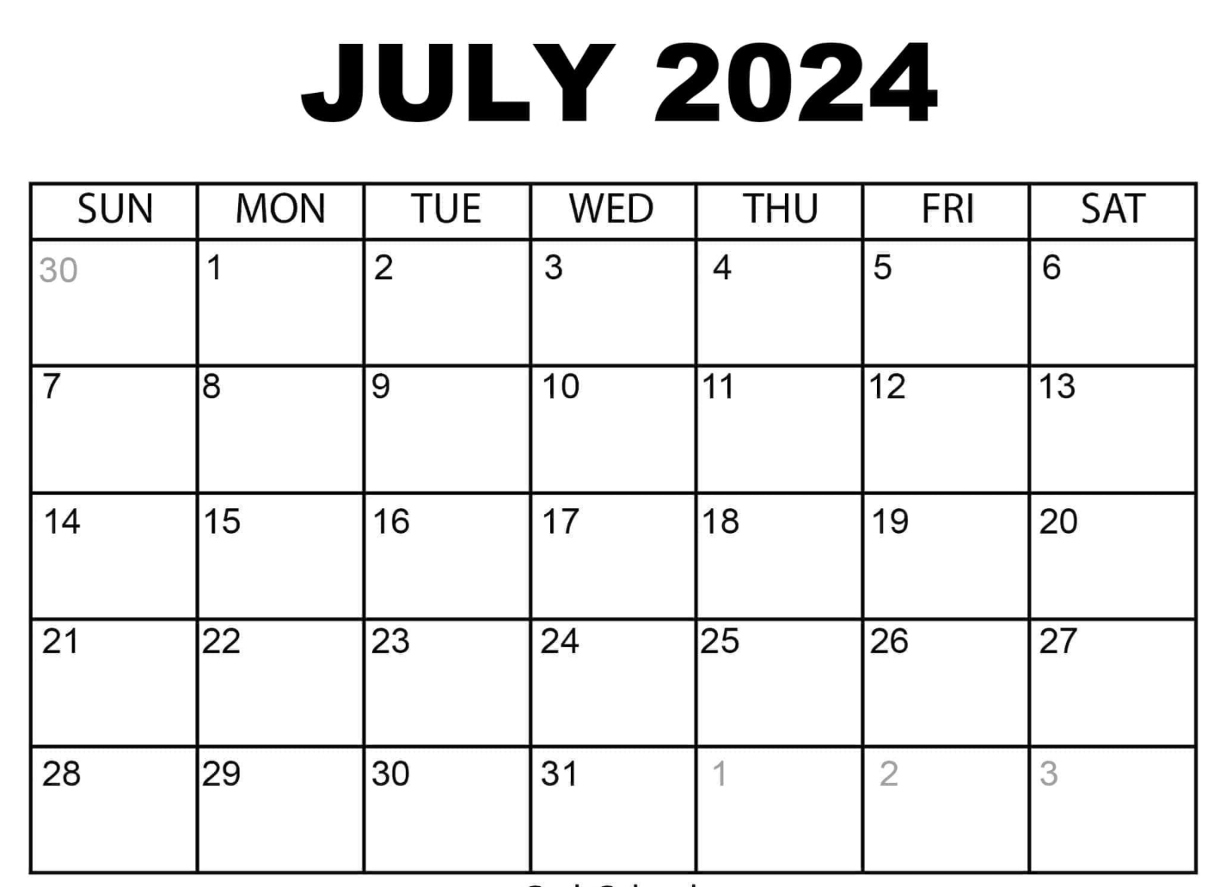
MD, PhD Picnic Dates/days that DO NOT work for a majority?

Slide 12
Summer Clinical Workshops
Attendance optional
What would be helpful and worthwhile?

Slide 13
MSIII Start Date
2024 orientation: May 20
2025 orientation: March 10-14; mandatory. 10 weeks earlier
2025 schedule
Period A 3/17-4/18/25
Period B 4/21-5/23/25
Period C 5/27-6/27/25
Seek advisement; Dr. Dhamoon and Dr. Mason

Slide 14
MS3 Transition in New Curriculum
Expectation:
Clerkship Track Selection by December 1st
Defend in January/February
Begin MS3 Orientation into clerkships early March (March 10, 2025)

Slide 15
PLAN AHEAD SEEK ADVISEMENT (Dr. Mason + Dr. Dhamoon)
Options:
Clerkship Track Selection by December 1st
Any track: No delay
Track 3: 5-week delay
Track 3 + moving "family medicine" into MS4: 10-week delay

Slide 16
MD, PhD Community
Weekly Grand Round Meals
Monthly Newsletters
MD, PhD Picnic
Dhamoon's lakehouse
MD, PhD Book Club/anti-journal club
Mindset by Dweck
July gathering
Queen's Jubilee
mid-July or August 1st GR?
Publications:
Everyone should have a publication link; ORCiD, google scholar ID
Send Andrea new publications ALWAYS

Slide 17
What's not going so well? Suggestions?
What's going well?

