Slide 1
Introduction to the MD-PhD program
Auyon Ghosh, MD, MPH
8/28/24

Slide 2
About me
Local product
Born in Crouse, grew up in Jamesville
Syracuse University 2010, BS in Physics and Economics
Upstate 2014, MD
Nieman Lab
Clinical training
Boston University Medical Center 2017, internal medicine
Harvard-Brigham and Women’s Hospital 2020, pulmonary & critical care medicine
Research training
Harvard Medical School/Brigham and Women’s Hospital, genetic epidemiology/genomics post-doc
Harvard School of Public Health 2021, MPH Quantitative Methods

Slide 3
About me
Clinical
Intensivist – 8 weeks medical ICU service per year
Pulmonologist – 1 day clinic QOW
Research
Interested in understanding heterogeneity in chronic lung diseases and identifying subtypes

Slide 4
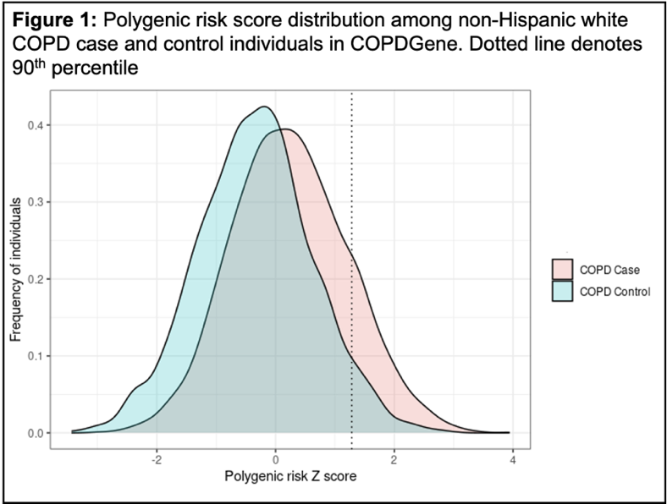
Genetic Resilience in COPD
NHLBI K08 01/2024 – 12/2028
Aim 1: Identify polygenic resilience score for COPD
Aim 2: Clinical characteristics and gene expression of resilience in COPD
Aim 3: Predict lung tissue gene expression profiles of COPD risk and resilience

Slide 5
Other projects
Gene expression signatures of extrapulmonary sarcoidosis – American Thoracic Society/Foundation for Sarcoidosis Research Grant 8/15/2022 – 8/14/2025
Transcriptomic Predictors and Biomarkers of Sepsis-induced Cardiomyopathy - Hendricks Pilot Award 10/1/2023 – 9/30/2024
Investigating the role of sex-specific gene and protein expression in pulmonary fibrosis through a multi-omic approach – NHLBI/ORW R21 pending scientific review

Slide 6
Questions?
ghosha@upstate.edu
Thank you!

