Slide 1
MD/PhD Town Hall
2026

Slide 2
Agenda
Recruitment Update
MD/PhD Courses
MD/PhD Orientation + Summer
Community/Events
Open discussion

Slide 3
Recruitment Update
Visit Days – Grace + Claire (HPA) + Ethan (virtual visit)
Kaleb, Taja, Wolu join CO 2033
May 1st - "Commit to Enroll"
Day 1 = May 29th (followed by MD/PhD Orientation week)

Slide 4
MDPH602- Grand Rounds (2025/6)
MS1 + 2 Participation:
10-minute Summer Lab presentations – 10 minutes
PhD Participation
Year 1: Paradigm-Shifting Research Paper(s)
Year 2: Dissertation Work – (2 presenters/GR)
Year 3: Clinical Trial
MS 3 + 4 Participation
Attend as much as possible
MS4: Capstone Presentation – 50 minutes
Year 4/5:Paradigm-Shifting Research Paper(s)
*subject to change under new directorship

Slide 5
MDPH603- Patient Care and Clinical Skills
Clinical training
Timeline aligns with Grand Rounds (August-April/May)
PhD years
MDPH 603 MD/PhD Clinical Skills and Patient Care
Shadowing (with mentor and at least one standardized event 1x/semester)
SP Training 1x/semester
Tracking
SP training participation
SOAP note following clinical event with Ghosh
Maintain EPIC access!

Slide 6
Ways to get involved in the MD/PhD program
Director Search Committee Student Rep: H.J.
MD/PhD Orientation Committee (June 1-5): Sanaea
Looking for a trainee and replacement starting this June
Social committee: Kevin + Greg
Recruitment panel: varies
Welcoming Committee: Matty and Jess
Need replacement, most "work" is in spring
SURF JC: Kailey, Jess, Tracy, Greg, Olivia (and past students)
Various panels (MS3 transition, SURF, conferences, etc)
Student mentorship (new student mentors, MD/PhD grant writing TA)
Tri-institutional conference
October 24th

Slide 7
Welcoming New Students Social Committee + Orientation Committee
Orientation Week (lunch Tuesday – Friday)
June 2, 3, 4, 5
Lunch with MS2's
Lunch with Leadership
Lunch with Student Support Team in COM
Lunch with MD/PhD team (review student handbook)
Greg, Kevin, Sanaea, ?
Annual MD/PhD Picnic
Open to suggestions for picnic
June/July?
Place?

Slide 8
Summer Workshops/Events
Attendance optional
What would be helpful?

Slide 9
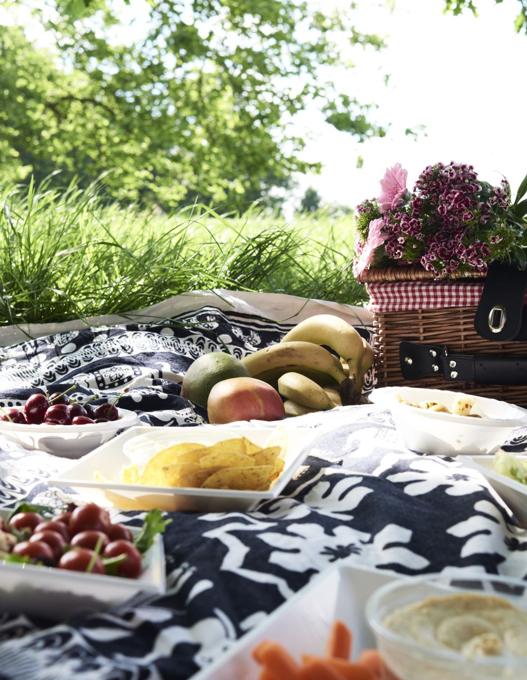
MD/PhD Community
Weekly Grand Round Meals
Monthly Newsletters
MD/PhD Picnic
Grander Rounds
Publications:
Everyone should have a publication link; ORCiD, google scholar ID
Send Andrea new publications ALWAYS

Slide 10

What's not going so well? Suggestions?
What's going well?

