Slide 1
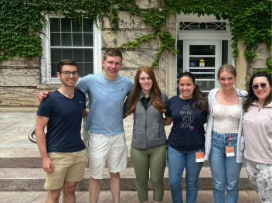

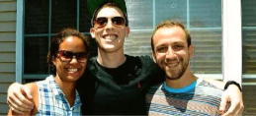

Summer 2026 Work Opportunity:
Students Needed!
Looking for a Summer Opportunity?
Interested in networking with specialty advisors and gathering information regarding elective options?
Applications available on Career Planning Brightspace
Go to Summer Opportunities to find the application
Complete application and send to Dann Miller (millerda@upstate.edu) or drop it off in-person and say hi – WSK 1213B)

