Slide 1



Welcome to the Upstate Community!
Resources, Rights, & Responsibilities
Robert F. Ruiz
Interim Vice President for Educational Services & Dean of Student Affairs

Slide 2
What We Do
Provide outstanding student experience
Advocate for and empower you-- professionally and personally
Leverage partnerships, technology and our dedicated staff members to meet you where you are and help you get to where you want to go

Slide 3




Student Counseling - 30+% use
Student Affairs Resources:
Always available and growing!
Multicultural Affairs & Student Inclusion
Support Services: Food Insecurity; Disability Services; Emergency Funds
Academic Support/Success
Engagement & Wellness

Slide 4

Rights & Responsibilities: Balancing Individual & Community Needs
RIGHTS
RESPONSIBILITIES
Speech/Expression/Press
Non-Discrimination
Assembly/Protest
Religious/Political Association
Privacy/Search/Seizure
Academic Pursuits
Quality Environment
Governance/Participation
Due Process
Confidentiality
Academic Honesty
Do No Harm (or threat of harm)
Respect Campus Activities/Events
Respect Campus & Personal Property
Honesty & Integrity
Civil & Respectful Behavior
Compliance with Laws, Policies & Staff
Assurance of a Safe Environment
Professionalism

Slide 5
Code of Student Conduct
Personal Honor & Integrity Educational Process
Personal Responsibility & Community Interdependence

Slide 6

Judicial Process: Academic & Social Misconduct
Distinct but similar processes
Try to resolve at least complicated level
Student found not responsible
Student accepts resolution
Case referred to a Board
Repeat or Egregious Cases = Automatic Referral to a Board
Students have due process rights throughout process
Consequences: Lowered/Failing Grade; Disciplinary Warning; Probation; Suspension; Dismissal; Revocation of Admission and/or Degree

Slide 7

Professionalism Starts Here and Now!
Taken very seriously:
Academic Honesty
Patient Confidentiality
Interactions with Others
Meeting Expectations
Unprofessional behavior is grounds for dismissal.
Remember, you’ve chosen noble professions that demand higher standards!

Slide 8
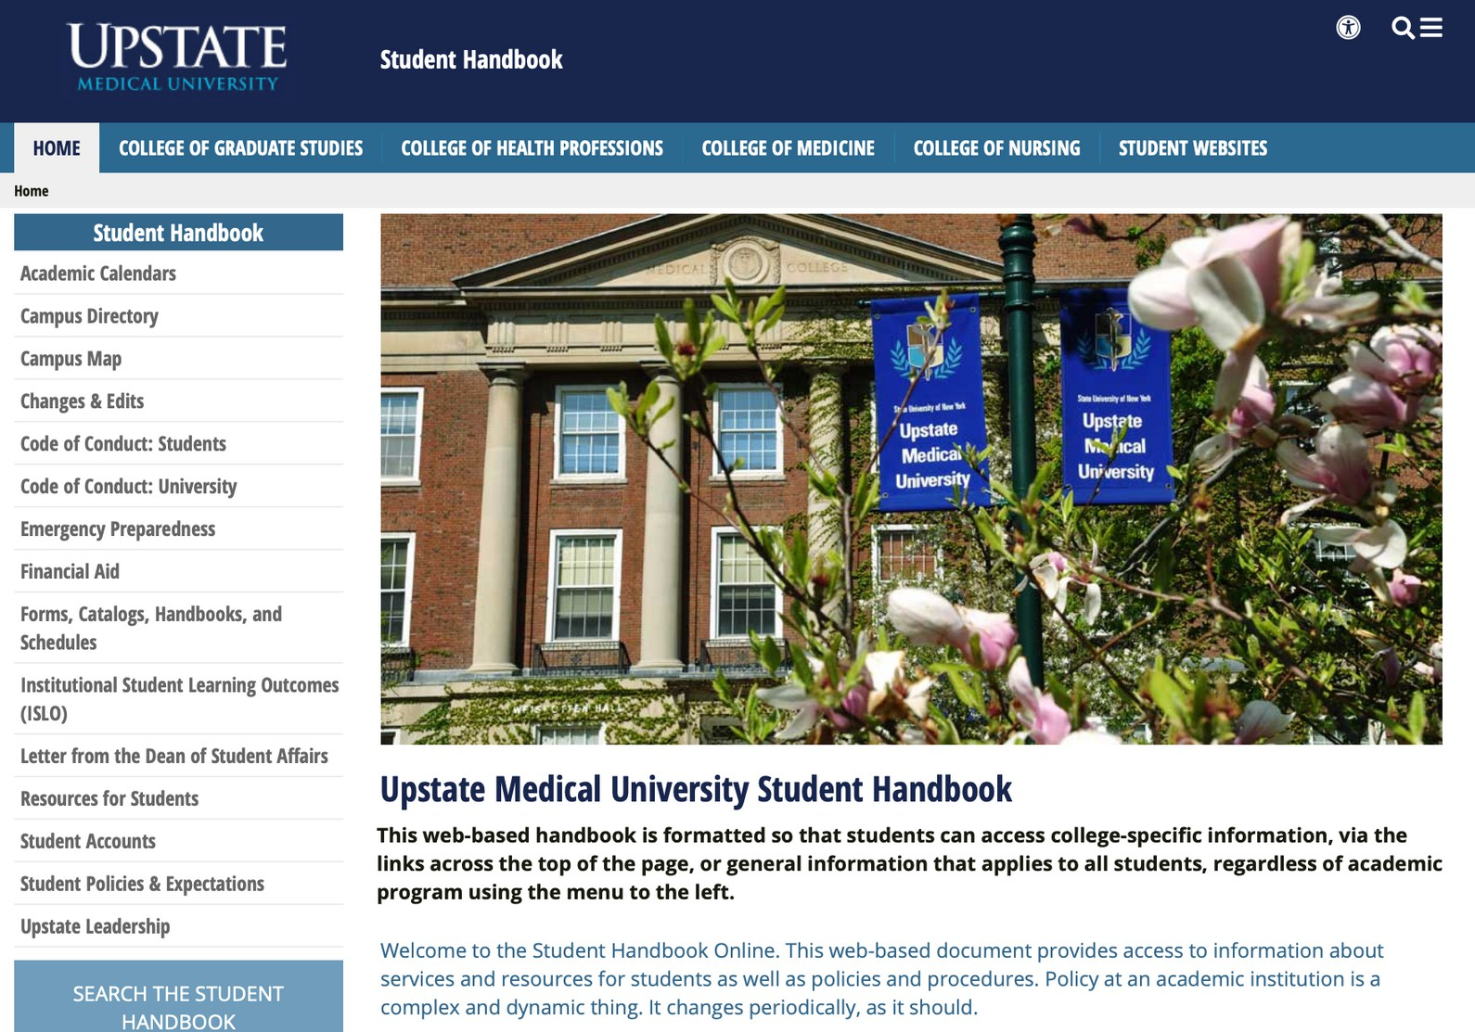
Policies
&
Procedures

Slide 9
Alcohol & Other Drugs
prevention; health risks; treatment; sanctions
Bias Related Crimes & Hazing
laws; penalties; sanctions; support
Campus Crime Reporting/Stats
university police; website
Campus Crime Prevention
escort service; personal security; emergency telephones; safety committee

Slide 10
Equal Opportunity, Non-Discrimination, Sexual Harassment & Title IX
procedures; definitions; victims’ rights; reporting options
Family Educational Rights & Privacy Act (FERPA)
rights and procedures
Missing Students
contact info up to date in MyUpstate
Sexual Assault, Domestic Violence & Stalking Prevention
definitions; prohibited acts; laws; reporting options; support

Slide 11
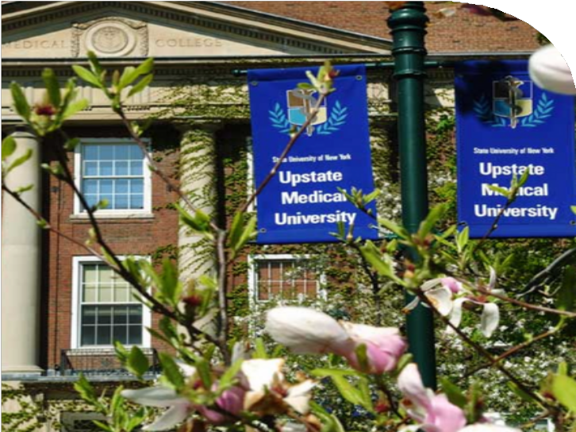
You are now part
of the Upstate
Community!
Student Handbook: www.upstate.edu/currentstudents/support/rights/index.php

Slide 12

Welcome!

