Slide 1
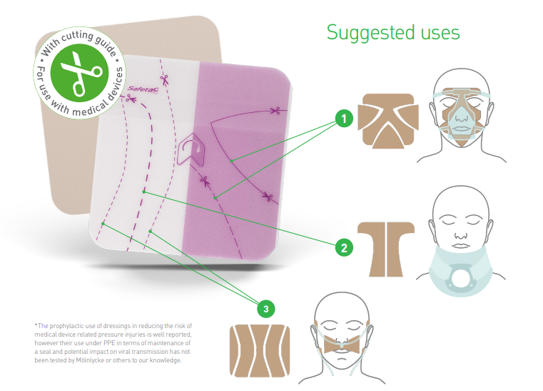
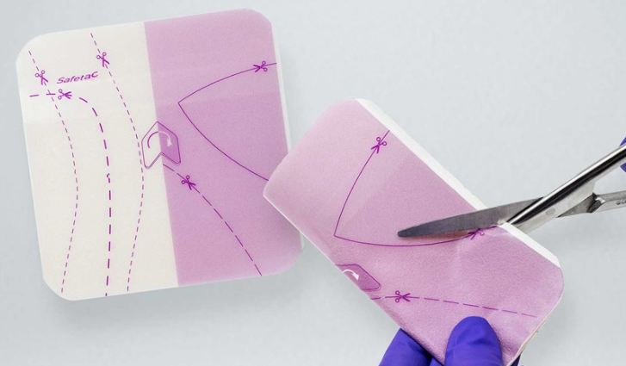
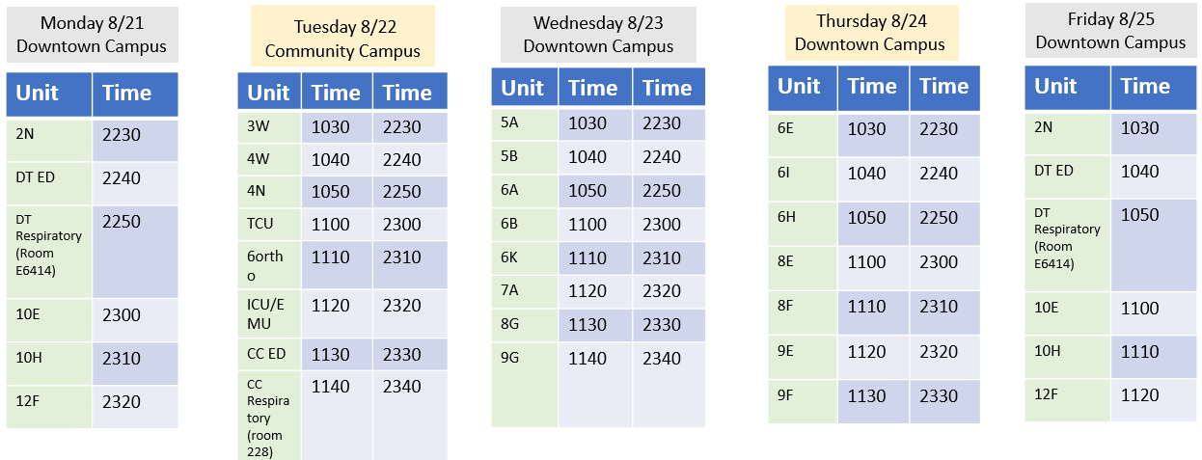
Mepilex Lite 5x5
A foam dressing used to protect skin from medical devices
Has a built-in template for your convenience.
Can be used under medical devices such as BiPap, oxygen tubing, oxygen masks, and cervical collars
Replacing the white foam mepilex we currently use under BiPap masks
Skin assessment under mepilex: q4h for use with BiPap masks
Continue to Change Mepilex Lite q24h (CMS-10 Skin policy)
Vendor in-services August 21-25
QR code located on packaging has cutting guide videos
Nursing Practice Excellence BP 7/2023

