Slide 1
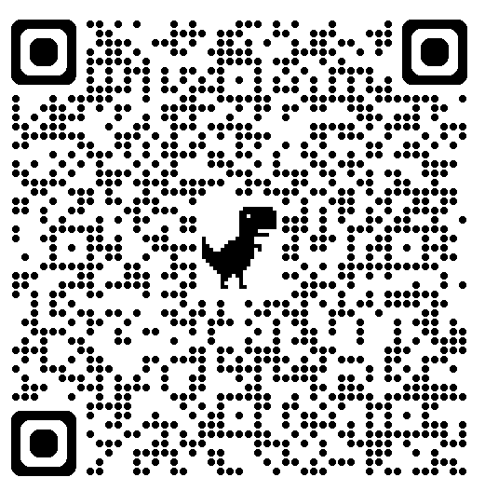
BLS CPR & QCPR Information
TWO components for American Heart Association (AHA) or American Red Cross (ARC) BLS CPR Renewal:
(BLS CPR cards expire 2 years from issue date on last day of month)
1. BLS CPR Brightspace course - completed in the current year & prior to that AHA or ARC BLS CPR card expiring.
2. QCPR Skills Walk-In – attended according to quarterly schedule & prior to AHA or ARC BLS CPR card expiring.
DECREASING TIME during QCPR sessions:
1. Staff have current AHA or ARC BLS CPR Card readerly available
Option #1 = Paper copy via ID badge
Option #2 = Photograph AHA or ARC card (create Upstate album/phone)
Option #3 = Photograph via NOTES app/phone
Option #4 = Paper copy of staff tracker record indicating CPR-3 TRACKER CODE
Managers/Trainers/Charge Nurses = send only 2 to 4 staff at a time
QCPR instructors are limited
Staff pairs are desirable for compressions/ventilations
Current CPR & QCPR Schedule:
https://www.upstate.edu/nursing/intra/clinical-education/index.php#jump-CPR
AHA
Card Look-Up

