Slide 1


Magnet Redesignation Survey Completed!
Congratulations to Everyone!

Slide 2

In this Presentation
Magnet Survey Overview
Success & Exemplars
Opportunities & Lessons
Plan for the Road Ahead

Slide 3

Magnet Survey Overview
Schedule
Guides & Hosts
Incredible welcome at both Downtown & Community!!
Remained on schedule predominately!!
Day #2 – Senior Appraiser departure -> need to modify Day 3&4 Agendas
  Condensed several sessions
  Shifted session times
  Transitioned unit tours to Conference room sessions
Amazing enthusiasm and engagement from this team!
Ensured all rosters complete, bags with waters, mints for appraisers were stocked! And all sessions went well!
Teams communication and Vocera Magnet Team worked well and enabled real time communication with any needs (changes in appraisers, etc.)
Rides & Breaks – Thank you!!

Slide 4
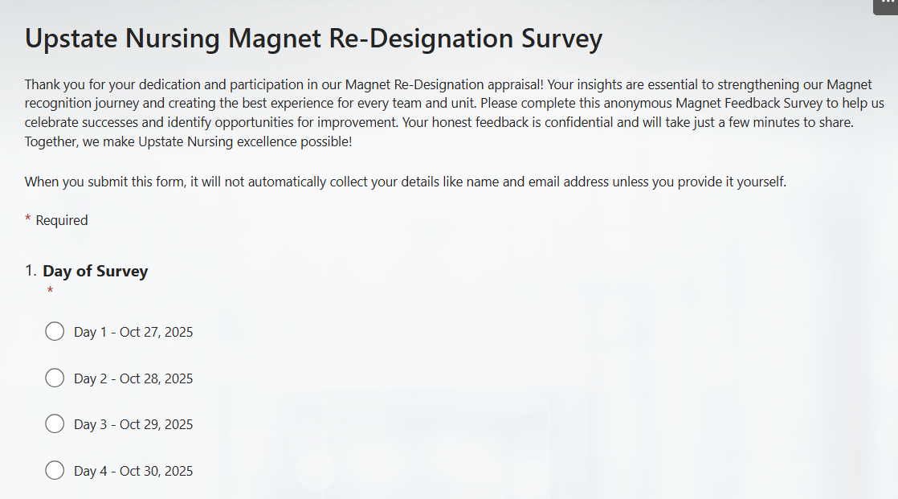
Magnet Survey Overview
Participants
Please Complete the Survey!
Impressively prepared & excited to share!
Attended 74 sessions and 84-unit tours
Over 700 participants across 106 room reservations!!!
Shared examples of profound nursing practice excellence!
We are seeking feedback regarding your Magnet Survey Experience
(Click on the box below to complete Survey!)

Slide 5


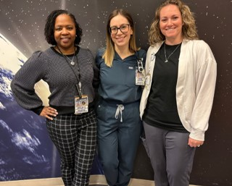
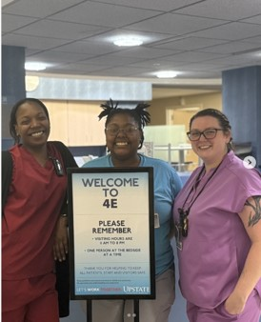
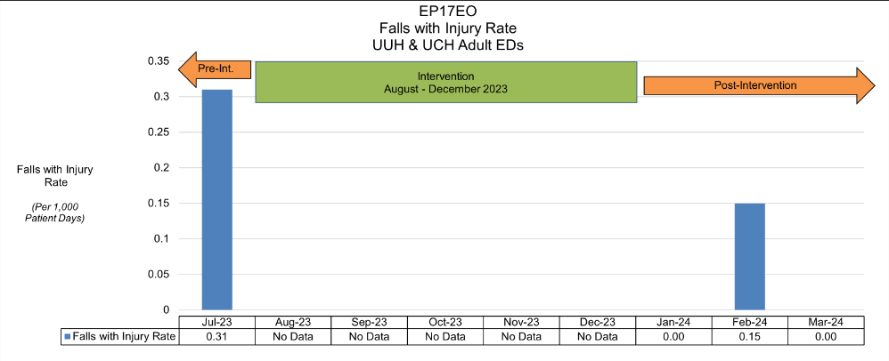

Successes
Confidence
Practice Excellence
Professionalism
All interdisciplinary teams and Nurses showcased incredible confidence in their expertise!
Incredible examples of innovative, evidence-based, patient-centered work!
Language, evidence, attire- all impressive thank you!
Enthusiasm & Joy
Evidence of Expertise!
Resiliency
Sincere and authentic energy!!
Appraisers were very impressed with clinical nurses’ ability to reference quality data, etc.
Sincerely appreciate the positive responses with schedule changes and modifications..

Slide 6


Positive feedback across all locations regarding our CNO!
Emergency Department ASL Project
Trauma Yoga
Psychiatry’s approach to International patients
Pediatric Trauma, Stroke, Bubble & impressed with Peds tour and their “passion and pride”
CAP, Certification process & Preceptor development!
Magnet Champions
Clinical nursing knowledge of Quality across all clinical areas!
Throughput & Virtual Nursing
Hospital at Home
Dr. Corona’s Positive Feedback
Teamwork/Engaged/Tight Knit clinical teams
Ambulatory locations: Urology, Bariatric & Connect Care
Inclusive Health r/t LGBTQ+
International Health r/t social determinants of health

Slide 7

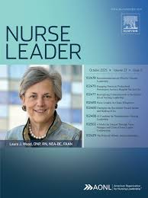
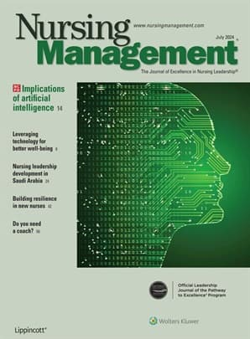

Opportunities & Lessons
We Need to Publish!!!

Slide 8
Timeline & Next Steps
ANCC Commission on Magnet
Will Review Upstate’s Survey Findings & Make Determination
Upstate Magnet Re-Designation Timeline
2/3/2025
Magnet Document Submission
8/1/2025
ANCC approved additional documentation
4/29/2025
Additional documentation requested by ANCC
10/27/2025
SUNY Upstate Successfully Completes Magnet Site Survey
7/18/2025
Additional documentation submitted to ANCC
Anticipated notification of Magnet Re-Designation
1/1/2025
The ANCC’s Commission on Magnet Recognition is a governing body comprised of members appointed by the ANCC Board of Directors. Nurses from across all roles and practice settings are represented including long-term care, APRNs, Nursing leaders, Clinical nurses, Ambulatory & Inpatient. The Commission on Magnet Recognition will be the final decider as to Upstate’s 2nd Magnet Designation. Click here for more information.

Slide 9
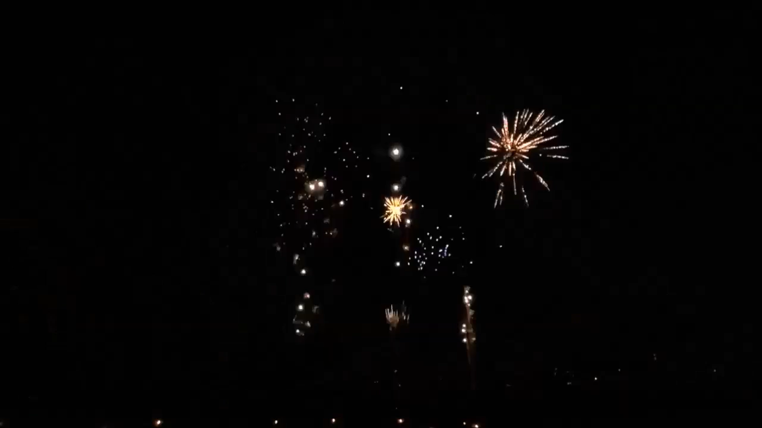
CONGRATULATIONS &
THANK YOU FOR YOUR EXCELLENCE

