Slide 1
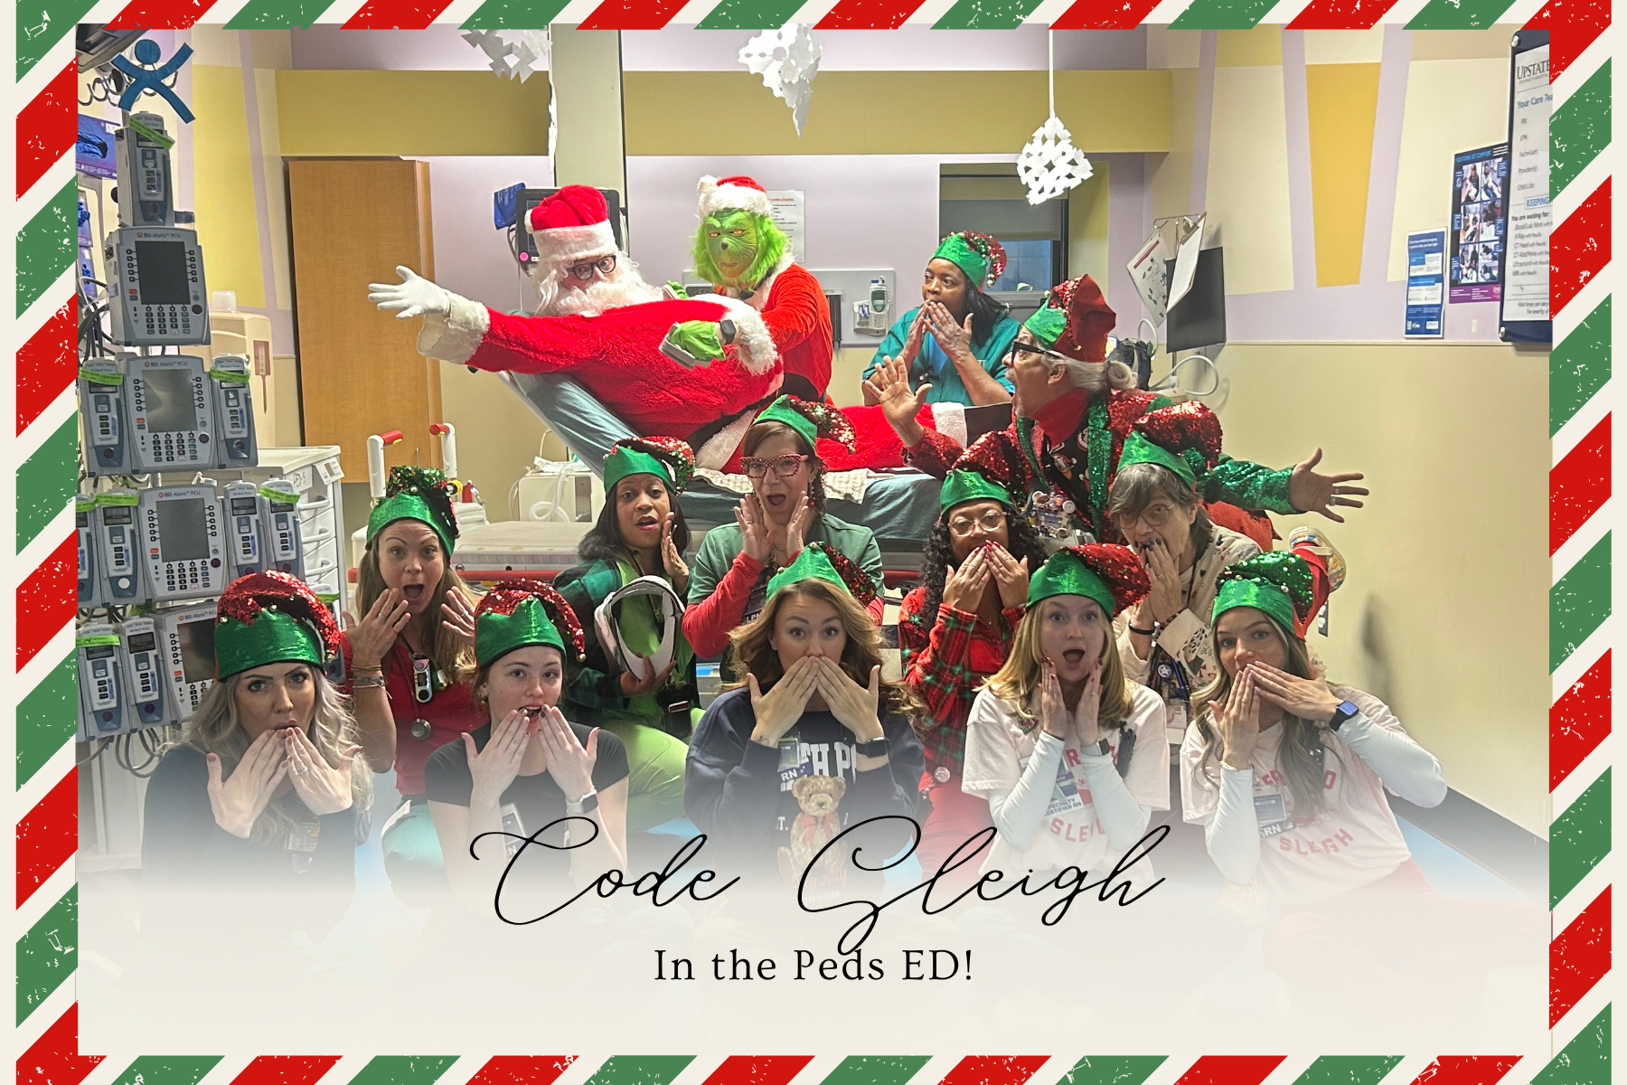
The winning Holiday card!
Peds ED

Slide 2
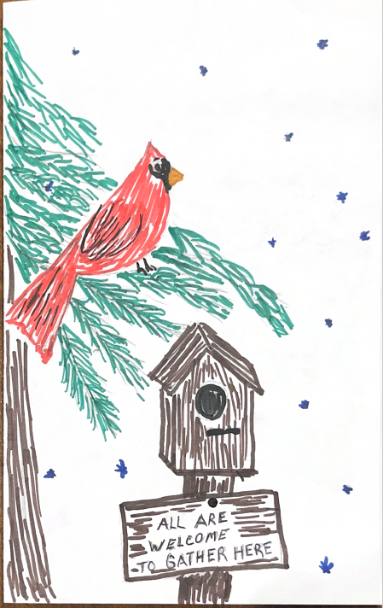

5W

Slide 3
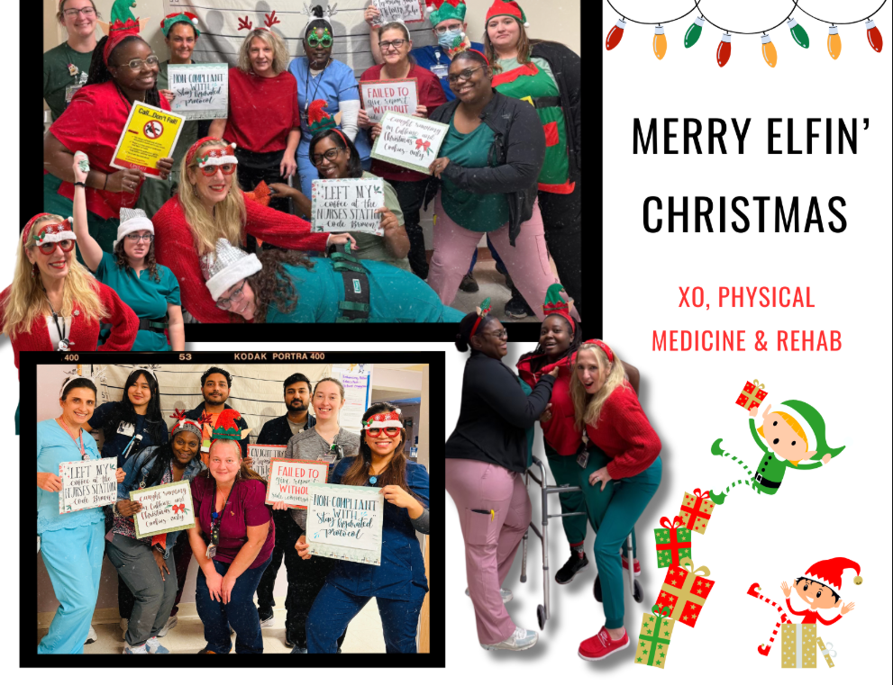
2N-Rehab

Slide 4
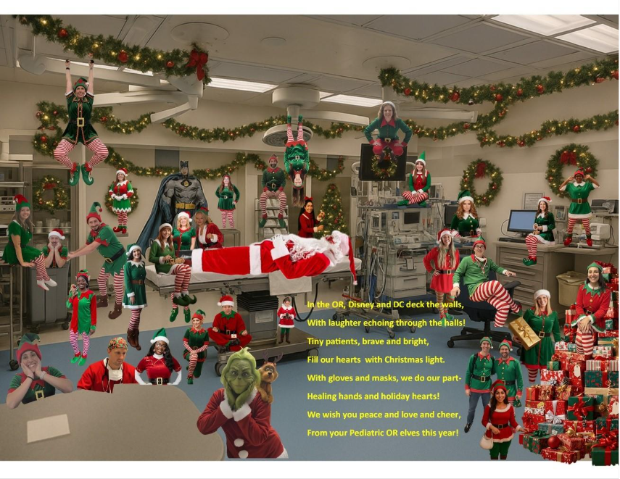

Peds OR

Slide 5
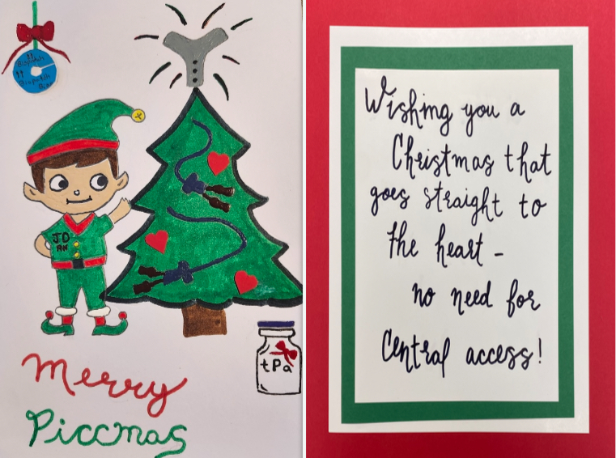
Vascular Access
Team

Slide 6
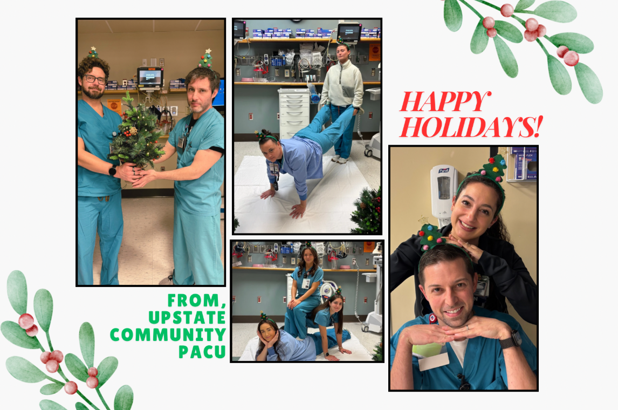
Community PACU

Slide 7

8F

Slide 8


10G

Slide 9

Clark Burn Center

Slide 10

Adult ED

Slide 11
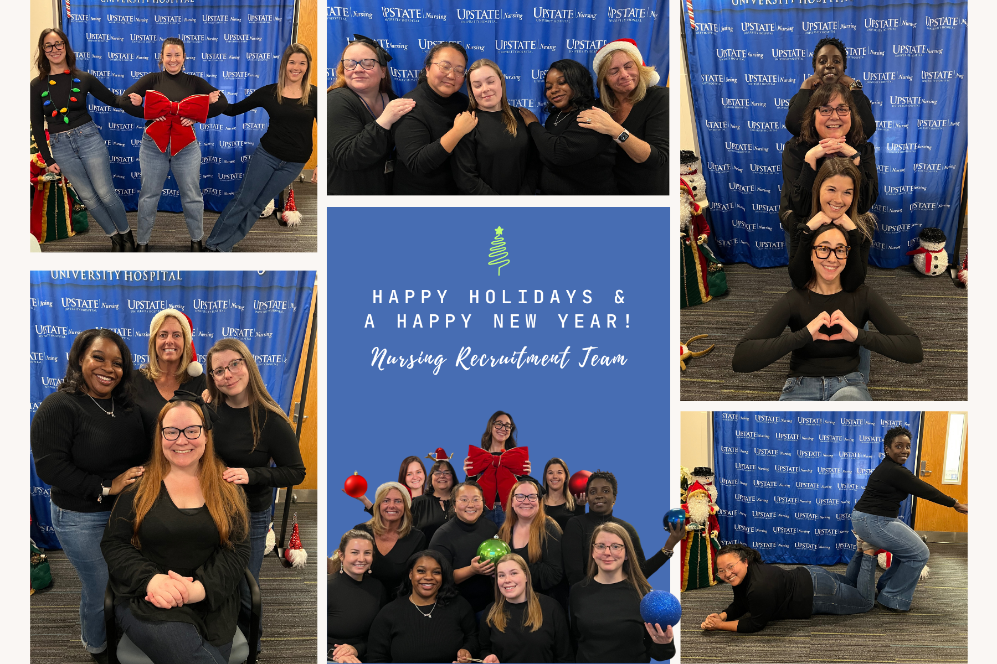
Nursing Recruitment
Office

Slide 12
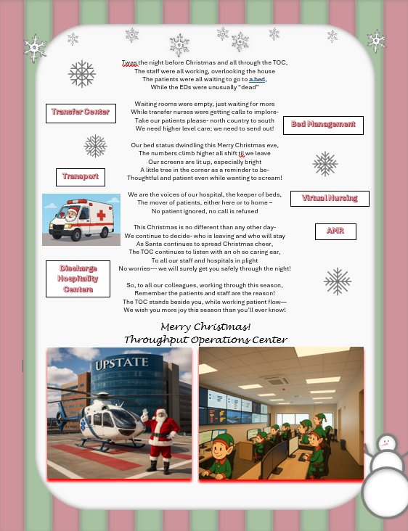
Throughput Operations
Center

Slide 13
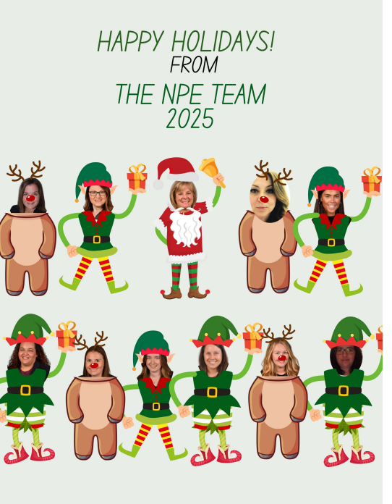
Nursing Practice
Excellence

