Slide 1
Grief, Depression, and Depressive Personality Themes: Clinical Implications of Each Grand Rounds Webinar SUNY Upstate Medical University Thursday, March 3, 2025 12:30 pm to 2:00 pm
Nancy McWilliams, PhD, ABPP
Emerita Visiting Professor
Rutgers Graduate School of Applied & Professional Psychology

Slide 2
Disclaimer
The speaker has no financial interest in any of the material she will be referencing in this talk. Although she will mention the third edition of the Psychodynamic Diagnostic Manual (PDM-3), which she co-edited, she does not earn royalties from that publication. All royalties go into a fund for grants that support psychodynamically oriented research.

Slide 3


Slide 4
Kavita Patel on Somatized Grief
I have now started to see the physical effects of this – people who have lost someone, who have had no ability to mourn that loss in person, who have not been able to deal with this in the way we would normally do, by getting together or talking about it with a human being in person. I am starting to see other physical ailments, more patients with joint pain, more patients with problems with their sleep, more patients where their other medical conditions are adversely affected, and all I can do is tie it back to their inability to grieve and to process their grief.
April 7, 2021: Yahoo News

Slide 5
Verdery, A. M., Smith-Greenaway, E., Margolis, R., & Daw, J. (2020). Proceedings of the National Academy of Sciences, July 10.
COVID-19 has created a mortality shock throughout the world, and it may yield a second wave of population health concerns tied to bereavement and social support reductions. We created the COVID-19 bereavement multiplier, an indicator that clarifies one downstream impact of COVID-19 mortality and can be applied to different epidemiological projections of death counts: How many people are at risk for losing a grandparent, parent, sibling, spouse, or child for each COVID-19 death. In the United States, we estimate that on average, under diverse epidemiological circumstances, every death from COVID-19 will leave approximately nine bereaved.

Slide 6
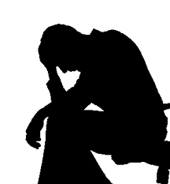
Normal grief: It does not equate with depressive illness
. . . even though they have much in common emotionally, and both have been very much in evidence during the recent COVID-19 pandemic.

Slide 7
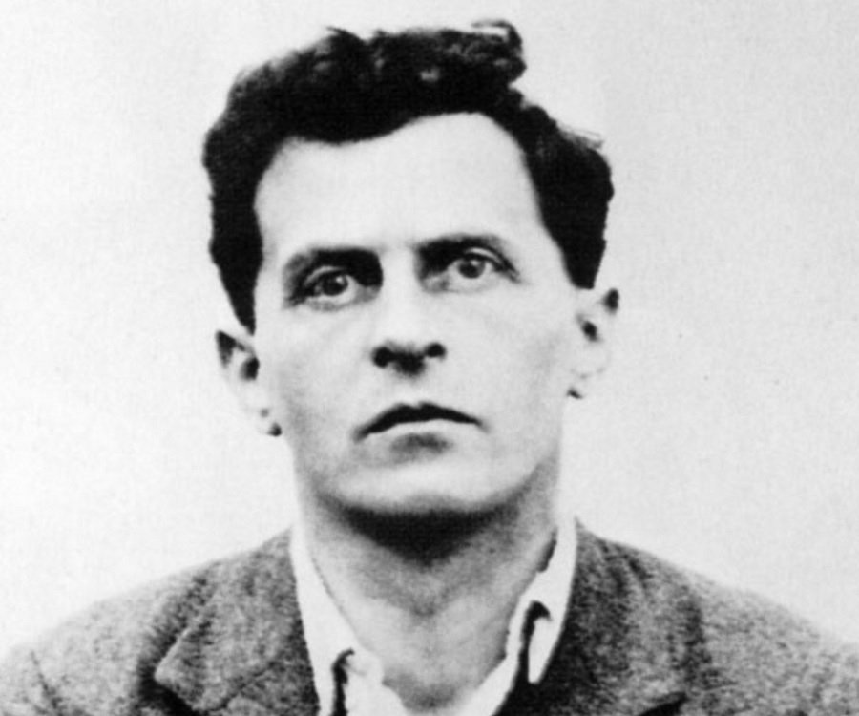
Ludwig Wittgenstein 1889 - 1951
“The limits of my language are the limits of my world”

Slide 8
Normal Grief Contrasted with Depression
Normal Grief
You know why you are sad: You’ve suffered a loss, disappointment, criticism, or rejection.
The world seems bad or empty.
Painful feelings come in waves.
The sadness can be alleviated temporarily by music, friends, etc.
One can imagine eventual recovery.
Depression
You may not know why: There may be no clear “trigger,” or the trigger may seem insufficient to the pain.
The self seems bad or empty.
Painful feelings are constant.
There is no way to improve one’s mood (learned helplessness).
Recovery is unimaginable.

Slide 9
Sigmund Freud (1917) on Mourning versus “Melancholia” (Major Depression)
“The distinguishing mental features of melancholia are a profoundly painful dejection, cessation of interest in the outside world, loss of the capacity to love, inhibition of all activity, and a lowering of the self-regarding feelings to a degree that finds utterance in self-reproaches and self-revilings . . . . This picture becomes a little more intelligible when we consider that, with one exception, the same traits are met with in mourning. The disturbance of self-regard is absent in mourning; but otherwise the features are the same.”
(Mourning and Melancholia, Standard Edition, v. 14, p. 244)

Slide 10
Elimination of the “Bereavement Exclusion” in DSM-5
If you have lost a child, and you are still in an anguished state of mind more than two weeks after that child’s death, the DSM-5 considers you to be clinically depressed. Diagnostic manuals prior to DSM-5 made a distinction made between depression and bereavement.
Haslam, N. & Tse, J. S. Y. (2026). Concept creep and the calibration of harm. Journal of Applied Research in Memory and Cognition, 1-11.

Slide 11
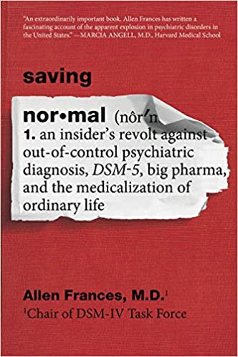
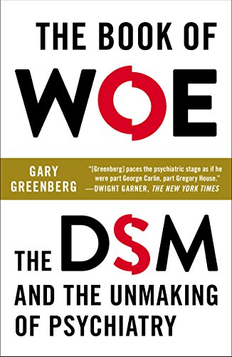
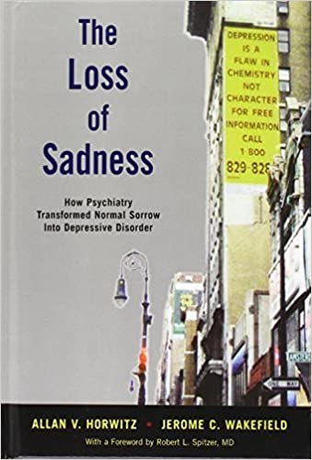

Slide 12
Omission of the bereavement exclusion: The change reflects efforts to help the bereaved
The line between health and disease is not always clear, either in psychiatry or in general medicine. In truth, we do not find Nature “carved at its joints,” neatly delineating disease from health. It is we who must decide how broadly or narrowly to define disease and disorder, with the ultimate aim of relieving human suffering and incapacity.⁷ There will always be an element of clinical judgment in rendering our diagnoses, and we need to view our diagnostic systems with humility. Moreover, the elimination of the bereavement exclusion will require improved communication between psychiatrists and primary care physicians, who now provide most of the treatment (such as it is) for depressed patients.⁴ We need to ensure that PCPs are aware that there are fundamental differences between grief and major depression--and that normal grief must not be “medicated away.” Indeed, we must all remain mindful of Erich Fromm’s teaching: “To spare oneself from grief at all costs can be achieved only at the price of total detachment, which excludes the ability to experience happiness.”
- Robert Pies, Psychiatric Times, December 12, 2012

Slide 13
Complicating the issue: Depression and sadness are not mutually exclusive
Although there is a clear distinction to be made between depression and sadness, it is possible for major depressive disorder to occur in addition to sadness resulting from a significant loss, such as bereavement, financial ruin, or a serious medical illness. The decision as to whether a diagnosis of depression should be made will depend on the judgment of the clinician treating the individual.
– Jessica Truschel, psycom.net June 25, 2020

Slide 14



Grief in Other Animals

Slide 15

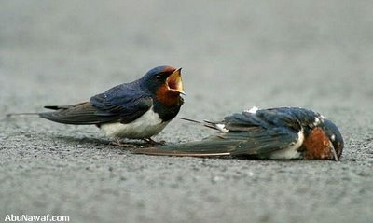
Mourning in Other Animals
King, B. J. (2013). When Animals Mourn. Scientific American, 309(1), 62-67.
Vincent Formica, Corlett Wood, Phoebe Cook, & Edmund Brodie, III (2017). Consistency of animal social networks after disturbance. Behavioral Ecology, 28(1), 85–93.
Firth, J. A., Voelkl, B., Crates, R. A., Aplin, L. M., Biro, D., Croft, D. P., & Sheldon B. C. (2017). Wild birds respond to flockmate loss by increasing their social network associations to others. Proceedings of the Royal Society B: Biological Sciences, 284.

Slide 16
Stages of normal grief (E. Kubler-Ross, 1969)
1. Denial
2. Anger
3. Bargaining
4. Sadness/grief/mourning (incorrectly called “depression” in Kubler-Ross’s model)
5. Acceptance
6. Finding meaning (D. Kessler’s later addition, 2019)

Slide 17
Kernberg, O. F. (2010). Some observations on the process of mourning. International Journal of Psychoanalysis, 91(3), 601-619
The desires, aspirations and ambitions of the person who has died, particularly the wishes for his or her own life and future, as well as for the life and future of the person who mourns, and for other persons who were central in the love and concern of the lost person, may be experienced by the person in mourning as a mandate, a command, a moral obligation to fulfill the wishes and hopes of the deceased. They become part of the mourner’s superego…preserved as highly personalized relations with the lost object….Beyond atonement, there may be a growing impulse to redeem oneself by means of personal change, constructive action, and striving to be a “better person” in ongoing and new relationships….Reparative processes, in short, expand into spiritual demands.

Slide 18
More Kernberg (2010, p. 618):
. . . The capacity to love anew increases with the tolerance and elaboration of mourning as a permanent process. In fact, the capacity to love again may become enriched by this perennial mourning process, that combines the gratitude for a new relationship with the gratitude for a new opportunity to fulfill the mandate of the lost object. Normal mourning enhances the capacity for loving.

Slide 19
Normal grief accomplishes certain vital psychological functions:
It honors critical attachments;
It carries on the values and goals of those who have been lost;
It reminds the community of the importance of cherishing the present;
It slowly restores vitality to the grief-stricken;
It slowly opens up the capacity to develop new attachments;
It brings meaning back to one’s life.
Grief never ends, never reaches “closure.” But it does recede in one’s psychic life, eventually becoming a bittersweet old friend rather than a tormenting attacker.
Witztum, E., Malkinson, R., & Rubin, S. S. (2016). Loss, traumatic bereavement, and mourning culture: The Israel example. In Interdisciplinary handbook of trauma and culture (pp. 365-375). Cham: Springer International Publishing.

Slide 20
Parental Loss and Later Creativity
Eisenstadt, J. M. (1978). Parental loss and genius. American Psychologist, 33(3), 211–223. https://doi.org/10.1037/0003-066X.33.3.211

Slide 21
Psychotherapy turns depression and other psychopathology into mourning
When psychiatrists treat patients with blocked mourning, regardless of diagnosis, symptoms, and prescription of appropriate pharmacotherapy, there is important work to do in freeing up blocked mourning processes in the service of resilience. For example, in addition to prescribing and monitoring a mood stabilizer for patients with onset of bipolar disorder, part of our work is creating a safe space to face losses associated with the onset of the disorder in the service of helping our patients mourn them and move on. Reshaping one’s identity to accept the need for medication, the presence of a potentially chronic and disabling condition, the potential need to surrender or adjust fantasies about the future, and coming to grips with side effects of our imperfect drugs and with the self-stigma of viewing oneself as damaged are often important components of work with patients with bipolar and other disorders as they struggle to adapt to losses and search for their own pathway to recovery and resilience. – Eric Plakun, Psychiatric Times, July 2020

Slide 22
Reactive and Anticipatory Grief: Needs of Patients with Terminal Illnesses
A witness to their suffering who does not patronize or infantilize them.
A caring person who does not necessarily become a cheerleader for the patient’s capacity to cure the illness if only the patient has the right attitude, eats the most nutritious foods, takes the right supplements, or gets the best medical treatment.
A listener who is comfortable with people’s anger about being afflicted with a cruel disease, who can help the patient not to take that anger out on friends, relatives, and health professionals.
A companion who is comfortable with grief, who knows how to let the mourning process do its emotional work.
A collaborator in facing practical challenges: personal decisions about care and about coping with limitations that one’s situation may impose on future activities.
A professional who can listen and talk respectfully about spiritual issues that matter to the patient.

Slide 23
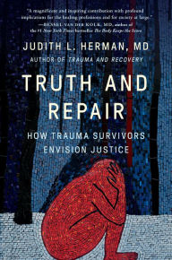

Slide 24
Psychotherapy outcomes vary according to
1. Personality factors (in both client and therapist)
2. Relationship factors (the “fit” between the two)
www.apa.org/about/policy/resolution-psychotherapy.aspx
Norcross, J. C. (2011). Psychotherapy relationships that work: Evidence-based responsiveness. New York: Oxford.
Wachtel, P. (2010). Beyond “ESTs”: Problematic assumptions in the pursuit of evidence-based practice. Psychoanalytic Psychology, 27(3), 252-272.
Norcross, J. C., & Wampold, B. E. (2018). A new therapy for each patient: Evidence‐based relationships and responsiveness. Journal of Clinical Psychology, 74(11), 1889-1906.
Wampold, B. E., & Flückiger, C. (2023). The alliance in mental health care: conceptualization, evidence and clinical applications. World Psychiatry, 22(1), 25-41.

Slide 25
Therapist qualities that correlate with patient improvement and satisfaction:
Accurate empathy
Acceptance
Positive regard
Genuineness
Focus
Hope and Expectation
Emotional evocation
Offering of information
Miller, W. R., & Moyers, T. B. (2021). Effective psychotherapists: Clinical skills that improve patient outcomes. New York: Guilford.

Slide 26
Given the extensive empirical work attesting to the importance of personality and relationship,
Why do we tend to study specific techniques as applied to specific DSM diagnostic categories and conclude that this is the only relevant evidence base for psychotherapy?
Why do we not consider research on individual differences and the relationships they tend to influence as equally valuable empirical evidence, equally pertinent to decisions about psychotherapy?
This presentation integrates 10 different, intersecting perspectives on individual differences, all of which have been investigated empirically.
Norcross, J. C., & Wampold, B. E. (2019). Relationships and responsiveness in the psychological treatment of trauma: The tragedy of the APA Clinical Practice Guideline. Psychotherapy, 56(3), 391-399.
Orlinsky, D. E. (2009). The “Generic Model of Psychotherapy” after 25 years: Evolution of a research-based metatheory. Journal of Psychotherapy Integration, 19(4), 319–339.

Slide 27
Depressive and self-defeating personality disorders are not in the DSM or the ICD taxonomies
The decision not to include them, despite evidence that depressive-masochistic personality (Kernberg, 1984) is the most common kind of personality disorder, resulted from political rather than scientific factors.
The Psychodynamic Diagnostic Manual (PDM-2) (Guilford Press, 2017), which tries to reflect both accumulated clinical experience and research, does have a category for depressive personality styles and disorders, with hypomanic and self-defeating variants.
In the just-published PDM-3 (Guilford, 2026), because of feedback from clinicians, depressive and masochistic (self-defeating) personality disorders have been separated.
Westen, D., & Shedler, J. (1999). Revising and assessing Axis II, Part II: Toward an empirically based and clinically useful classification of personality disorders. American Journal of Psychiatry, 156(2), 273-285.

Slide 28
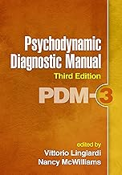
New Edition of the PDM (Guilford Press, 2026)

Slide 29
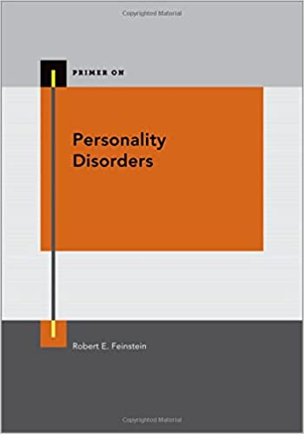

Slide 30
Depressive personality does not equate with depressive illness
It is a chronic, low-grade tendency toward feeling guilty or inadequate, feelings that go with cognitions explaining painful life experiences in terms of personal malfeasance or failure. One can have a depressive personality and never have had a significant depressive episode.

Slide 31

In fact . . .
It appears to be the most common personality type among psychotherapists (Hyde, 2009)

Slide 32
Depressive and Masochistic Affect
Psychological pain
Distress and a sense of grief without a clear object
Guilt and/or shame
Self-hatred (Fairbairn’s “moral defense”)
At the level of brain activity, activation of Jaak Panksepp’s PANIC/GRIEF system (the separation/attachment system)

Slide 33
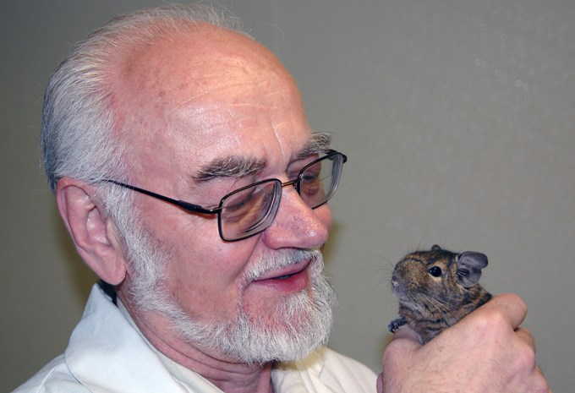
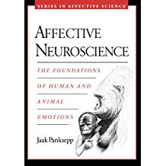
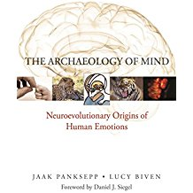
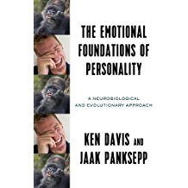
Jaak Panksepp 1944-2017

Slide 34
Depressive and Masochistic Cognition
“When I experience a rejection, loss, or disappointment, I conclude it is because there is something wrong with me.”
Early childhood experience that sets the stage for depressive psychology may include the inference, “Mother is gone. It must be my fault. I was bad or insufficient in some way.”
In masochistic psychology, the inference is more like, “Mother is gone. It must be my fault. I was bad or insufficient in some way. But maybe if I keep demonstrating how hurt or needy I am, she will return.” Thus, attachment is predicated on suffering (cf. Martha Stark’s “relentless hope”)

Slide 35
Depressive and Masochistic Defenses
For both:
Introjection
Turning against the self
Idealization of others
Identification with the aggressor
For masochistic patients:
Acting out
Moralization
“Victim entitlement”

Slide 36
Two Subjective Experiences of Depressive Psychology (Blatt, 2008)
Anaclitic (self-in relationship)
Introjective (self-definition)
Shame
Sense of being empty of anything valuable.
Relationship itself is therapeutic and reduces symptoms quickly.
Danger of losing gains at the end of a therapy.
Guilt
Sense of being full of badness, evil.
Therapy takes longer and must include focus on cognitions about one’s “faults.”
Improvement may continue after the end of treatment.

Slide 37
Transference in Depressive Patients
They attach quickly and may convey a sense of trust and hope.
They tend to idealize the therapist, but not in an empty way: they appreciate good qualities in the therapist that are real.
They are alert for criticism and rejection from the therapist.
They try to please, and they try not to “bother” the therapist.
They are frightened of any negative feelings or attitudes toward the therapist.

Slide 38
Countertransferences to Depressive Patients
They are likeable and evoke natural sympathy.
The introjective type may be perfectionistic and be admirable as a result.
Both types may induce warmth and genuine concern, though the self-hatred of the introjective patient can become tedious, as can the passive dependency of the anaclitic one.
Both depressive types may eventually evoke a sense of futility that mirrors the patient’s despair.
It is sometimes easy to enjoy the patient’s idealization and not notice opportunities to explore the person’s negative experiences of the therapist.

Slide 39
Treatment Implications: Depressive Patients
Because of their tendency to attach easily, they work well in therapy.
Anaclitically depressive patients may be helped by normalizing their sensitivity to attachment and separation. They may need either significantly long treatments, so that they can internalize the therapist’s attitude, or specific psychoeducation about separation when in shorter therapies.
Introjectively depressive patients need confrontation of their underlying automatic cognitions.
“Supporting the ego” versus “attacking the superego.”
Both need to become comfortable with critical and hostile feelings toward the therapist; otherwise, they will end treatment thinking they were lucky to go to such a wonderful person – without improvement in their self-acceptance.

Slide 40
Relevant Literature: Depressive Psychology
Blatt, S. J., & Bers, S. (1993). The sense of self in depression: A psychoanalytic perspective. In Z. V. Segal & S. J. Blatt (Eds.), The self in emotional distress: Cognitive and psychodynamic perspectives (pp. 71-210). New York: Guilford Press.
Blatt, S. J. (2008). Polarities of experience: Relatedness and self-definition in personality development, psychopathology, and the therapeutic process. Washington, DC: American Psychological Organization.
Hyde, J. (2009). Fragile narcissists or the guilty good: What drives the personality of the psychotherapist? Unpublished doctoral dissertation, Macquarie University, Sydney, Australia.
Huprich, S. K. (2012). Considering the evidence and making the most empirically-informed decision about depressive personality in the DSM-5. Personality Disorders: Theory, Research, and Treatment, 3, 470-482.
Huprich, S. K. (2013). New directions for an old construct: Future research directions for depressive personality in the DSM-5 era. Personality and Mental Health, 7, 213-222.
Shedler, J. (2022). The personality syndromes. In R. E. Feinstein (Ed.), (Primer on) Personality Disorders (pp. 3-32). New York: Oxford University Press.
Voytenko, V. L., & Huprich, S. K. (2025). Treatment-resistant depression and personality disorder: An update on conceptualization, assessment, and evidence-based psychodynamic approaches. Psychoanalytic Psychology, 42(1), 1-8.

Slide 41
Masochistic (Self-Defeating) Psychologies
DSM proposed definition of Self-Defeating Personality Disorder:
A pervasive pattern of self-defeating behavior, beginning by early adulthood and present across contexts. The person may often avoid or undermine pleasurable experiences, be drawn to situations or relationships in which they will suffer, and prevent others from helping them, as indicated by at least five of the following:
Chooses people and situations that lead to disappointment, failure, or mistreatment even when better options are clearly available.
Rejects or renders ineffective the efforts of others to help them.
Following positive personal events (e.g., new achievement), responds with depression, guilt, or a behavior that produces pain (e.g., an accident).
Incites angry or rejecting responses from others, then feels hurt, defeated, or humiliated (e.g., makes fun of spouse in public, provoking an angry retort, then feels devastated).
Rejects opportunities for pleasure, or is reluctant to acknowledge enjoying themselves (despite having adequate social skills and the capacity for pleasure).
Fails to accomplish tasks crucial to their personal objectives despite having demonstrated ability to do so (e.g., helps fellow students write papers, but is unable to write their own).
Is uninterested in or rejects people who consistently treat them well.
Engages in excessive self-sacrifice that is unsolicited by the intended recipients of the sacrifice.
These behaviors are not specific to situations of abuse or anticipated abuse or to conditions of depression.

Slide 42
“Normal Masochism” (Adaptive Altruism)
Like all psychopathology, self-defeating patterns are extreme versions of normal human tendencies.
Altruistic self-sacrifice is evolutionarily important to the survival of the human species. Parenting mammals will put the welfare of their children ahead of their individual welfare; we are biologically equipped for such sacrifices.
C. G. Jung: Masochism as a perversion of the normal need to worship or venerate;
Helena Deutsch: Masochism as a normal and inevitable part of mothering;
Emmanuel Ghent: Masochistic submission as a perversion of the normal need to surrender to something larger than the self.

Slide 43
Subgroups of Masochistic Patients
All editions of the PDM have distinguished between:
relational (anaclitic) masochism, in which the patient would rather be mistreated than be alone, and
introjective masochism, in which the patient clings to suffering as a badge of personal superiority.
Theodor Reik (1941) wrote about the latter as “moral masochism,” in which self-esteem is predicated upon suffering.
Jule Nydes (1965), Reik’s student, identified a paranoid version of masochism that he called the “paranoid-masochistic character.”
Arnold Cooper described in 1988 a constellation of dynamics that he identified as “narcissistic-masochistic personalities.”
Theodor Millon (1995) construed the phenomena that Reik would have called “moral masochism” and Cooper would have called “narcissistic-masochistic personality” as the “aggrieved pattern” of personality.

Slide 44
Theodore Millon’s Subtypes
Subtype | Features | Personality traits
Virtuous masochist | Including histrionic features | Proudly unselfish, self-denying, and self-sacrificial; self-ascetic; weighty burdens are judged noble, righteous, and saintly; others must recognize loyalty and faithfulness; gratitude and appreciation expected for altruism and forbearance.
Possessive masochist | Including negativistic features | Bewitches and ensnares by becoming jealous, overprotective, and indispensable; entraps, takes control, conquers, enslaves, and dominates others by being sacrificial to a fault; control by obligatory dependence.
Self-undoing masochist | Including avoidant features | Is "wrecked by success"; experiences "victory through defeat"; gratified by personal misfortunes, failures, humiliations, and ordeals; eschews best interests; chooses to be victimized, ruined, disgraced.
Oppressed masochist | Including depressive features | Experiences genuine misery, despair, hardship, anguish, torment, illness; grievances used to create guilt in others; resentments vented by exempting from responsibilities and burdening "oppressors".

Slide 45
Differentiating between Depressive and Masochistic Personalities
When seeking clinical services, patients with both kinds of personality organization appear to be similar: They tend to present with depressive affects and symptoms, and the therapist may readily infer from their story the themes of either guilt (introjective orientation) or feelings of emptiness, aloneness, and abandonment (anaclitic orientation).

Slide 46
Unconscious Motives behind Self-Defeating Behavior (Reik, 1941)
Provocation (“Let’s get the suffering over with”)
Appeasement (“I’m already suffering, so please don’t hurt me”)
Exhibitionism (“Pay attention! I’m in pain!”)
Deflection of guilt (“Look what you made me do!”)

Slide 47
Some Masochistic Clinical Presentations
The “Ain’t it awful?!” invitation, in which the patient attempts to enlist the clinician in lamenting a kind of victimization that is taken for granted and generalized (for example, “Don’t you hate how men treat women?!”)
Indications of the patient’s unconscious pleasure in frustrating clinical efforts to help, like the slight smile when reporting that, for example, “That medicine didn’t work, either . . .”
Emphasis on the role of others in wounding the patient and recruitment of the therapist to feelings that the patient deserves special compensations for a difficult history (“victim entitlement”).

Slide 48
Research on Masochism
Békés, V., Perry, J. C., & Robertson, B. M. (2017). Masochism: A mixed-method analysis of its development, psychological function, and conceptual evolution. Psychoanalytic Review, 104(1), 33-63.
From the abstract: Analysis of 23 publications from 1924 to 2012. Most authors emphasized painful early attachments, early injury of self-representation, identification with an abusing parent, and narcissistic injury as core childhood experiences. The main psychological function of masochism was described as a way of avoiding uncontrollable suffering by willingly undertaking other, milder, more controllable suffering.

Slide 49
Some transference attitudes in masochistic patients resemble those of depressive patients:
They may attach quickly;
They tend to idealize the therapist;
They are alert for potential criticism and rejection from the therapist;
They are frightened of any negative feelings or attitudes toward the therapist;
But eventually, the therapist of masochistic patients feels a sadistic undertone to their complaints and/or an unconscious determination to foil the therapist’s efforts to help.

Slide 50
Common Countertransferences to Self-Defeating Patients
Initially, deep compassion, based on the person’s having had a difficult history and often having been realistically victimized;
Early in treatment, masochistic reactions (expressed in behaviors such as reducing the fee, seeing the patient at inconvenient times, being available by telephone at all hours);
Usually later, irritable, sadistic feelings, including impatience, hostility, exasperation, lack of compassion.

Slide 51
Treatment Implications: Masochistic Patients
Don’t exemplify masochism;
Don’t be too sympathetic (it can reinforce the schema that attachment is based on the patient’s suffering);
Don’t take on the patient’s anxiety (masochistic patients off-load it on the therapist, and they need it to motivate change);
Confront the underlying fantasy that if the therapist really understands the patient’s pain, psychological progress will happen without the patient’s personal effort.
These stances tend to evoke the person’s anger, which should be welcomed and worked through to change the internal conviction that only the suffering self is acceptable to others.

Slide 52
Relevant Literature: Masochistic Psychology
Reik, T. (1941). Masochism in modern man. New York: Farrar, Straus.
Nydes, J. (1963). The paranoid-masochistic character. Psychoanalytic Review, 50, 215-251.
Cooper, A. M. (1988). The narcissistic-masochistic character. In R. A. Glick & D. I. Meyers (Eds.), Masochism: Current psychological perspectives (pp. 189-204). Hillside, NJ: Analytic Press.
Kernberg, O. F. (1988). Clinical dimensions of masochism. Journal of the American Psychoanalytic Association, 36, 1005-1029.
Ghent, E. (1990). Masochism, submission, surrender – Masochism as a perversion of surrender. Contemporary Psychoanalysis, 26, 108-136.
Novick, J. & Novick, K. K. (1991). Some comments on masochism and the delusion of omnipotence from a developmental perspective. Journal of the American Psychoanalytic Association, 39, 307-331.
Hanley, M. A. F. (Ed.) (1995). Essential papers on masochism. New York: New York University Press.
Bach, S. (1999). The language of perversion and the language of love. Northvale, NJ: Jason Aronson.
Wurmser, L. (2007). Torment me but don’t abandon me: Psychoanalysis of the severe neuroses in a new key. Lanham, MD: Jason Aronson.
Békés, V., Perry, J. C., & Robertson, B. M. (2017). Masochism: A mixed-method analysis of its development, psychological function, and conceptual evolution. Psychoanalytic Review, 104(1), 33-63.
Glick, R. A., & Berger, B. (2022). Masochistic/self-defeating personality styles. In R. E. Feinstein (Ed.), Personality disorders (pp. 613-629). New York: Oxford University Press.
Serna-Galindo, J. R. (2024). The sadomasochistic character and borderline personality organization: Working through the underlying conflicts and defenses using Transference-Focused Psychotherapy. Psychoanalytic Psychology, 41(4), 153-160.

Slide 53
Thank you!
nancymcw@aol.com

