Slide 1
ISC 2023 highlights
AFDAS
ARCADIA
LAA closure
Expanded criteria for Thrombectomy

Slide 5
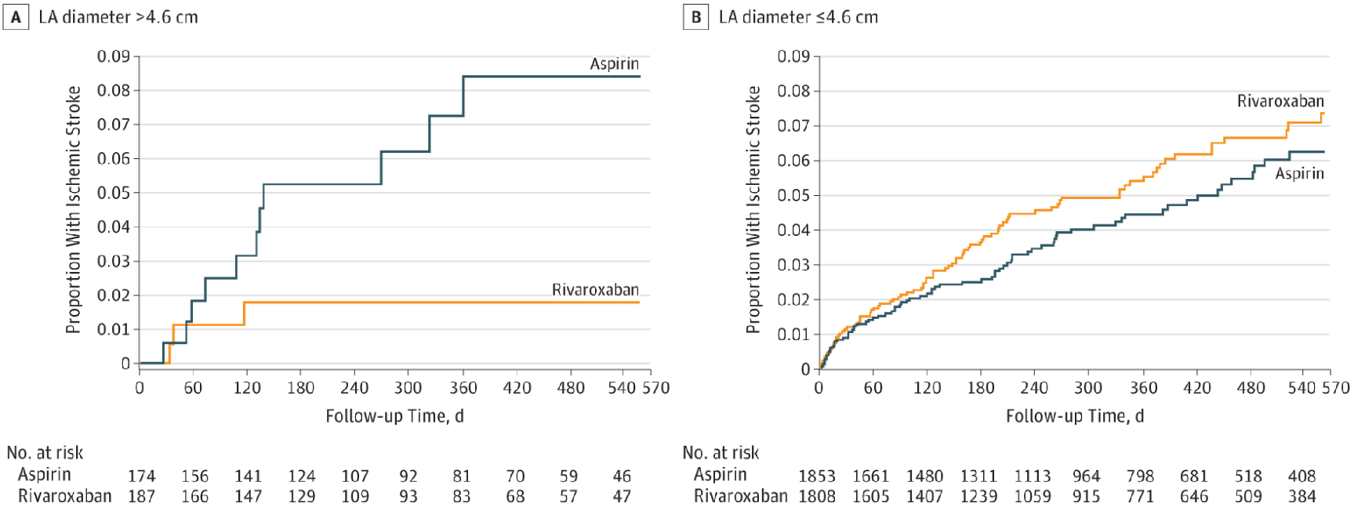

Slide 6
ARCADIA: Apixaban vs ASA for Cryptogenic stroke with Atrial cardiomyopathy

Slide 7
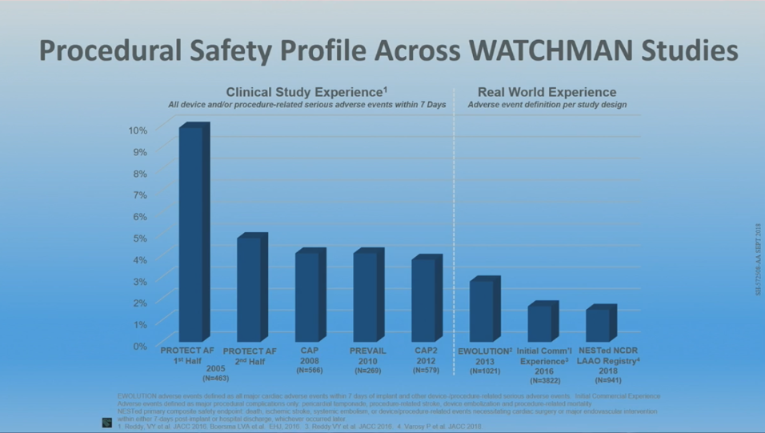

Slide 8
Thrombectomy: Expanded criteria

Slide 9
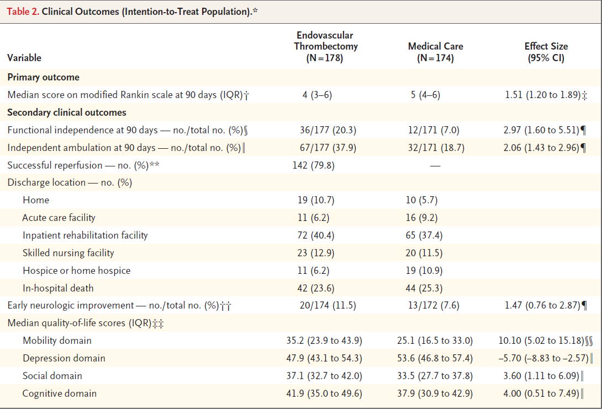

Slide 10
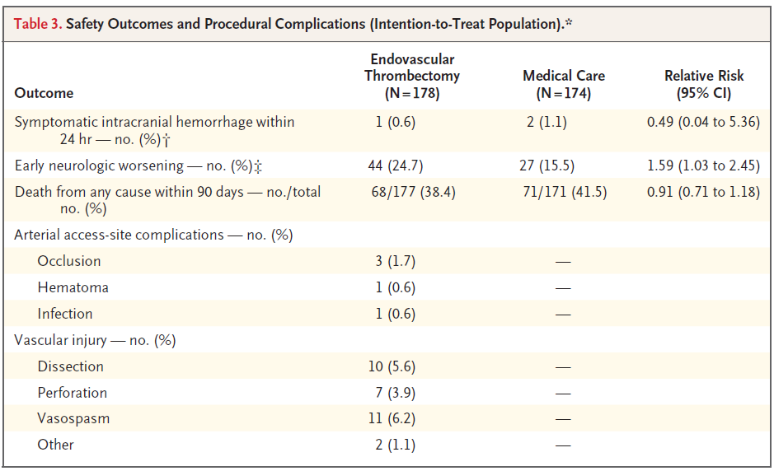

Slide 11
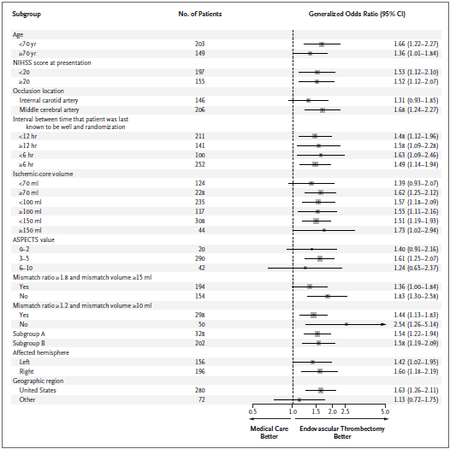

Slide 12
ANGEL-ASPECT: Trial of Endovascular Therapy for Acute Ischemic Stroke with Large Infarct
Purpose: Comparisons between endovascular therapy (EVT) with medical management and medical management alone for acute stroke patients with large infarct core have not been well studied.
Trial Design: Multicenter, prospective, open-label, randomized clinical trial in China. N=456. AIS with acute anterior anterior circulation LVO with an Alberta Stroke program early CT score of 3-5 or infarct core volume of 70-100ml. Assigned within 24 hrs. from symptoms onset, 1:1 to receive EVT (mechanical thrombectomy, aspiration thrombectomy, intra-arterial thrombolysis, angioplasty or stenting) or medical management guideline-based per treating clinician.
Primary Endpoint: Shift toward better outcomes in the distribution of scores on the modified Rankin Scale (mRS).
Primary Safety Endpoint: Symptomatic ICH within 48h.
Key Takeaways for the Clinician: Participants in this study with a large infarct core and who received EVT within 24 hours had better functional outcomes at 3 months compared to those participants with large infarct core who received medical management alone.
RESULTS | EVT N=230 | Medical Management N=225 | Treatment Effect (95%CI) | 95% CI and P-value
Primary Endpoint
Distribution of 90-day mRS scores in the Intention-To-Treat (ITT) Analysis | 4 (2-5) | 4 (3-5) | 1.37 | 1.11-1.69 P=0.004
Safety Endpoints
Primary: symptomatic ICH within 48 h | 14 (6.1%) | 6 (2.7%) | 2.07 | 0.79-5.41 P=0.12
Any ICH within 48 h | 113 (49.1%) | 39 (17.3%) | 2.71 | 1.91-3.84 P<0.001
Results: In this trial conducted in China, stroke patients with large infarct core treated with endovascular therapy had a better functional outcome at 3 months than medical management but had more intracranial hemorrhage.
Presented by: Xiaochuan Huo MD International Stroke Conference 2023.
© 2023, American Heart | American Stroke Association. All rights reserved.
Results reflect the data available at the time of presentation.
#ISC23
Notes:
Title: A Randomized Trial Of Endovascular Therapy For Acute Ischemic Stroke With A Large Infarct Core
A total of 231 patients were assigned to the endovascular therapy group and 225 to the medical management group.
There was a shift toward better outcomes in the distribution of mRS scores at 90 days in favor of endovascular therapy (generalized odds ratio, 1.37; 95% confidence interval, 1.11 to 1.69; P=0.004).
Symptomatic intracranial hemorrhage occurred in 14 patients (6.1%) in the endovascular therapy group and in 6 patients (2.7%) in the medical management group (P=0.09); any intracranial hemorrhage occurred in 113 patients (49.1%) vs 39 (17.3%), respectively.

Slide 13
Tirofiban for Disabling Stroke without Large or Medium Vessel Occlusion (RESCUE-BT2)
Purpose: Assess the efficacy and safety of the glycoprotein IIb/IIIa receptor inhibitor tirofiban compared with low-dose oral aspirin for patients with acute ischemic stroke without large or medium size vessel occlusion within 24h of stroke onset or stroke symptom progression.
Trial Design: Multicenter, randomized, double-blind, double-dummy trial includes 1158 patients enrolled from 117 sites in China, between Oct 2020 and June 2022, and randomly assigned patients to intravenous tirofiban with oral placebo therapy (tirofiban group) or oral aspirin with intravenous placebo therapy (aspirin group).
Primary Endpoint: Excellent outcome, defined as a modified Rankin Scale (mRS) of 0 or 1 at 90 days.
Safety Endpoints: Death at 90 days or symptomatic intracranial hemorrhage (sICH) within 48 hours.
Key Takeaways for the Clinician: Intravenous tirofiban showed excellent neurologic clinical outcomes (mRS 0 or 1) in patients with disabling, acute ischemic stroke without visible large or medium intracranial vessel occlusion within 24 hours of last known well or of onset of stroke symptom progression but had a higher chance of sICH.
RESULTS | Tirofiban group (n=606) | Aspirin Group (n=571) | P-value
Primary Endpoint:
mRS 0 or 1 at 90 days | 29.1% | 22.2% | 0.02
Safety Endpoints:
Death | 3.8% | 2.65% | 0.12
sICH | 0.99% | 0% | 0.03
Results: In this cohort of Asian patients, compared to aspirin, intravenous tirofiban significantly improved the proportion of mRS 0-1 at 90 days in patients with disabling stroke without visible large or medium intracranial vessel occlusion within 24 hours of last known well or of onset of stroke symptom progression.
Presented by: Wenjie Zi, International Stroke Conference 2023.
© 2023, American Heart | American Stroke Association. All rights reserved.
Results reflect the data available at the time of presentation.
#ISC23

Slide 14
ISC 2024: Phoenix AZ

