Slide 1
Chairman’s Update
June 16, 2023

Slide 2
Acute Ischemic Stroke (AIS)

Slide 3
Evidence for EVT alone (in px presenting directly to CSC)
Study | Location | N EVT only | N EVT plus IVT | Result
Yang et al 2020 | China | 327 | 329 | Noninferior
Suzuki et al 2021 (SKIP trial) | Japan | 101 | 103 | Noninferior
Wenjie et al 2021 (DEVT trial) | China | 116 | 118 | Noninferior
LeCouffe et al 2021 | Europe | 277 | 270 | Noninferior
Conclusion: In patients presenting directly to CSC, EVT alone is noninferior to EVT plus IVT
CAN WE TRANSLATE THIS TO PATIENTS PRESENTING TO PSC BEFORE TRANSFER TO CSC???

Slide 4
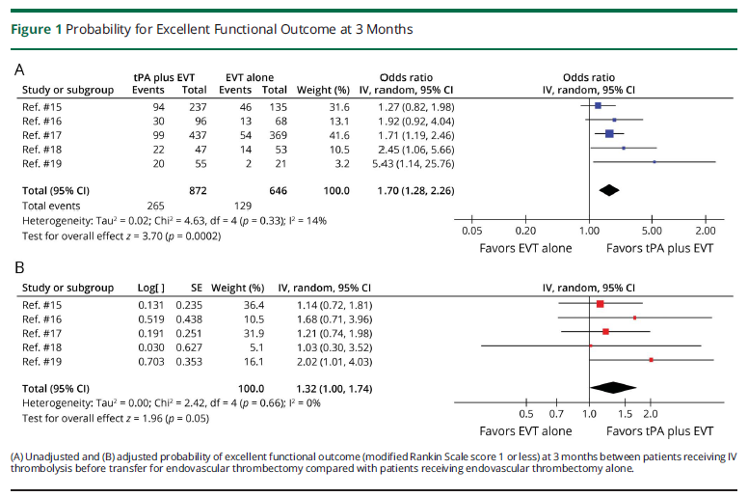
EVT alone vs EVT plus IVT (at PSC, transferring to CSC)

Slide 5
EVT vs EVT plus IVT
IV thrombolysis given at PSC prior to transfer to CSC for thrombectomy is SUPERIOR to no IVT.
Conclusion: Give IVT prior to transfer if px meets criteria.

Slide 6
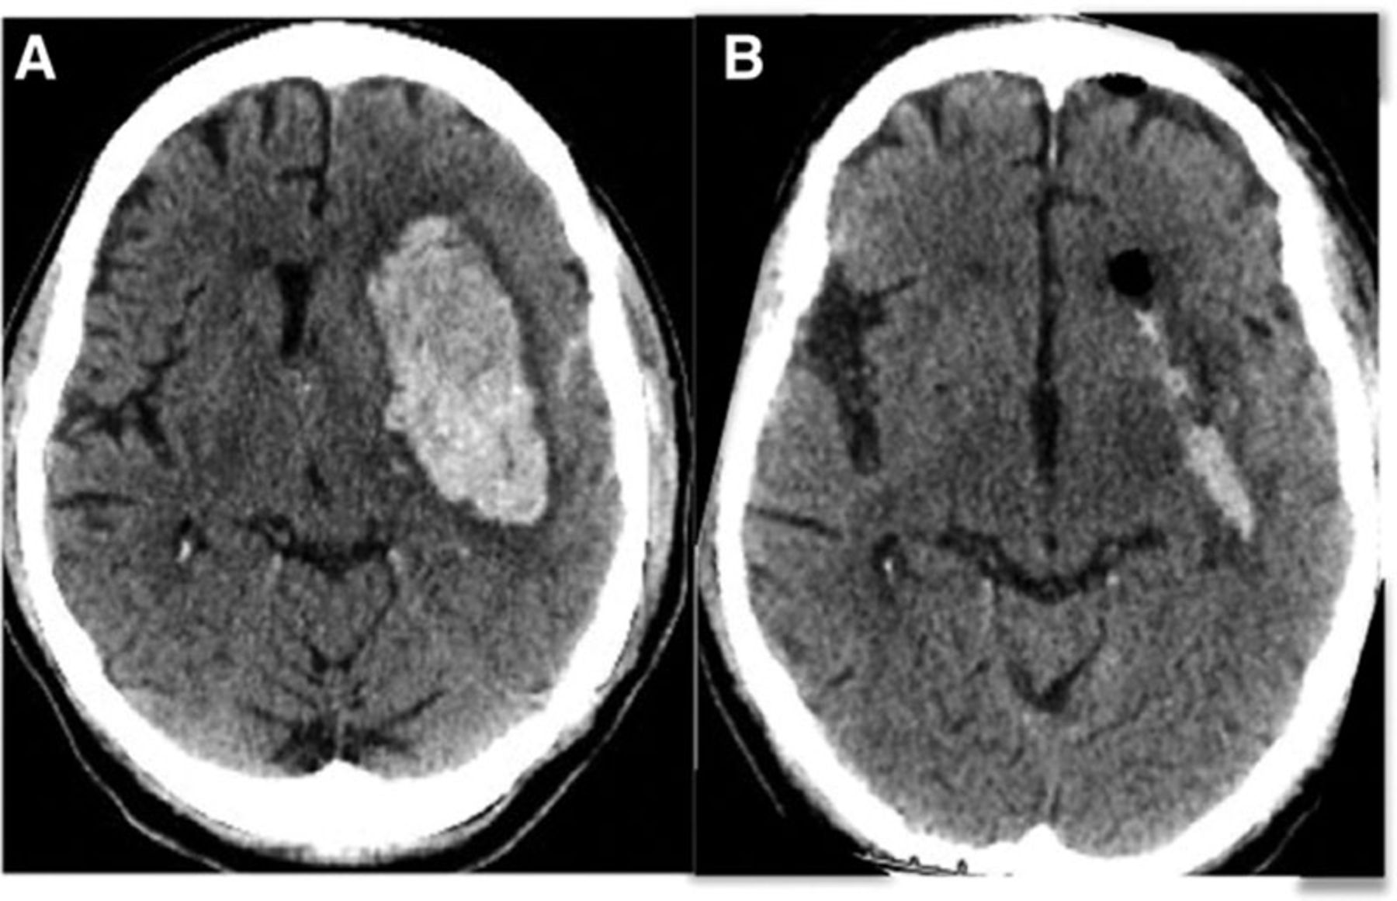
Intracranial Hemorrhage (ICH)
ENRICH (Early MiNimally-invasive Removal of ICH)

Slide 7
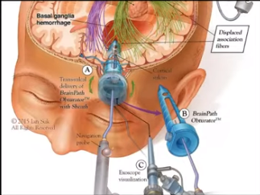
ENRICH = first ICH trial to show positive result in functional outcome

