Slide 1
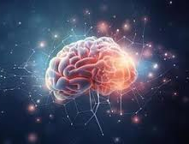
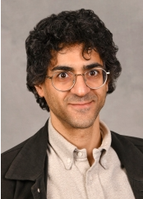
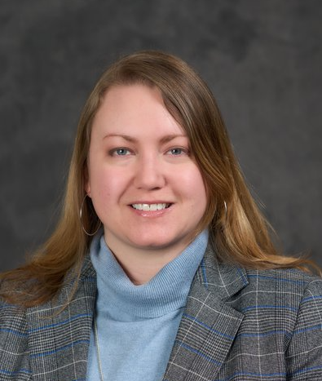
Upstate Comprehensive Stroke Center
Virtual Rush Conference series
January 22, 2025
1200-1300
Zoom Meeting Platform
Presenters:
Hesham Masoud, MD
Endovascular Surgery
Upstate Medical University
Simulations in the Medical Education Process
Ellyn Riley, Ph.D. CCC-SLP
Associate professor
Syracuse University
Focusing on Attention after Stroke
LEARNING OBJECTIVES: Following this activity participants should be able to:
The Learner will understand this simulation process that is utilized for educational purposes at Upstate.
The learner will understand attention processes after suffering a stroke.
The learner will gain knowledge on educational simulation and attention after a stroke.
LOCATION: Virtual via Zoom (https://upstate.zoom.us/meeting/register/tJUuce6orD0sG9OrsZJsqiDJ23m7iN-gRzUm#/registration)
TARGET AUDIENCE: Nurses, residents, attending, mid-levels, pharmacy.
SPEAKERS/Moderators/Planners: Joshua Onyan, MSN, RN, SCRN, Gene Latorre, MD
Accreditation: SUNY Upstate Medical University is accredited by the Accreditation Council for Continuing Medical Education (ACCME) to provide continuing medical education for physicians.
Credit Designation: SUNY Upstate Medical University designates this live activity for a maximum of 1 AMA PRA Category 1 Credit™. Physicians should claim only the credit commensurate with the extent of their participation in the activity.
Planners/Moderators: none of the planners or moderators have relevant financial relationships with ineligible companies.
ICNE Accreditation and Credit Designation: 1.0 Contact Hour will be awarded for this activity. The Upstate Medical University Institute for Continuing Nursing Education is approved with distinction as a provider of nursing continuing professional development by the Northeast Multistate Division Education Unit, an accredited approver by the American Nurses Credentialing Center’s Commission on Accreditation.
Commercial Support: No commercial support was received for this activity.

