Slide 1
International Stroke Conference
2025 Highlights
Julius Gene Latorre, M.D., M.P.H.
SUNY Upstate Medical University

Slide 2
Extended window for intravenous thrombolysis

Slide 3
AIS: extended window IVT
WAKE-UP (>4.5hr, symptom on awakening): MRI DWI/FLAIR mismatch
EXTEND (4.5-9hr) CTP with salvageable penumbra
TRACE 3 (4.5-24hr) LVO with salvageable penumbra not treated with EVT
No benefit in pooled analysis if NO MISMATCH
Trial | WAKE-UP (tPA) N=503 |  | EXTEND (tPA) N=225 |  | TRACE 3 (TNK) N=516
 | IVT | BMT | IVT | BMT | IVT | BMT
mRS 0-1/90d | 53.3% | 41.8% | 35.4% | 29.5% | 33% | 24.2%
sICH | 2.0% | 0.4% | 6.2% | 0.9%* | 3.0% | 0.8%*
Death | 4.1% | 1.2% | 11.5% | 8.9% | 13.3% | 13.1%

Slide 4
Extended time window (4.5-24hr) for IV thrombolysis in patients with LVO going for MER .
TIMELESS
  4.5-24 hr, px with LVO who went for MER
  Giving IV TNK 0.25mg/kg did not improve outcome
ETERNAL-LVO
  0-24 hr, px with LVO going for MER
  Giving IV TNK 0.25mg/kg did not improve outcome
Trial | TIMELESS N=458 |  | ETERNAL-LVO N=244
 | IVT | BMT | IVT | BMT
mRS 0-1/90d | 32.3% | 26.6% | 35.4% | 29.5%
sICH | 3.2% | 2.3% | 6.2% | 0.9%*
Death | 19.7% | 18.2% | 11.5% | 8.9%

Slide 5
Extended time window (4.5-24hr) for IV thrombolysis in patients with LVO NOT going for MER
TRACE
  4.5-24hr, px with LVO and CTP salvageable tissue who DID not go for MER
  IV TNK 0.25mg/kg max 25mg effective
HOPE
  4.5-24hr, px +/- LVO and CTP salvageable tissue who DID not go for MER
  IV TPA 0.9mg/kg effective
Trial | TRACE 3 N=516 |  | HOPE N=372
 | IVT | BMT | IVT | BMT
mRS 0-1/90d | 33.0% | 24.2%* | 40.3% | 26.3%*
sICH | 3.0% | 0.8%* | 3.8% | 0.5%*
Death | 13.3% | 13.1% | 10.8% | 10.8%

Slide 6
TAKE HOME Point #1
Intravenous thrombolysis (tPA or TNK)
  May be considered for patients presenting with LKW >4.5hr IF CT perfusion shows salvageable tissue and no large core infarct
  No added benefit if patient will go for thrombectomy

Slide 7
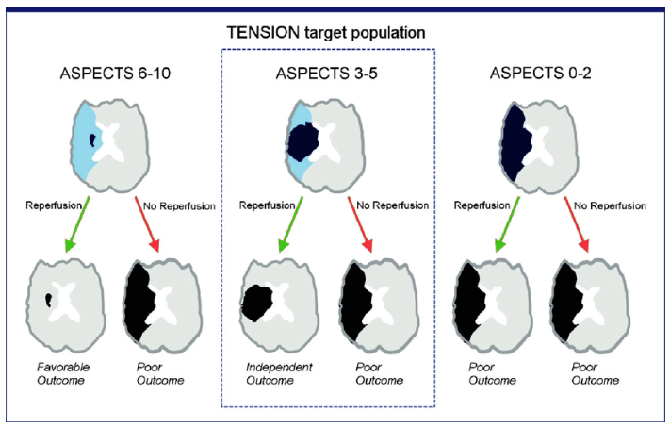
Mechanical thrombectomy for large core infarct

Slide 8
AIS: Large CORE EVT summary
Primary Endpoints/Efficacy
Trial | Functional Independence |  | Independent Ambulation
 | EVT | BMT | EVT | BMT
RESCUE-Japan | 14% | 7.8% | 31% | 13%
ANGEL-ASPECT | 30% | 12% | 47% | 33%
SELECT2 | 20% | 7% | 38% | 19%
TENSION | 17% | 2.4% | 31% | 13%
TESLA | 15% | 8.9% | 30% | 20%
LASTE | 13% | 4.9% | 34% | 12%

Slide 9
AIS: Large CORE EVT summary
Secondary Endpoints/Safety
Trial | sICH |  | Decompressive Crani |  | Mortality
 | EVT | BMT | EVT | BMT | EVT | BMT
RESCUE-Japan | 9% | 4.9% | 10% | 14% | 18% | 24%
ANGEL-ASPECT | 6.1% | 2.7% | 7.4% | 3.6% | 22% | 20%
SELECT2 | 0.6% | 1.2% | NA | NA | 38% | 42%
TENSION | 5.6% | 5.1% | 8.8% | 7% | 39% | 51%
TESLA | 4% | 1.3% | 22% | 15% | 35% | 33%
LASTE | 9.6% | 5.7% | 8.8% | 12% | 36% | 56%

Slide 10
TAKE HOME Point #2
Large Core Infarct – solid evidence from 6 randomized trials showing benefit and no excess harm
  Number needed to treat: 8
  Higher sICH with no excess mortality
  Limited date for >80

Slide 11
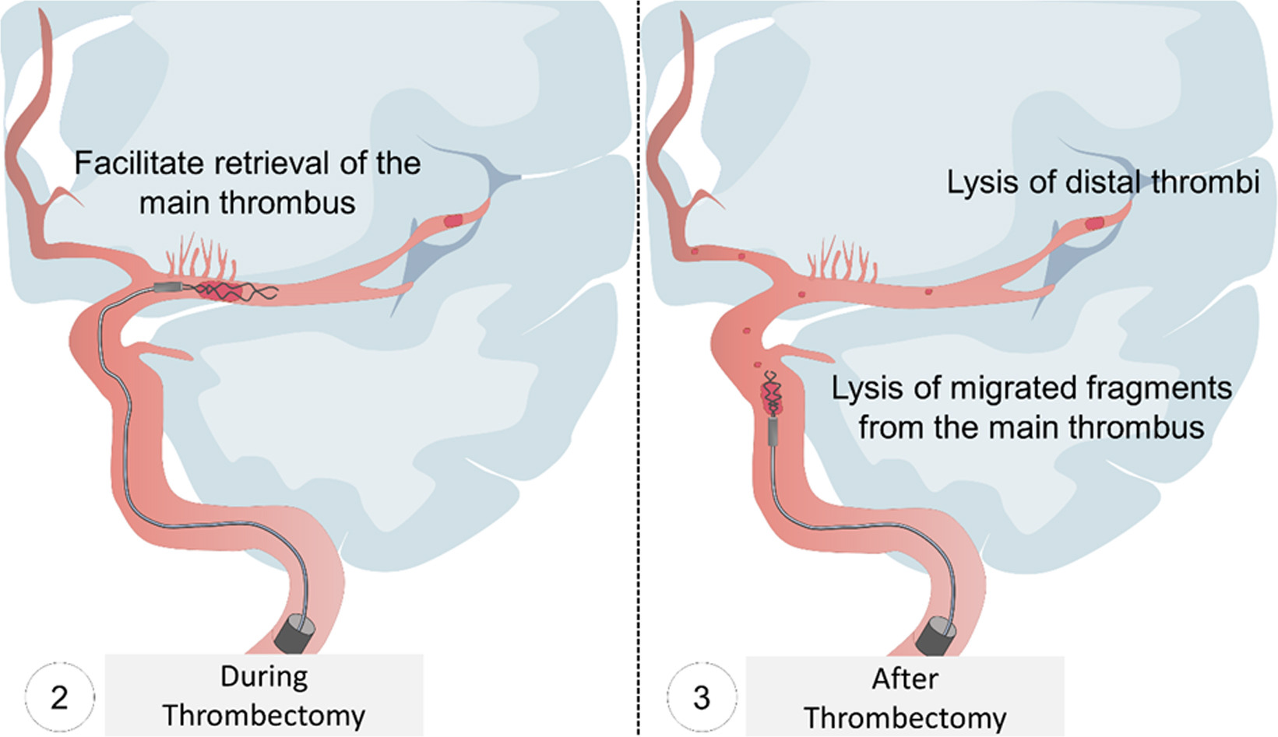
Intra-arterial thrombolysis after successful recanalization

Slide 12
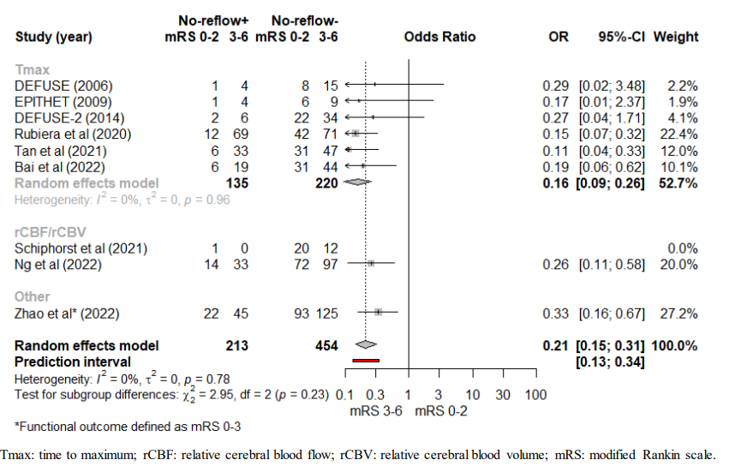
Why Intra-arterial thrombolysis after successful thrombectomy makes sense?
No reflow phenomenon observed in 1/3 of stroke patients with successful macrovascular reperfusion (29%, 95% CI 21-37%)
No reflow associated with reduced rates of functional independence (OR 0.21 95% CI 0.15-0.31)
Reference:Mujanovic A, Ng F, Meinel TR, et al. No-reflow phenomenon in stroke patients: A systematic literature review and meta-analysis of clinical data. International Journal of Stroke. 2024;19(1):58-67.
Notes:
Mujanovic A, Ng F, Meinel TR, et al. No-reflow phenomenon in stroke patients: A systematic literature review and meta-analysis of clinical data. International Journal of Stroke. 2024;19(1):58-67. doi:10.1177/17474930231180434

Slide 13
Why Intra-arterial thrombolysis after successful thrombectomy makes sense?
Despite successful recanalization in patients with LVO, approximately half of patients do not achieve good functional independence
Studies | Revascularization | 90d Good Functional Outcome | Absolute difference
2015 REVASCAT | 66% | 44% | 22%
2015 MR CLEAN | 59% | 33% | 26%
2015 EXTEND-IA | 86% | 71% | 15%
2015 ESCAPE | 72% | 53% | 19%
2015 SWIFT PRIME | 88% | 60% | 28%
2018 DEFUSE 3 | 76% | 48% | 28%
2018 DAWN | 84% | 45% | 39%

Slide 14
AIS: Intraarterial thrombolysis post EVT recanalization
 | ANGEL-TNK N=255m TNK 0.125mg/kg x 15 min 12.5mg max |  | PEARL N=324 TPA 0.225mg/kg 20mg max |  | CHOICE N=121 TPA 0.225mg/kg x 15-30min 22.5mg max
 | EVT+IA | EVT | EVT+IA | EVT | EVT+IA | EVT
mRS 0-1/90d | 40.5% | 26.4% | 44.8% | 30.2% | 59% | 40.4%
sICH | 5.6% | 6.2% | 4.3% | 5.0% | 0% | 3.8%
Death | 21.4% | 21.7% | 17.1% | 11.3% | 8% | 15%
TNK at 0.125mg/kg (max 12.5mg) infused at distal M1 x 15 min
or
TPA 0.225mg/kg max 20mg infused at distal M1 over 15-30 min

Slide 15
TAKE HOME Point #3
Intraarterial thrombolysis after successful recanalization
  Improves functional outcome
  Did not increase sICH or mortality
  Procedure update for thrombectomy ongoing

Slide 16
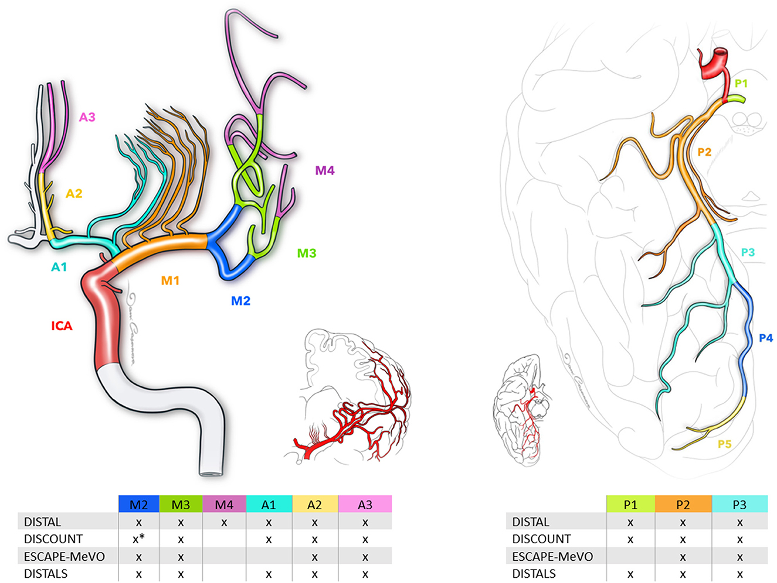
Mechanical thrombectomy for medium/distal vessel occlusion

Slide 17
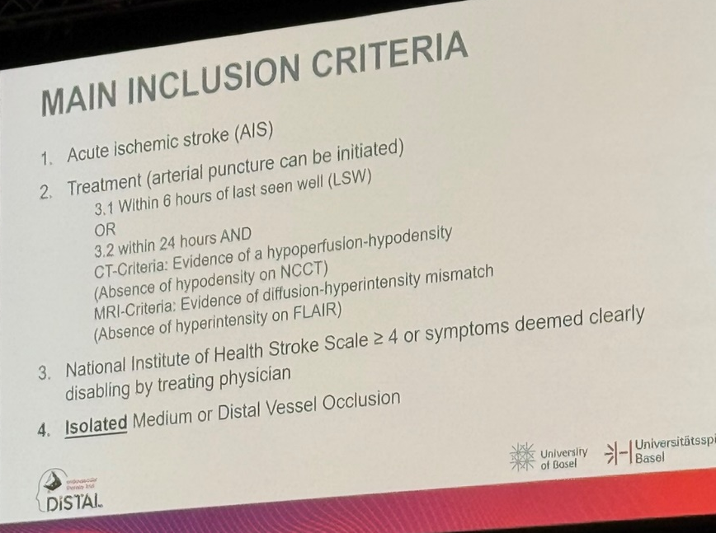
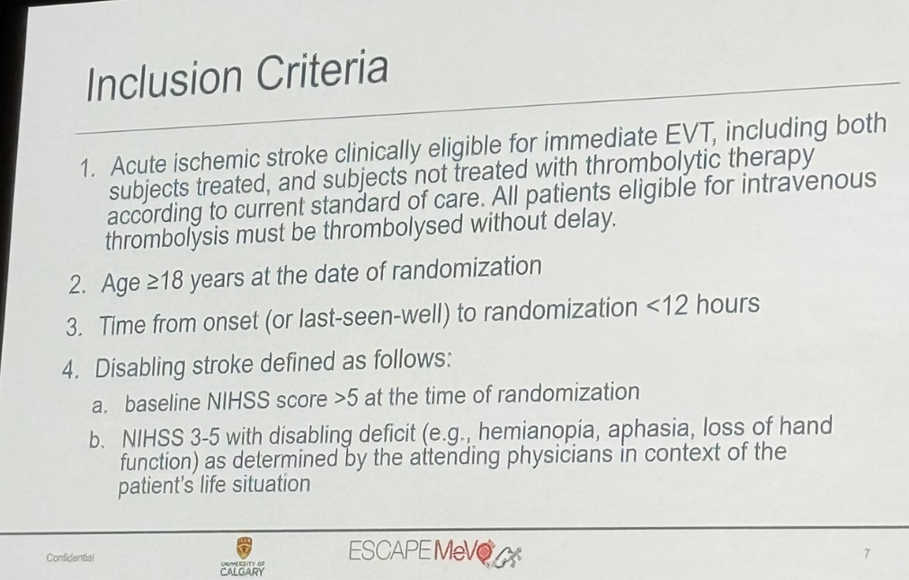
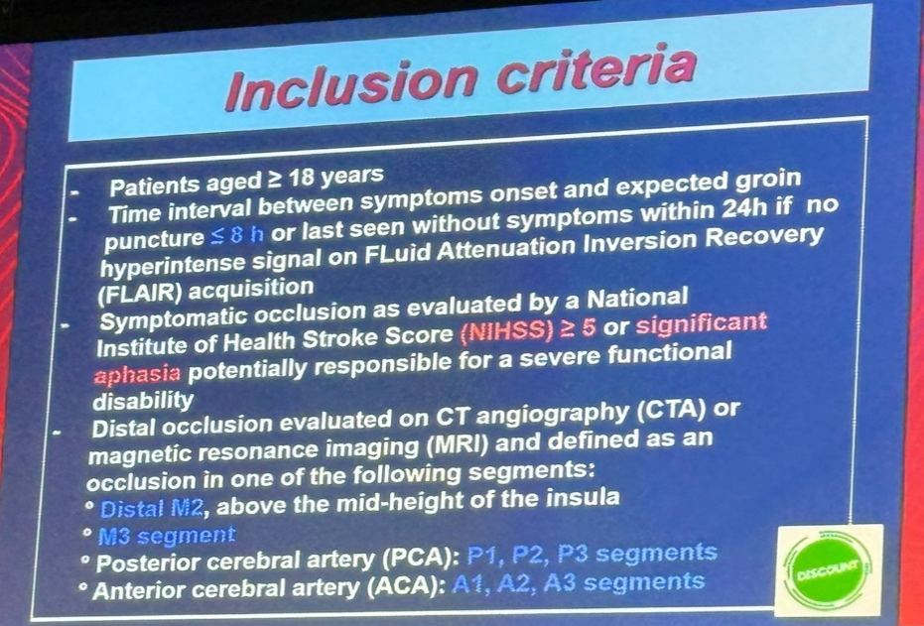
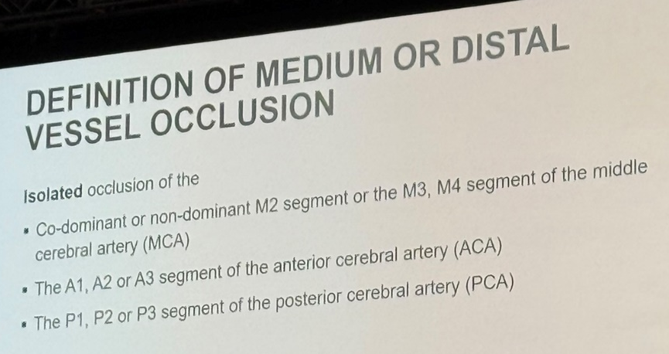
AIS: What about medium/distal vessel occlusion?
DISTAL trial
ESCAPE-MEVO trial
DISCOUNT trial
Trial | DISTAL |  | ESCAPE-MEVO |  | DISCOUNT
 | EVT | BMT | EVT | BMT | EVT | BMT
mRS 0-1/90d | 34.7% | 37.5% | 41.6% | 43.1% | 60%* | 77%*
sICH | 5.9% | 2.6% | 5.4% | 2.2% | 12% | 6%
Death | 15.5% | 14% | 13.3% | 8.4% | 3% | 7%

Slide 18
AIS-EVT: MEVO/DIVO bust
MEVO bust
  Three trials with negative result
  Best Medical Therapy wins
  Potential future role of EVT in MEVO/DIVO
    CT perfusion based patient selection: large mismatch
    More severe stroke: NIHSS 10 and over
    Combination intra-arterial thrombolysis

Slide 19
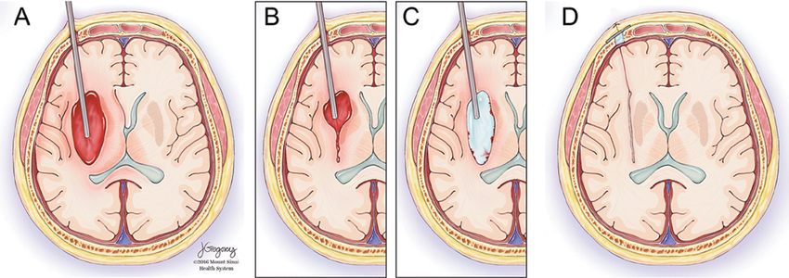
Minimally invasive surgery for intracranial hemorrhage

Slide 20
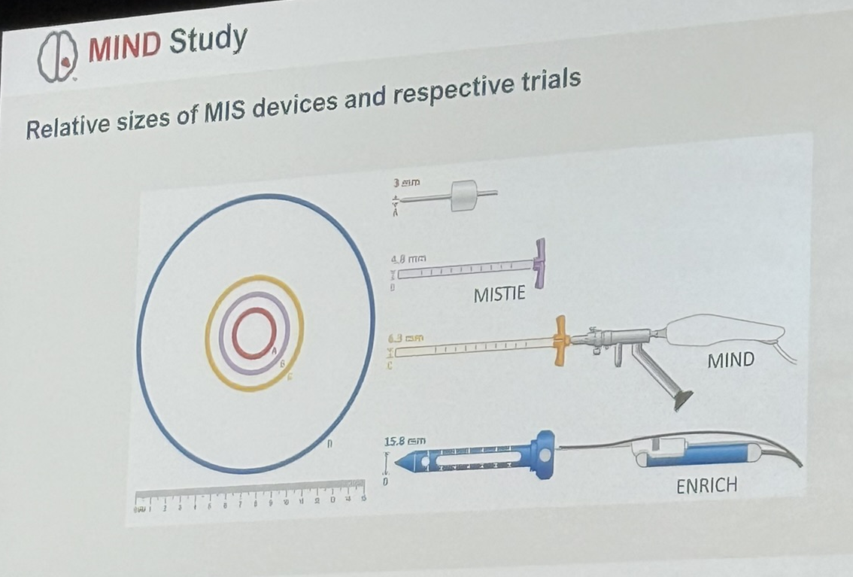
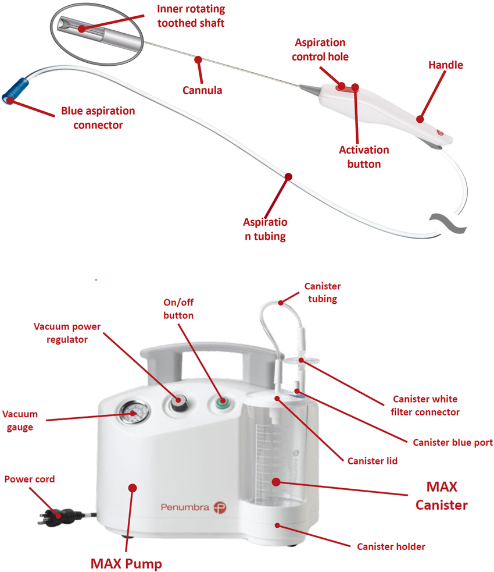
ICH – Minimally Invasive Surgery
ARTEMIS device

Slide 21
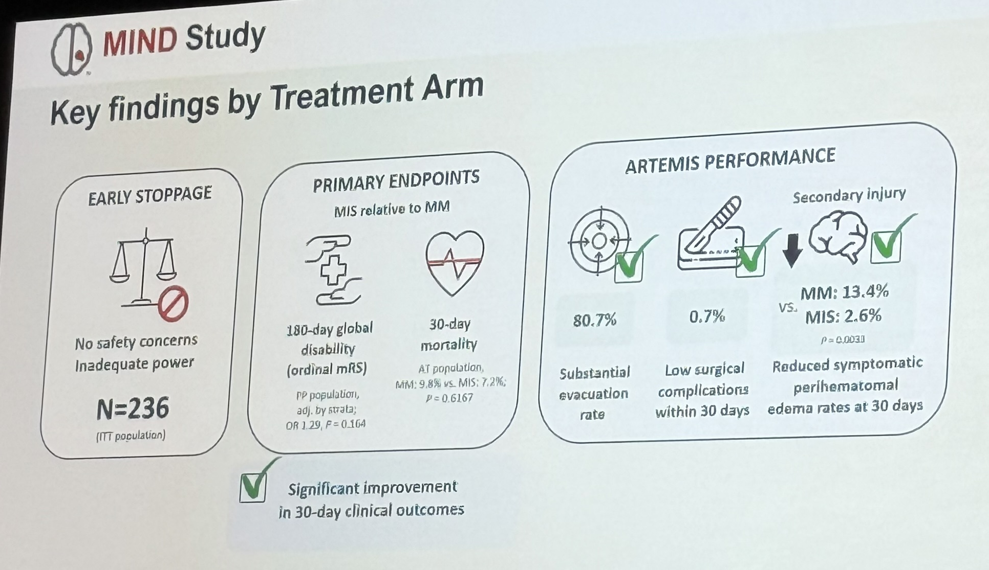
ICH – MIND trial

Slide 22
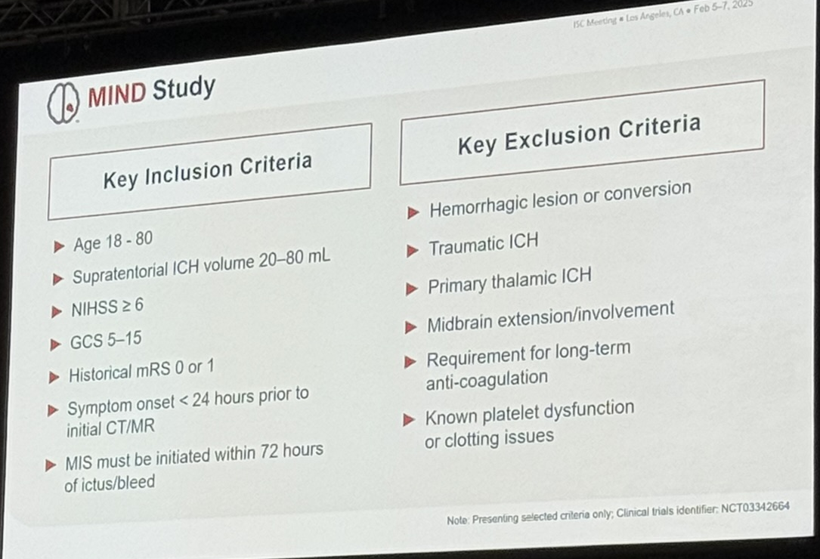
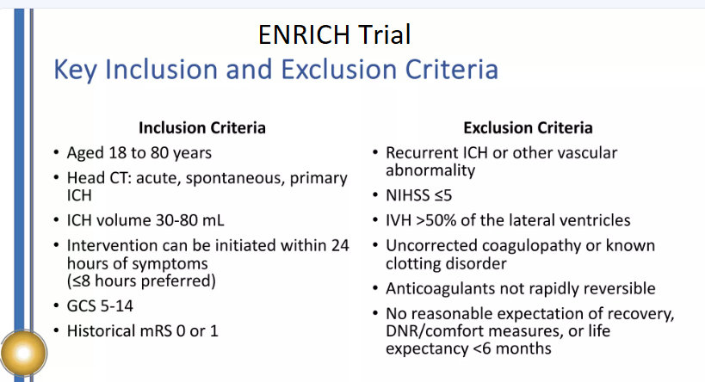
ICH – MIND trial

Slide 23
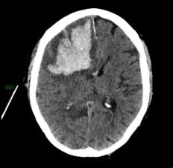
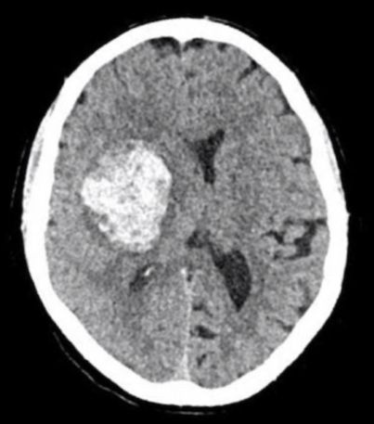
ICH-minimally invasive surgery
Lobar – ENRICH and MIND both positive
Deep – no good surgical option currently
Differential treatment effect based on location
  Lobar vs BG vs Thalamic (volume threshold differs)

Slide 24
TAKE HOME Point #4
Minimally invasive surgery for ICH
  Works for LOBAR hemorrhage (No good evidence for Deep)
  Early evacuation better than late
  Near complete evacuation associated with better outcome (residual <15ml)

Slide 25
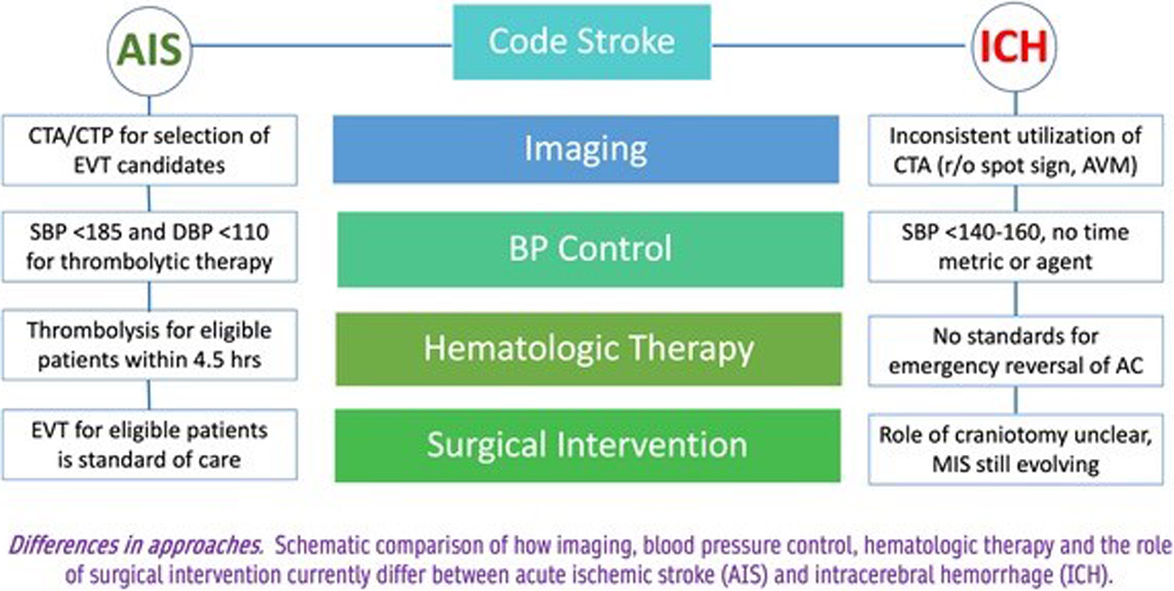
Code ICH
ICH Care bundle

Slide 26
ICH Care bundle (Code ICH)
Component | Detail | Reference
Rapid diagnosis/imaging | Door to CT 25 min (includes CTA/vessel imaging) | 2022 AHA ICH Guideline
Expedited BP control | Door to Target BP in 60 min If SBP <190mmHg target 130-150 mmHg if SBP >190mmHg target 55-85mmHg | ATACH-2 INTERACT 2/3
Glucose Control | Door to treatment 60 min Non-DM 110-140 mg/dL Diabetic 140-180 mg/dL | INTERACT 3
Body Temperature | Maintain </= 37.5 deg C | INTERACT 3
Early anticoagulation reversal | Door to Reversal 60 min (INR goal <1.5) VKA (IV Vit K and 4-F PCC Factor II inhibitor – idarucizumab Factor Xa inhibitor – 4F PCC (Andexanet if available) | Sheth 2024 INTERACT 3
Early/Minimally invasive Surgery | NS referral within 60 min Surgery within 24 hours (lobar) | ENRICH MEND MISTIE 3

Slide 27
ICH: Code-ICH
Joint Commission Ischemic Stroke Time Metrics |  | Code ICH (proposed ICH Time Metrics)
Door to Doc | <10 min | Door to Doc | < 10 min
Door to Stroke Team | <15 min | Door to Stroke Team | <15 min
Door to CT scan | <25 min | Door to CT scan | <25 min
Door to CT read | <45 min | Door to CT read | <45 min
Door to Needle (IVT) | <60 min | Door to Lab (coag) | <45 min
Door to groin (EVT) | <90 min | Door to BP target | <60 min
 |  | Door to Anticoag Reversal | <60 min
 |  | Door to Surgery/ | <180 min (<24 hours)
code-ich.org

Slide 28


THANK YOU!

