Slide 1

RSTAC
September 19th, 2025

Slide 2
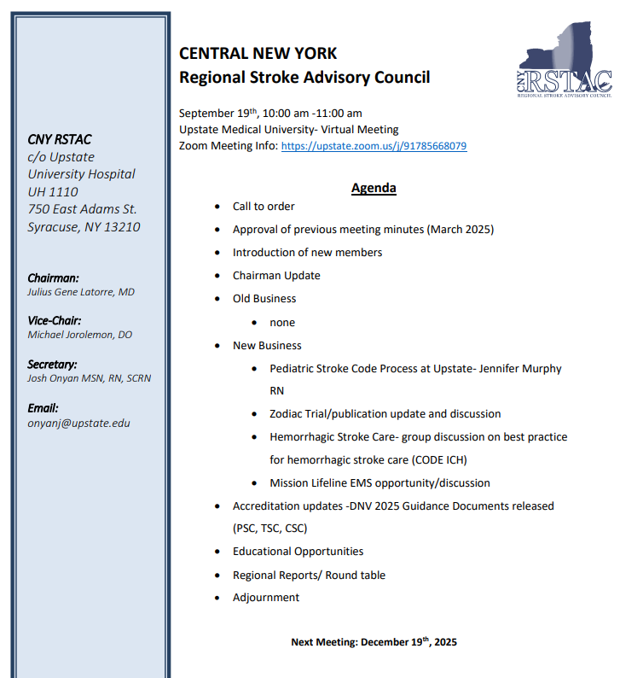

Slide 3
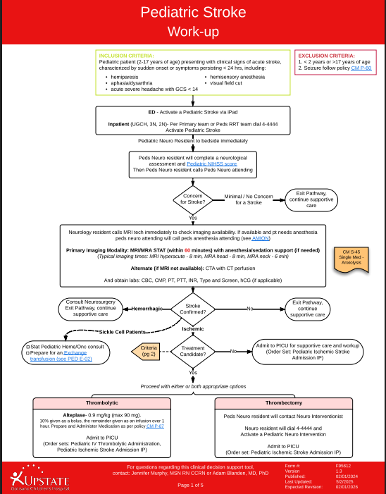
Pediatric Stroke Code Process- Jenn Murphy RN
https://upstate.ellucid.com/pman/documents/view/12346/?security=1c0e578dc4d74e33a732badf5207c0d7bb4bb508

Slide 4
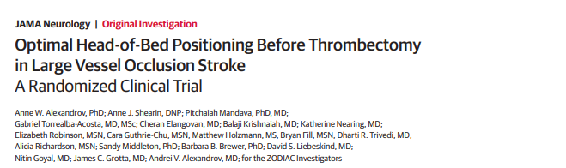

Zodiac Trial/publication update and discussion
https://jamanetwork.com/journals/jamaneurology/fullarticle/2835054

Slide 5
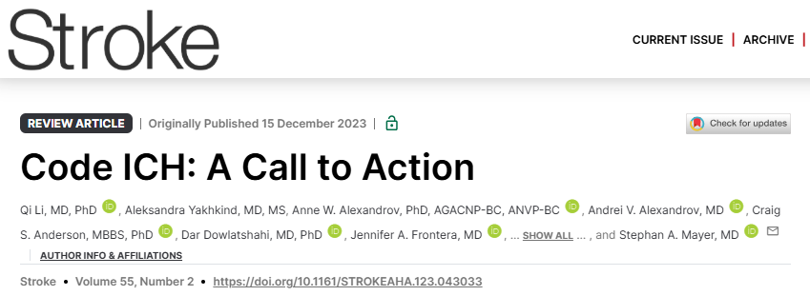
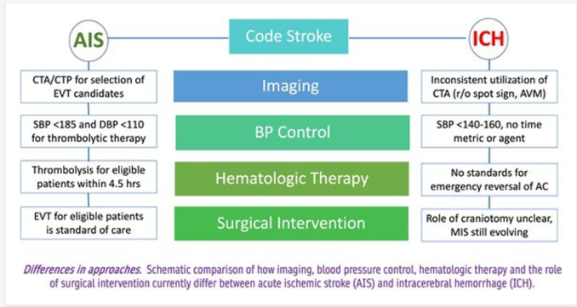
Hemorrhagic Stroke Care

Slide 6
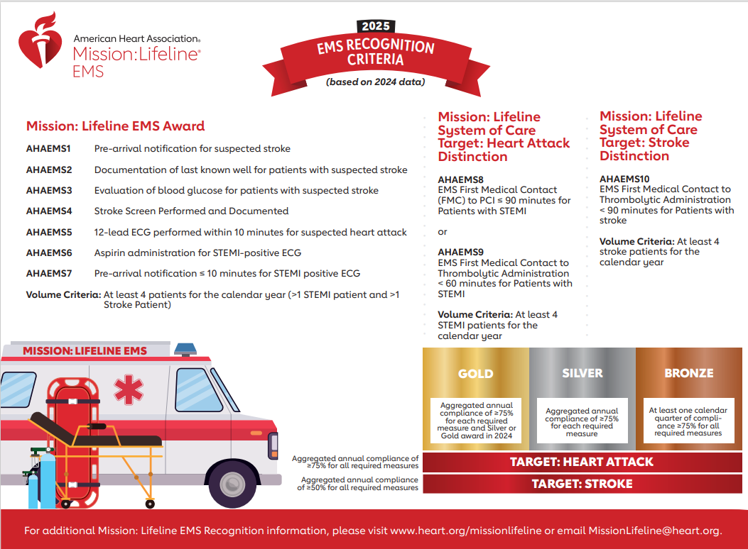
EMS Mission Lifeline
https://www.heart.org/en/professional/quality-improvement/mission-lifeline

Slide 7
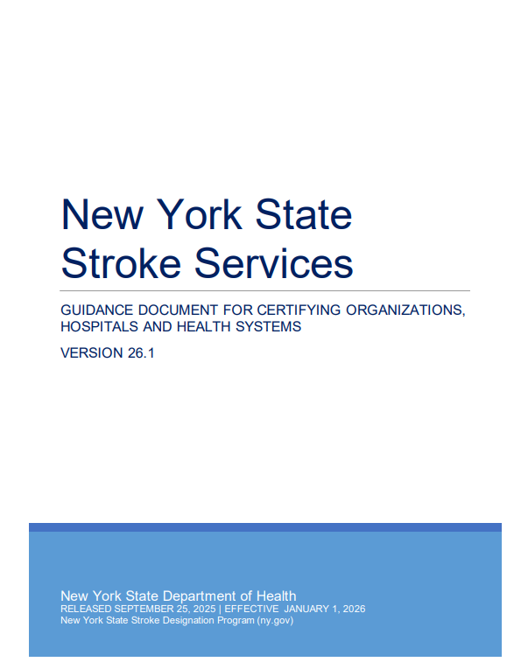

Accreditation Updates

