Slide 1
ISC 2026 Updates
Gene Latorre, MD

Slide 2
Emerging evidence
Acute ischemic stroke intervention – new ways to cure stroke!
  Intravenous thrombolysis
  Mechanical thrombectomy
Secondary stroke prevention – new ways to prevent another stroke!
Hemorrhagic stroke intervention
Neuroprotection

Slide 3
IV TNK extended time window 4.5-9hr
2026 AHA guideline: Class 2a recommendation
  IV TNK for LKW 4.5-9hr, patient selection using either one
    MRI: DWI/FLAIR mismatch, with DWI volume less than 1/3 MCA territorry
    CTP: small core with salvageable penumbra
    NIHSS – must be disabling symptom
  Evidence from two RCT
  WAKE-UP: uses MRI to select patients
  EXTEND: uses CT perfusion to select patients

Slide 4
IV TNK extended time window: 9hr to 24h?
What we know so far: IV TNK in px with LVO 4.5-24 hours
  If with LVO and patient will go for thrombectomy: additional IV TNK not beneficial
      TIMELESS trial (NEJM 2024)
      ETERNAL LVO (Stroke 2025)
      CHABLIS T-2 (Stroke 2025)
  If with LVO and unable to get thrombectomy: IV TNK beneficial
      TRACE III trial (NEJM 2024)
      ROSE-TNK (J Stroke 2023)

Slide 5
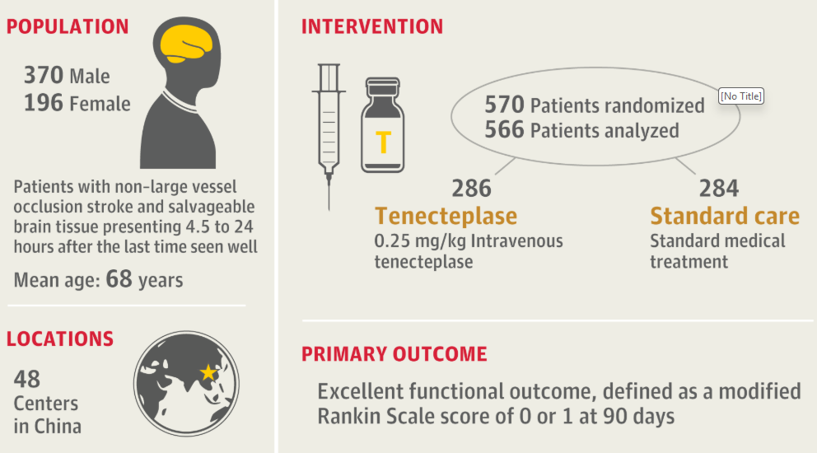
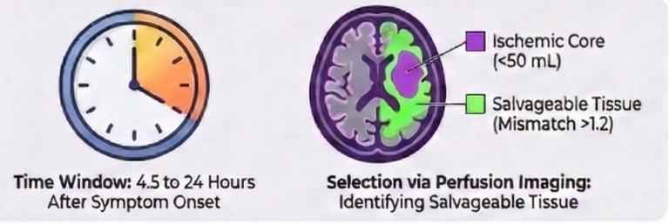
OPTION trial (ISC 2026)

Slide 6
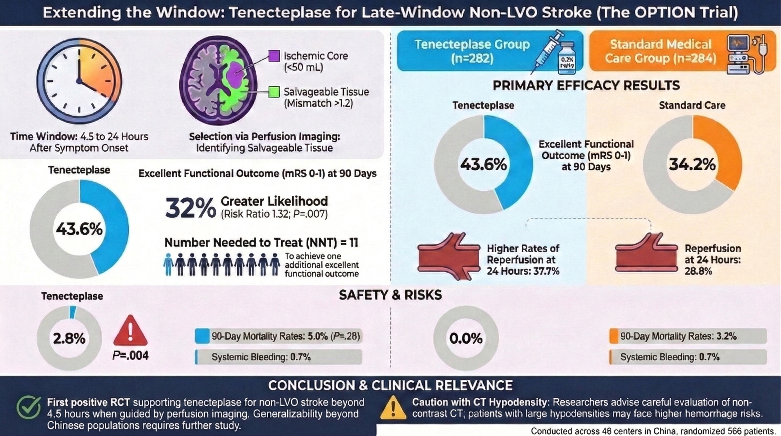

Slide 7
OPTION Trial: Take home point
If you have a patient with stroke presenting 4.5-24 hours
  And NO large vessel occlusion on CTA
  And disabling symptom (NIHSS 6 to 25)
  And you can either do CT perfusion (or MRI: for px 4.5-9hr)
  And CTP shows penumbra (or MRI showing DWI/FLAIR mismatch: up to 9hr)
  IV TNK 0.25mg/kg (max 25mg) may be beneficial to improve outcome

Slide 8
Emerging evidence
Acute ischemic stroke intervention – new ways to cure stroke!
  Intravenous thrombolysis
  Mechanical thrombectomy
Secondary stroke prevention – new ways to prevent another stroke!
Hemorrhagic stroke intervention
Neuroprotection

Slide 9
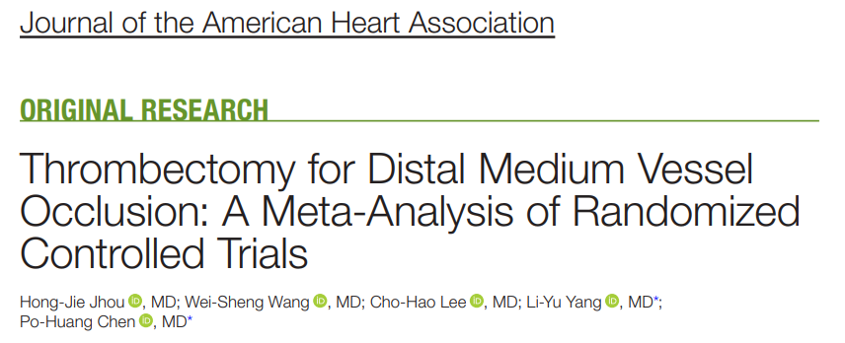
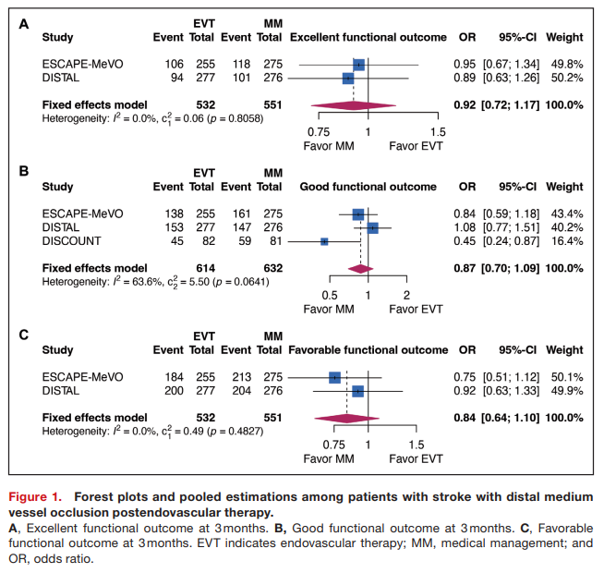
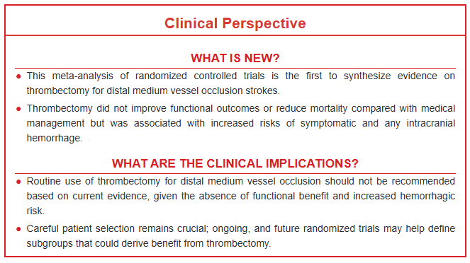
Acute Treatment: EVT for MeVO
ISC 2025: Three RCT (DISTAL, DISCOUNT, ESCAPE-MEVO)

Slide 10
EVT for MeVO
Why did the RCT's fail to show benefit?
  Patient selection:
    Majority of patients receive thrombolysis:
    Majority of patients have mild stroke (low NIHSS)
    Lots of old people enrolled (>40% over 80yrs)
  Device/Technique:
    High proportion of use of stentriever (increased hemorrhage when used for Mevo vs LVO)
    No specialized device designed for MeVO

Slide 11
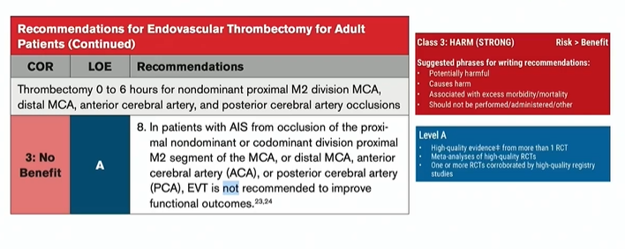

Slide 12
ISC 2026: EVT for MeVO
Oriental MEVO
  Done primarily in China (48 center)
  Median NIHSS 10
  Minimized use of IVT
  Defined MeVO (distal/nondominant M2, M3, A1,A2,A3,P1,P2,P3)
  Open label RCT: N=280 EVT, N=283 Medical Mgt
  Primary outcome: mRS90 0-2 (functional independence)
  EVT mRS90 (0-2): 58.6% vs 46.6% (ARR 1.24, p=0.004) NNT 8
  EVT mRS90 (0-1): 48.9% vs 33.2% (ARR 1.47, p=<0.001)
  Safety outcome
  Symptomatic ICH EVT: 4.7% vs 2.2% p=ns
  Mortality EVT: 11.1% vs 10.2% p=ns

Slide 13
ISC 2026: EVT for MeVO
DISTALS: Distal-specific thrombectomy system (Tigertriever 13)
  Multicenter RCT (USA, Belgium, Germany, Sweden)
  NIHSS 4-24, TLKW outside of IVT window
  N=118 randomized, EVT=51, Medical=47 included in analysis
  Primary outcome: successful reperfusion
    86.3% vs 27.7& p<0.001 vs medical management
  Safety outcome: symptomatic ICH
    None

Slide 14
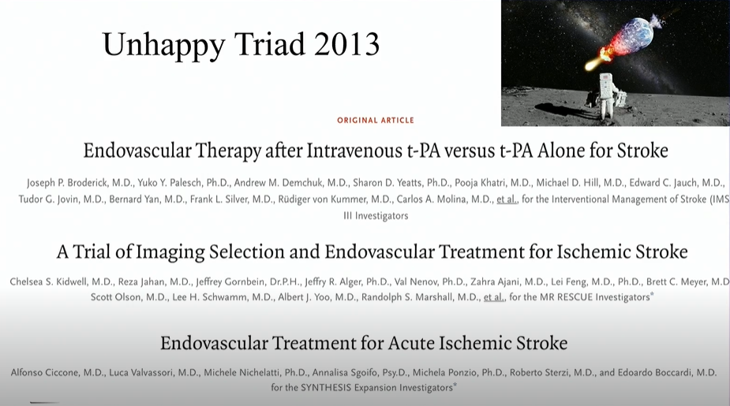

Slide 15
EVT for MEVO take 2 TAKE HOME Points
Despite previous trial results
If you have patients with distal medium vessel occlusion (smaller vessel)
  And presents within 24 hours
  And with moderate to severe stroke (NIHSS at least 10)
  And CT Perfusion showing salvageable penumbra
  Thrombectomy may be offered

Slide 16
Emerging evidence
Acute ischemic stroke intervention – new ways to cure stroke!
  Intravenous thrombolysis
  Mechanical thrombectomy
Secondary stroke prevention – new ways to prevent another stroke!
Hemorrhagic stroke intervention
Neuroprotection

Slide 17
New Era in Secondary Prevention
OCEANIC-STROKE trial: RCT multicenter placebo-controlled
  702 sites, 37 countries N=12,237
  Asundexian: new class of antithrombotic
    Factor XIa inhibitor
    Only affects intrinsic pathway (thrombogenic pathway)
    No or minimal effect on endogenous hemostatic pathway (no significant bleeding risk)
  Px with AIS within 72 hours of onset
  Non-cardioembolic strokes
  Treated with BMT (SAPT or DAPT)
  2 year follow-up
  Recurrent stroke among Asundexian group (6.2%) vs Placebo (8.4%)
  RRR=26% ARR 1.9% at 1 year NNT=53
  Bleeding rate similar to placebo

Slide 18
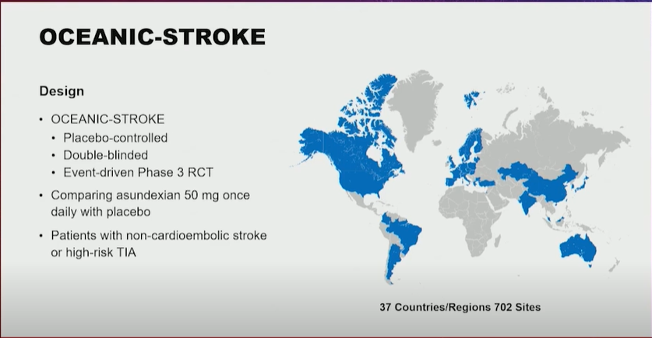

Slide 19
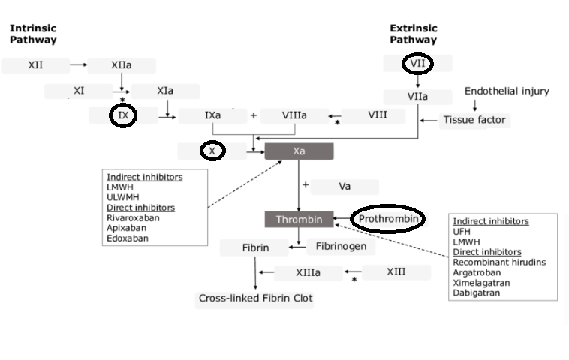
Asundexian: XIa inhibitor
Vit K antagonist
Factors II, VII, IX, II (prothrombin)

Slide 20
Emerging evidence
Acute ischemic stroke intervention – new ways to cure stroke!
  Intravenous thrombolysis
  Mechanical thrombectomy
Secondary stroke prevention – new ways to prevent another stroke!
Hemorrhagic stroke intervention
Neuroprotection

Slide 21
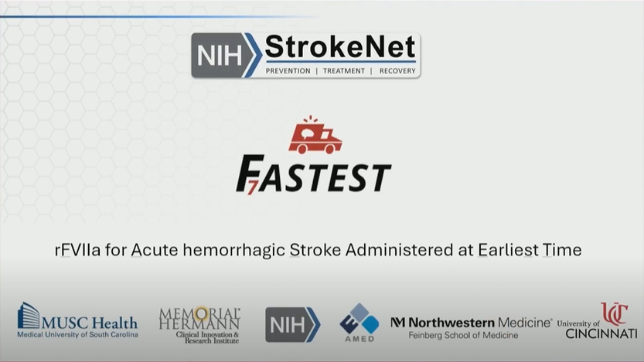

Slide 22
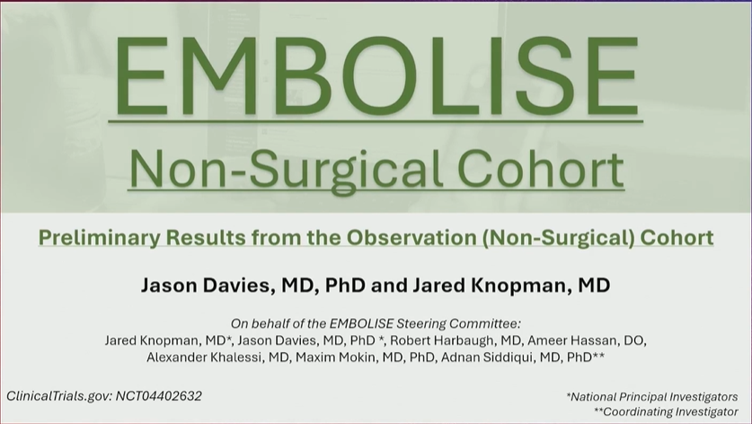

Slide 23
Emerging evidence
Acute ischemic stroke intervention – new ways to cure stroke!
  Intravenous thrombolysis
  Mechanical thrombectomy
Secondary stroke prevention – new ways to prevent another stroke!
Hemorrhagic stroke intervention
Neuroprotection

Slide 24
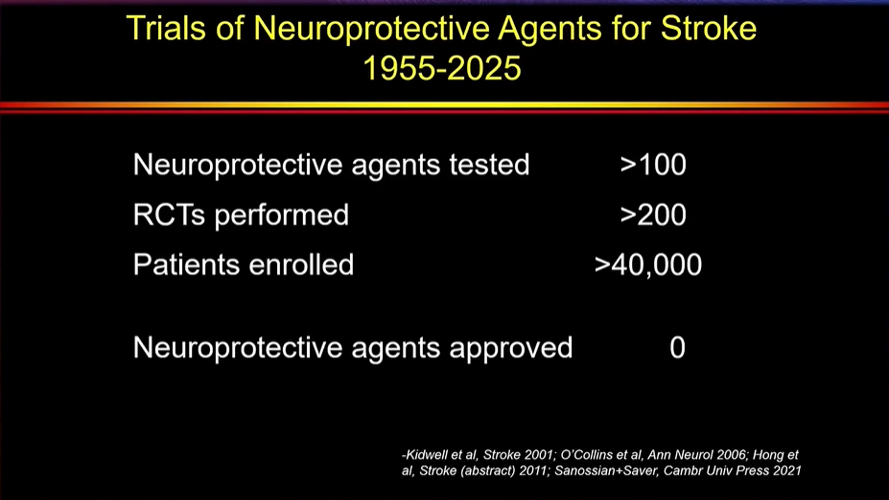

Slide 25
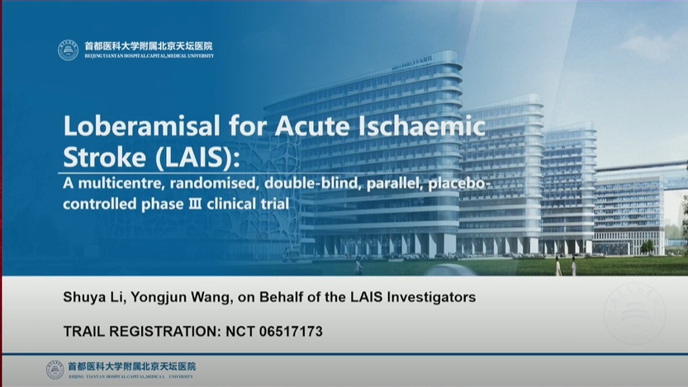

Slide 26
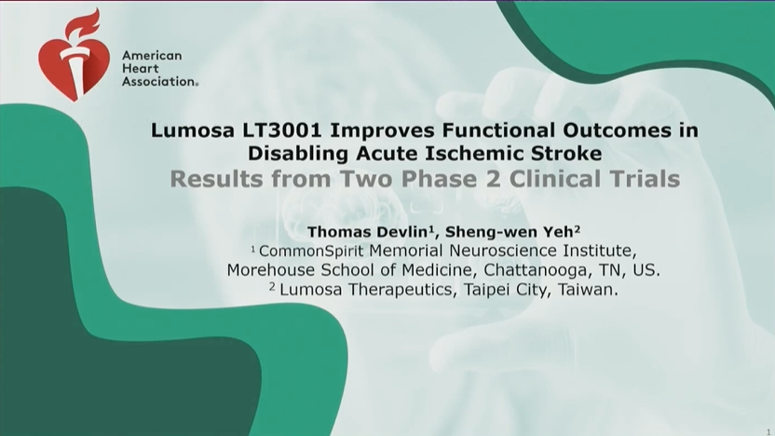

Slide 27
Neuroprotection making a comeback
LAIS trial (neuroprotective)
  Loberamisal give within 48 hours of stroke improves excellent outcome vs placebo
LT3001 trial (thrombolytic and neuroprotective)
  Odaltroltide given within 24 hours of stroke onset
  Safe, improves outcome, no increase bleeding

