Slide 1
Extended TNK window
For Acute ischemic Stroke
Practice Advisory: RSTAC
Gene Latorre, MD, MPH
June 2026

Slide 2
Last Known Well 0-4.5hrs
2026 AHA guideline: Class 1 recommendation (clear benefit)
  Inclusion criteria:
    LKW 0-4.5hrs
    DISABLING and PERSISTENT stroke symptoms
    CT brain without hemorrhage
    No exclusion criteria (Hx ICH, full dose anticoagulation use, etc)
  IV TNK 0.25mg/kg IV bolus STAT

Slide 3
Last Known Well 0-4.5hrs
2026 AHA guideline: Class 1 recommendation (clear benefit)
  IV TNK 0.25mg/kg IV bolus STAT
  If CTA shows LVO, proceed with mechanical thrombectomy STAT

Slide 4
Last Known Well 0-4.5hrs
2026 AHA guideline:
  Patient with NON-disabling symptoms
  IV TNK not recommended (Class 3: No benefit)
  Use DOAC instead (ASA 325mg now then 81mg daily, Clopidogrel 300mg now then 75mg daily for 21 to 90 days)
    Typically non-disabling symptoms include
      Isolated numbness/hemisensory loss
      Isolated facial droop and/or arm/leg drift
      Isolated mild aphasia (word finding dififculty, still able to communicate)
      Mild ataxia, still able to ambulate

Slide 5
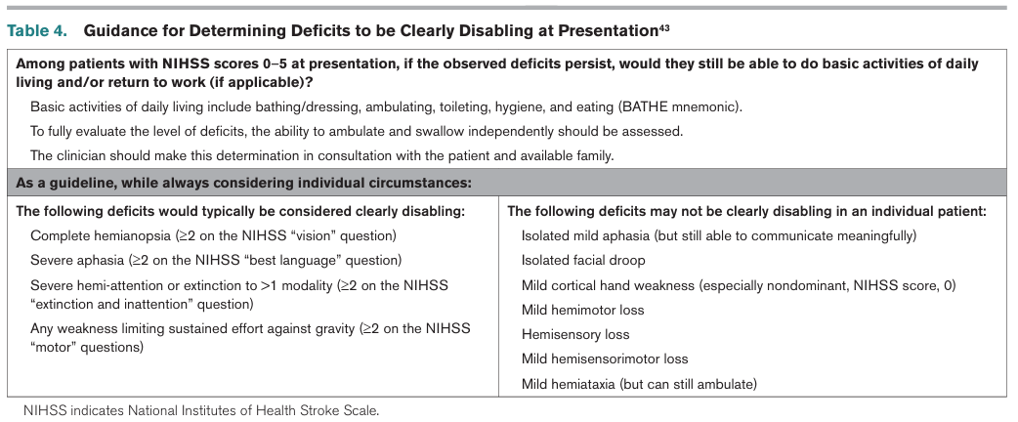
Last Known Well 0-4.5hrs
2026 AHA guideline: IV TNK Class 3 (No benefit)
Prabhakaran et al. 2026 AHA Acute stroke guideline. Stroke 2026;57:e00–e00. DOI: 10.1161/STR.0000000000000513

Slide 6
Last Known Well 4.5-9hr
2026 AHA guideline: Class 2a recommendation (some benefit)
  Inclusion criteria:
    LKW 4.5-9 hrs
    DISABLING and PERSISTENT stroke symptoms (NIHSS 6 or higher)
    CT brain without hemorrhage, no hypodensity
    No LVO on CTA
    No exclusion criteria (Hx ICH, full dose anticoagulation use, etc)
  Imaging criteria (MRI or CTP):
    MRI: DWI/FLAIR mismatch, with DWI volume less than 1/3 MCA territory
    CTP: small core with salvageable penumbra
  IV TNK 0.25mg/kg STAT

Slide 7
Last Known Well 9-24 hr
2026 AHA guideline: Class 2b recommendation (unclear benefit)
  Inclusion criteria:
    LKW 9-24 hrs
    DISABLING and PERSISTENT stroke symptoms (NIHSS 6 or higher)
    CT brain without hemorrhage, no hypodensity
    No LVO on CTA
    No exclusion criteria (Hx ICH, full dose anticoagulation use, etc)
  Imaging criteria (MRI or CTP):
    MRI: DWI/FLAIR mismatch, with DWI volume less than 1/3 MCA territory
    CTP: small core with salvageable penumbra
  IV TNK unclear benefit

Slide 8
2026 AIS Updated Recommendation Summary
TIME WINDOW | CLINICAL | RECOMMENDATION
0-4.5 hours from last known well | Disabling deficit | IV TNK 0.25mg/kg STAT
 | Non-disabling deficit | Dual antiplatelet and NO IV TNK Aspirin 325mg now then 81mg daily Plavix 300mg now then 75mg daily (21 days)
 | Large Vessel Occlusion | IV TNK STAT Mechanical Thrombectomy STAT
4.5-9 hours | Disabling deficit and CT without hypodensity | Stat CT Perfusion or limited MRI sequence (DWI, FLAIR) If DWI/FLAIR mismatch or positive CTP, consider IVTNK
9-24 hours | IVTNK benefit is uncertain

Slide 9
Key logistical info:
Px presenting with LKW 4.5-9hr with disabling symptoms
If you HAVE capacity to do either
  CT perfusion imaging
  Limited MRI brain imaging (DWI, FLAIR, ADC, SWI sequence)
  Action plan:
    Confirm absence of exclusion criteria for TNK (taking DOAC, etc)
    Proceed with imaging STAT and push to Upstate PACS
    Call Upstate Transfer Center to be connected to Stroke Attending for discussion on whether TNK may be appropriate (not appropriate for Telestroke consult)

Slide 10
Key logistical info:
Px presenting with LKW 4.5-9hr with disabling symptoms
If you DO NOT HAVE capacity to do either
  CT perfusion imaging
  Limited MRI brain imaging (DWI, FLAIR, ADC, SWI sequence)
  Action plan:
    Call Upstate Transfer Center to be connected to Stroke Attending for discussion on whether patient may be potential TNK candidate for expedited transfer for additional imaging in the ED (not appropriate for Telestroke consult)

Slide 11
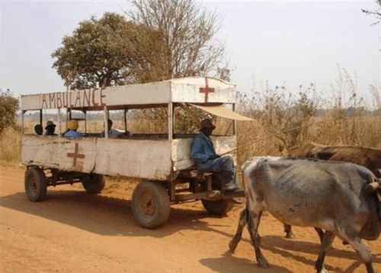
THANK YOU!

