Slide 1
Toxicology Visual Stimuli Conference
Cory Howard, MD
Vincent Calleo, MD

Slide 2
Objectives
To review significant events that have potential scientific/toxicologic explanation
To generate discussion regarding toxicologic pathophysiology and treatment.

Slide 3
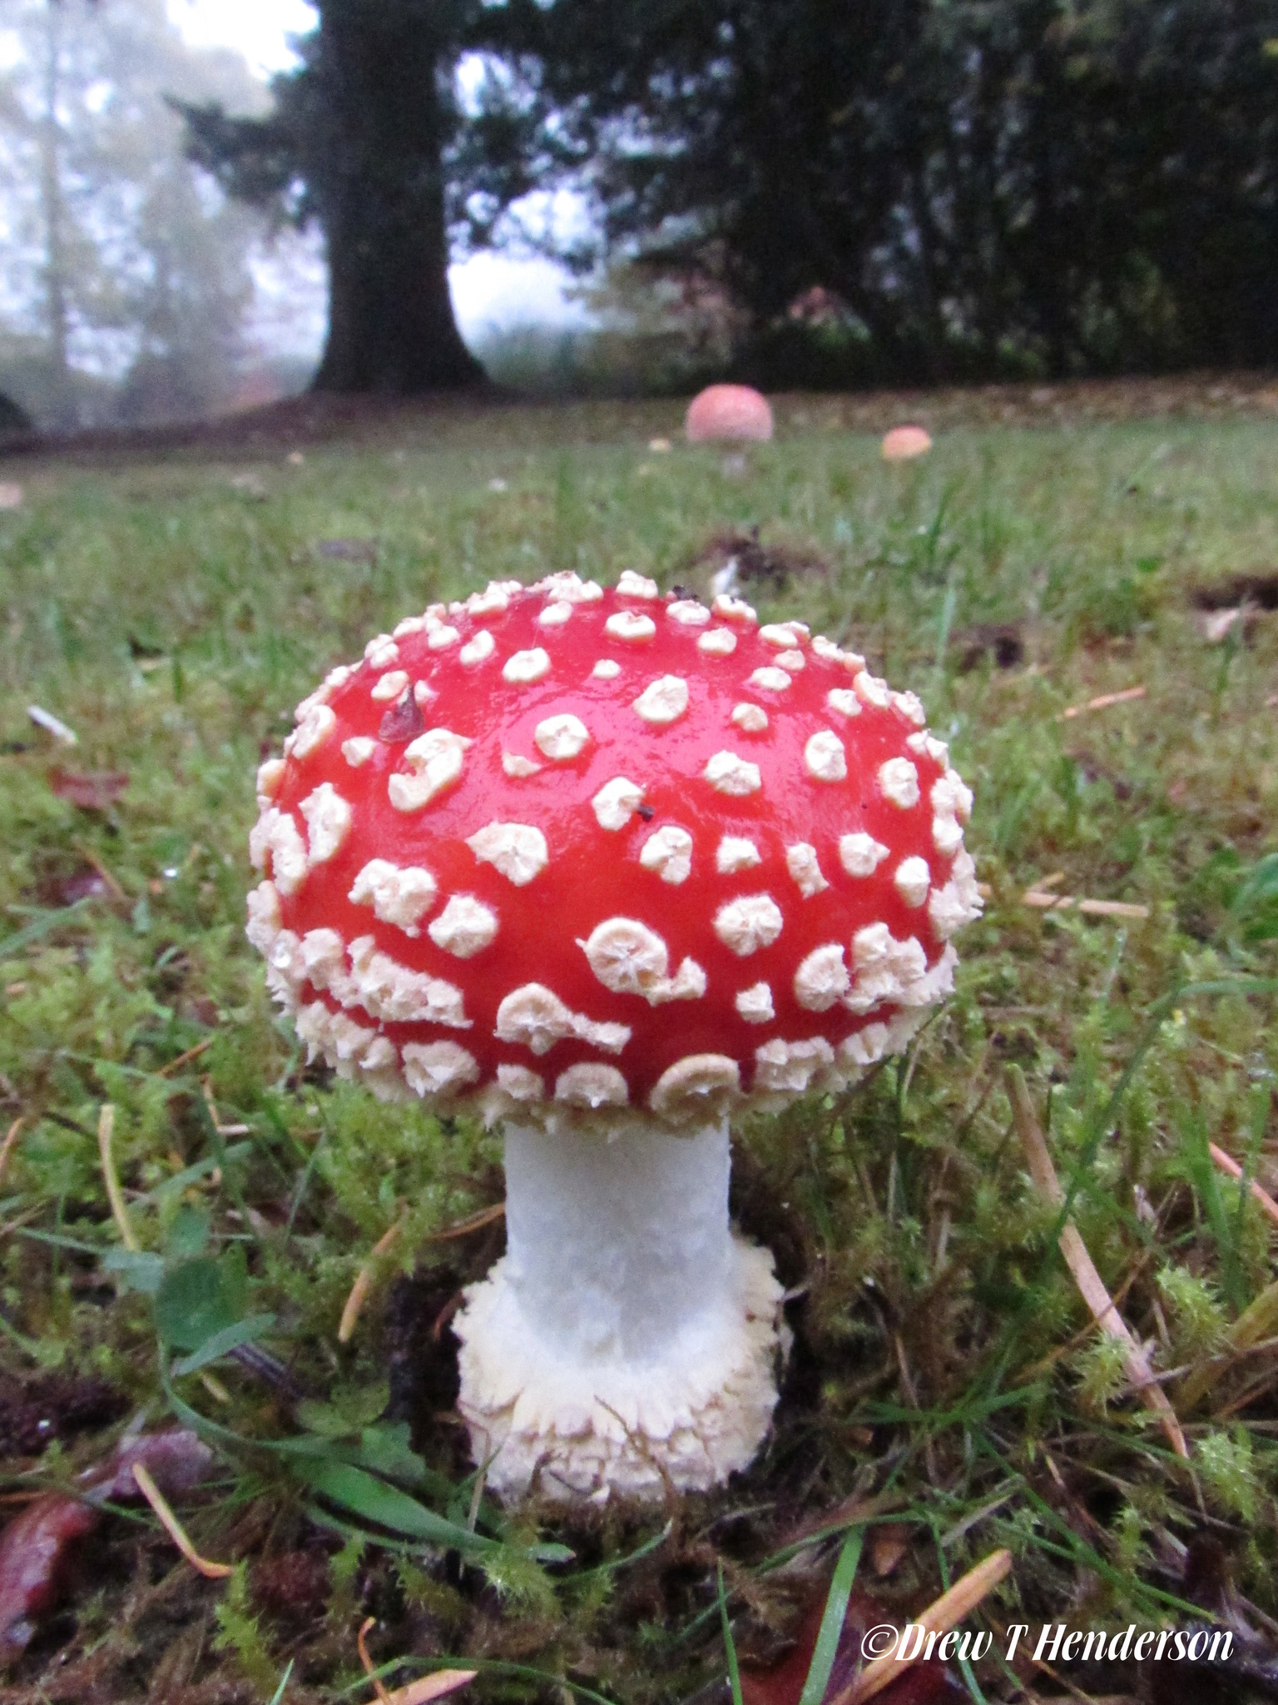
Iconic Video game culture mushroom.
This video game power-up is was based from this real life mushroom.
What is this? Discuss the mechanism, and toxicity

Slide 4
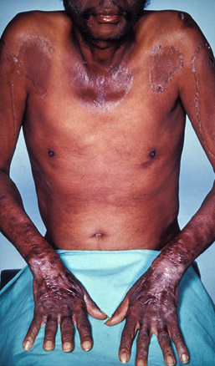
What vitamin deficiency has vampirism
been attributable to in recent literature?
Describe the deficiency? What about acute toxicity of this vitamin?

Slide 5
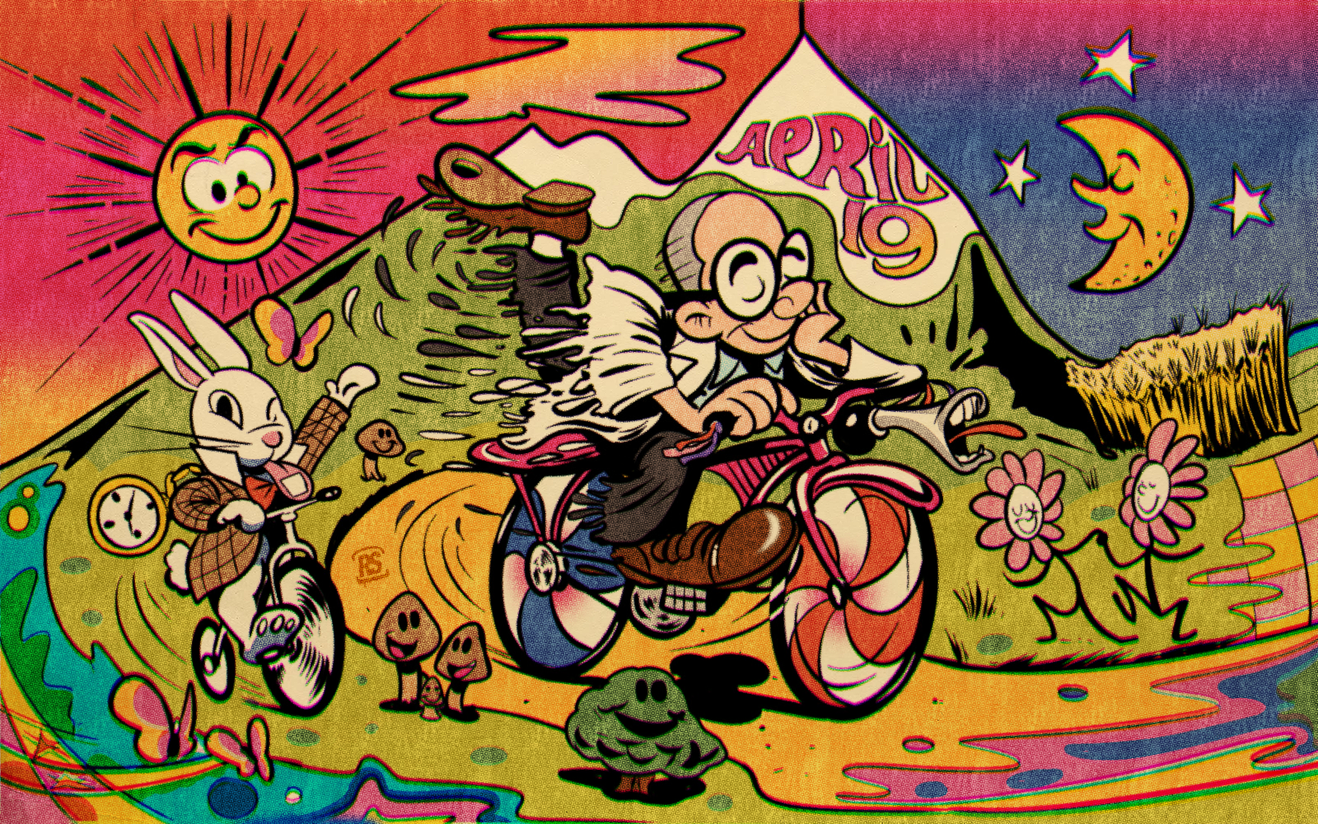
What is Bicycle Day ?
What is the substance that was experienced? Describe the pathophysiology of what could be seen in overdose.

Slide 6
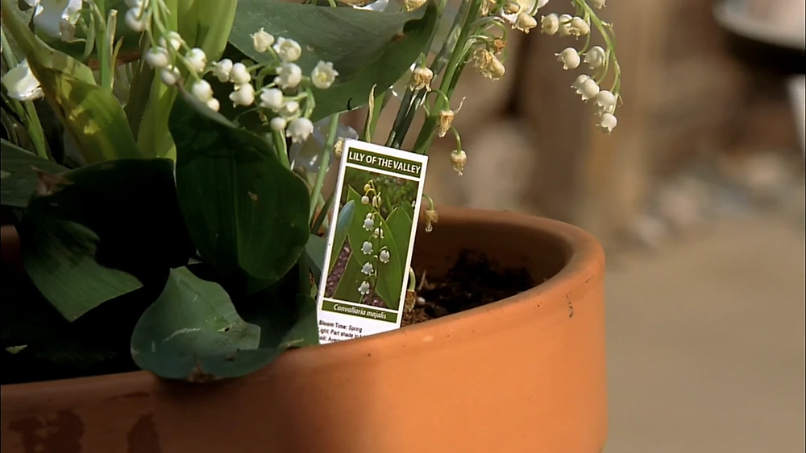
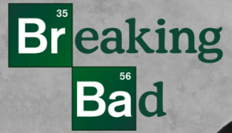
Explain the toxicity associated with ingestion of this plant. During this TV series the symptoms were confused for ricin poisoning.
What is the antidote if there is one?

Slide 7
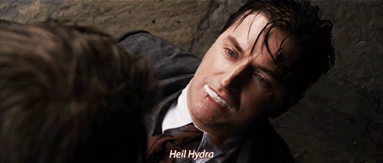
What was the knockout toxin used by this hydra SPY agent?
What is the mechanism of toxicity?
What are antidotes? Name a few other knockout toxins?

