Slide 1
Visual Stimuli 11/10/22

Slide 2
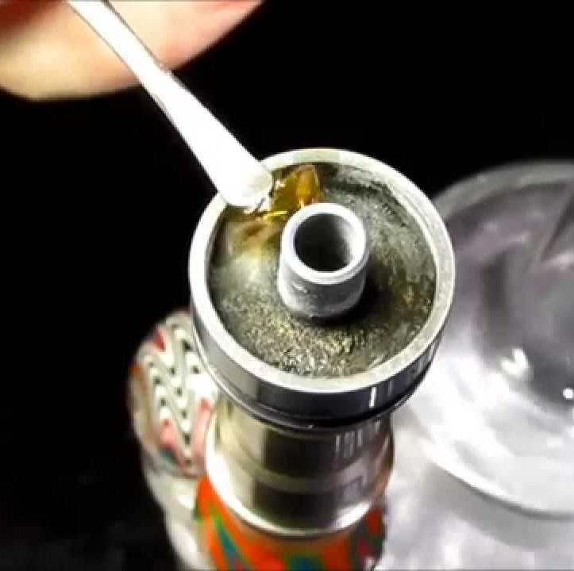
What is this person smoking?
How do they produce it?
For the original substance, summarize its legal history
Tell us about a recent legal change in 2018
How does this drug work?

Slide 3
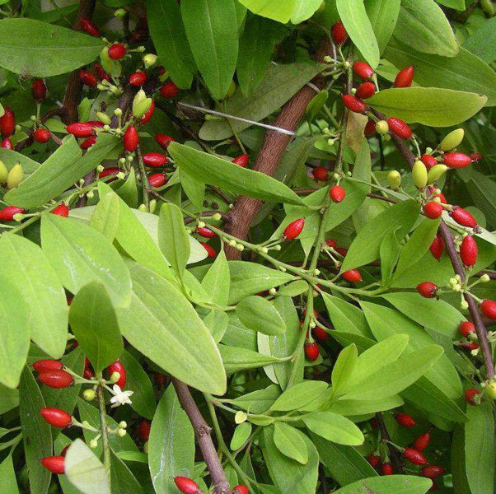
What plant is this?
Tell us a little about its legal history
In one form of this drug, ”free-based”, a unique metabolite is produced. What is it?
How does the drug this plant produces work?

Slide 4
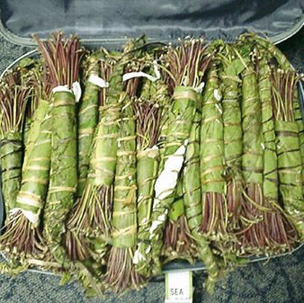
What plant is this?
What drug does it contain?
How do these drugs as a general class work?
A synthetic version of the active substance in this plant produced basal ganglia toxicity due to one of the ingredients in production. What was the drug and what was the contaminant?

Slide 5
What plant is this?
What drug is produced from it?
What synthetic forms of this drug cause seizures?
There are many synthetic versions of this drug. What was the contaminant implicated in outbreaks of drug-induced parkinsonism?

Slide 6
You have noticed a theme so far. What is the association between this material and another substance similar to the others in this powerpoint?
What is the metabolite of the compound in question
Name a mushroom with a similar effect
Name the specific cephalosporin side chain with a similar effect

Slide 7
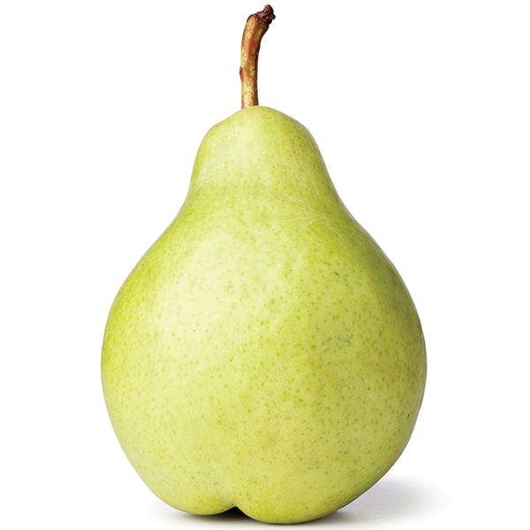
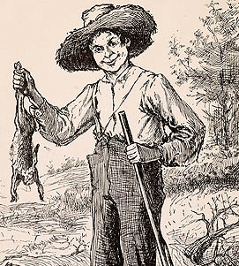
Another hard one. When consumed with a popular drug of abuse, this drug works synergistically
What is the metabolism of the drug of abuse and the drug referenced by these pictures?
What is unique about it radiographically?

