Slide 1
Visual Cases – Tox Movies for the holidays

Slide 2


Slide 3
What toxin is possibly associated with this movie?
What is the mechanism of the toxin?
Describe the original most well documented outbreak (hint: in Canada)
Describe steps that have been taken to prevent outbreaks in the future

Slide 4


Slide 5
What was the factory making?
What gas was released and why?
What is the toxicity of the gas?
Tell us a bit about the history of this event (events before/after)

Slide 6
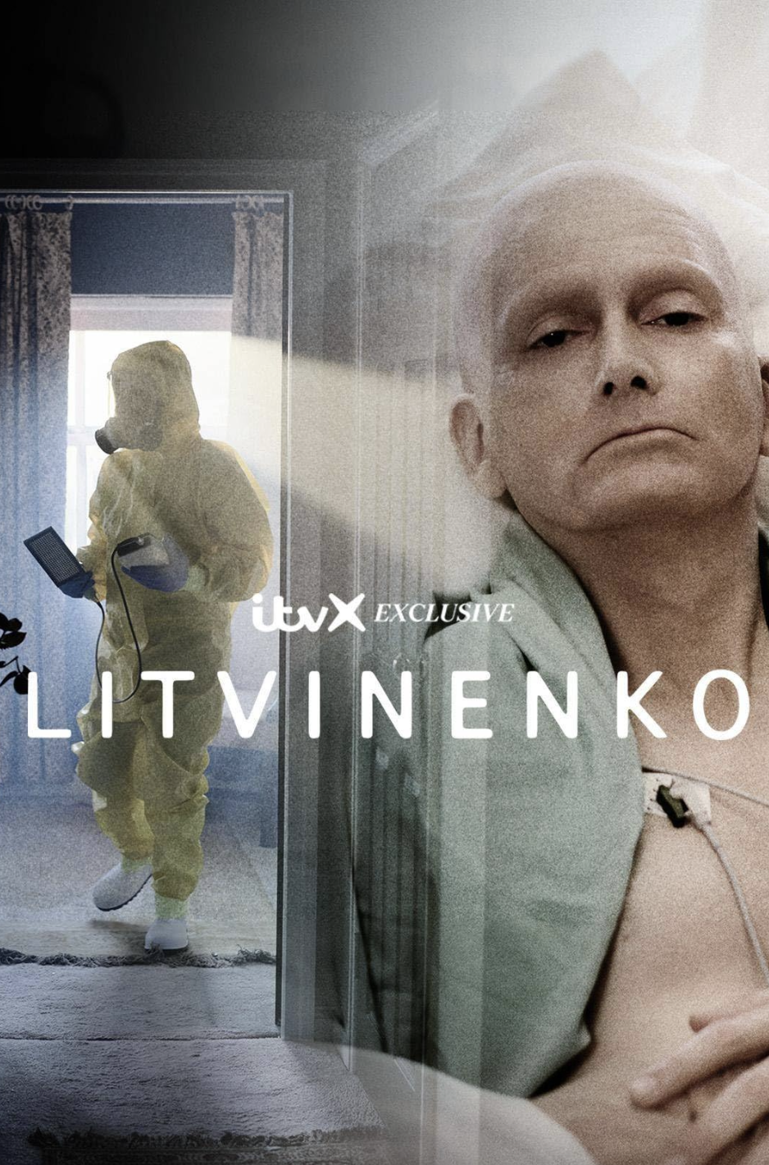

Slide 7
What was used to kill this man?
What is the mechanism?
What are potential treatments?
Why was this person murdered and by who?
Tell us about how the murder occurred (where, in what, etc)?

Slide 8


Slide 9
What toxin was involved in this disaster?
What is the toxicity?
What other forms of this toxin exist? Describe the differences in toxicity (elemental, inorganic, organic)
Tell us a bit about the disaster (before, after, ramifications?)
Can you tell us about another disaster with the toxin described in this movie?

Slide 10


Slide 11
What is this episode describing?
What is the substance causing the toxicity?
What is the toxicity?
Can you tell us about another outbreak of this toxicity?

Slide 12
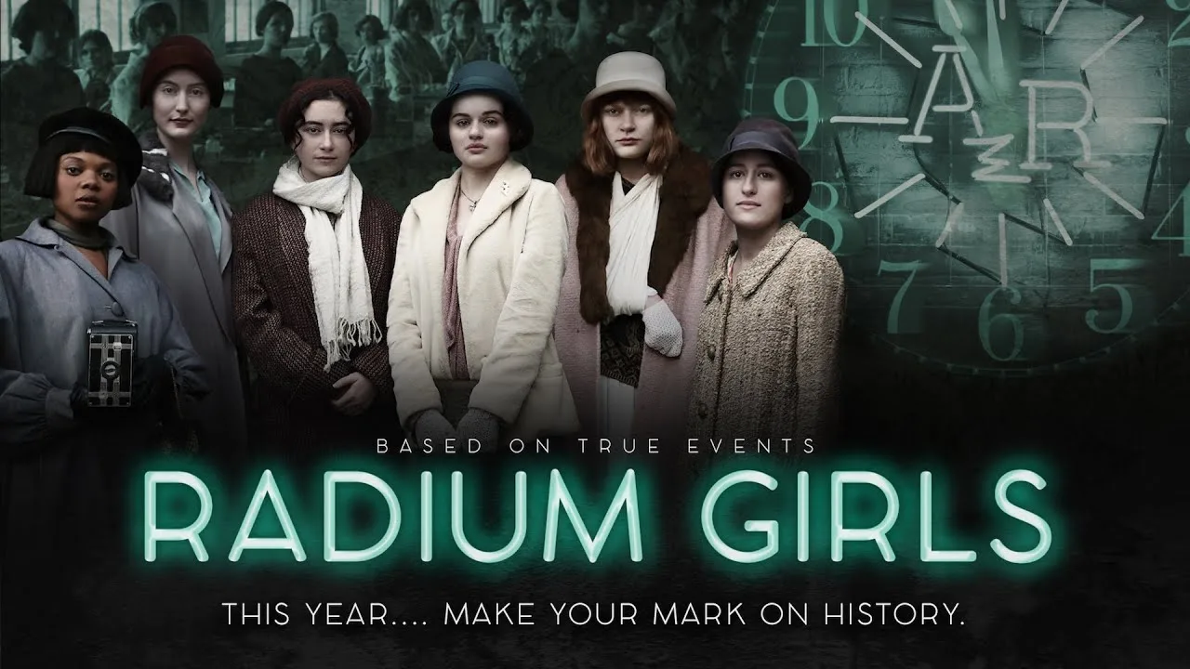

Slide 13
What is the toxicity of radium?
What other product was marketed as a catch-all cure containing radium?
Tell us about the history described in this movie

