Slide 1
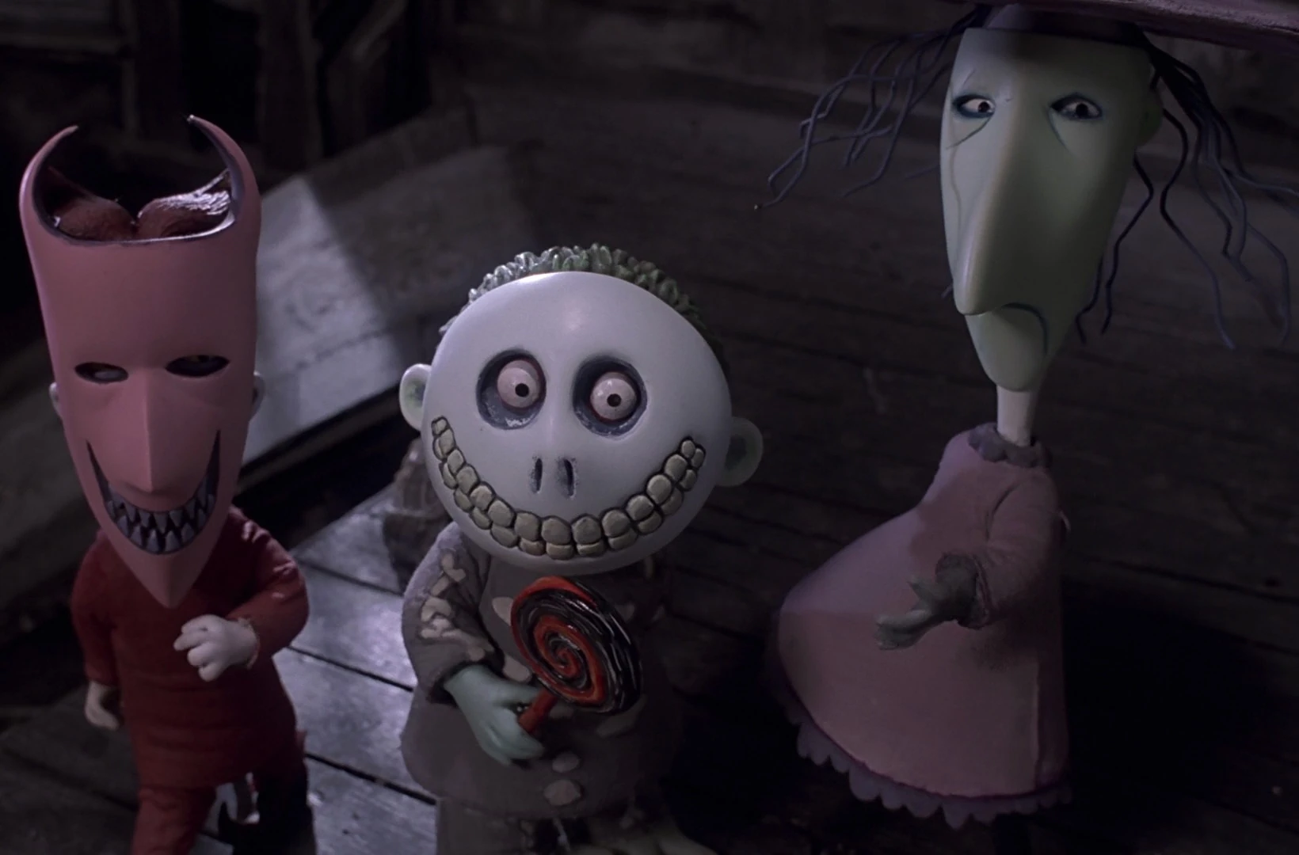
SPOOKY CASES CASE CONFERENCE 10/31/2024 Conor Young MD Medical toxicology Fellow

Slide 2
Trigger Warning: Arachnids and (Medical) Gore

Slide 3
For each case, please assess:
What is the toxin? Mechanism?
History and physical exam?
Specific treatments? Mechanisms? Complications?
Disposition? Home vs. Hospital? Monitoring period?

Slide 4
Case 1: Spider Bite
An otherwise healthy 32-year-old female was bitten by a spider 1 hour ago.
Now complaining of pain all over, rigid abdomen, red mark on skin
VS: BP 98/50, HR 124, RR 22, SPO2 98% RA, T 37.2 C

Slide 5
Case 2: “Tranq” wounds
38-year-old male with a history of injection drug use presents with depressed mental status and these skin findings.
He was given IN naloxone by a bystander without effect
VS: BP 115/70, HR 62, SPO2 91% RA, RR 10, T 36.8 C

Slide 6
Case 3: Costume Party
2-year-old girl presents from her home with concern for exposure to cocaine.
She presents with mental status depression, miotic pupils.
VS: BP 78/50, HR 92, RR 7, SPO2 88% RA

