Slide 1
Toxicology Case Conference
August 28,2025

Slide 2
Toxicology Captivating the Screen
Toxicology in Pop Culture has always been popular
References span in TV shows, movies and song lyrics
Here are some examples of toxicology references in pop culture
  What is the toxin being referenced?
  How does this toxin work mechanistically?
  What are common signs and symptoms?
  What is the treatment?
  Was the toxin represented accurately in the show/music?

Slide 3
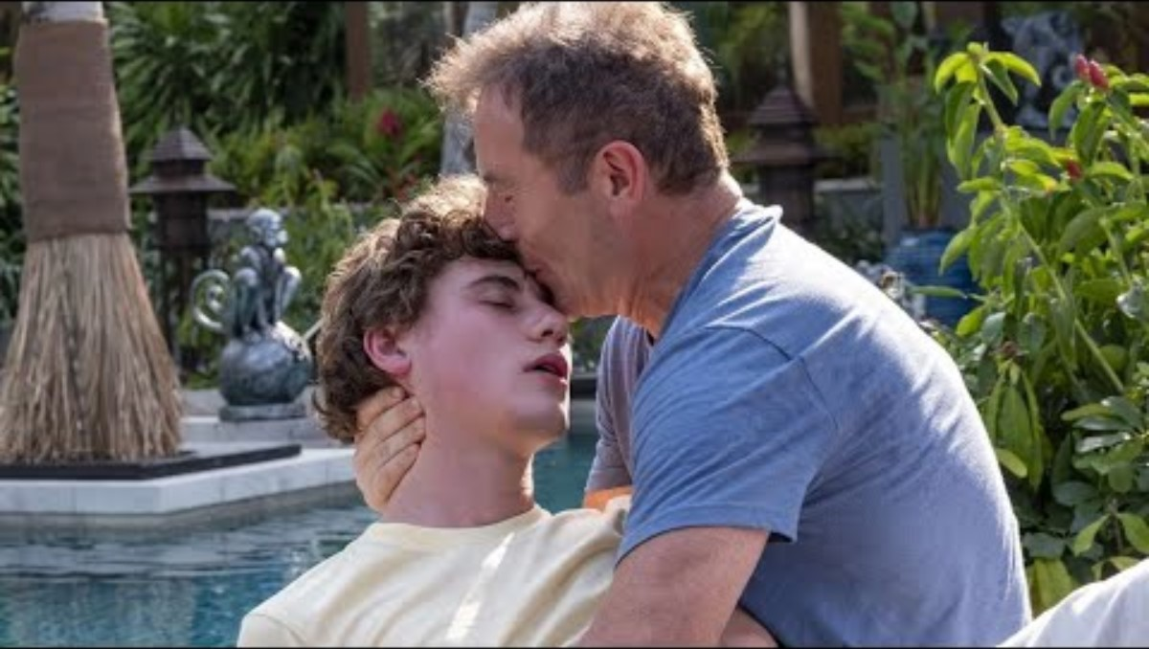

Slide 4
What is the toxin?
What is the mechanism?
What are treatment options?
Was this scene an accurate representation of the toxicity?

Slide 5
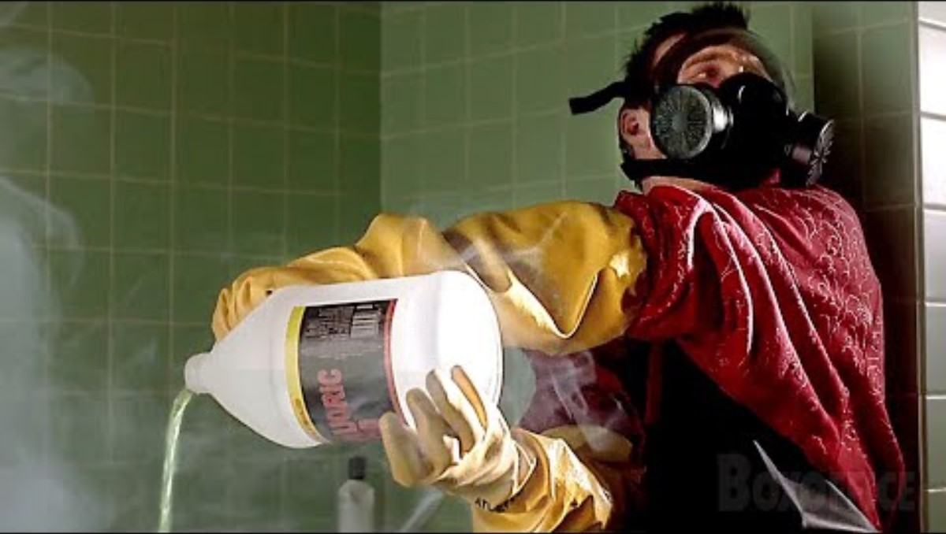

Slide 6
What is the toxin?
What is the mechanism?
What are treatment options?
Was this scene an accurate representation of the toxicity?

Slide 7
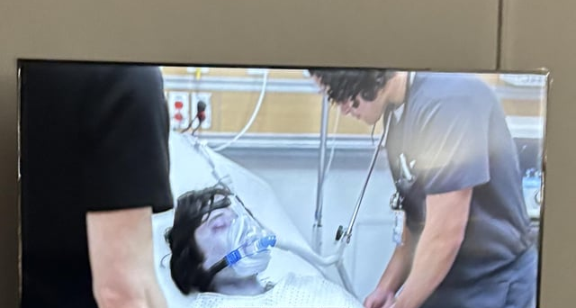
Scene from The Pitt
Teenager presents unresponsive and cyanotic

Slide 8
What is a differential in a patient with cyanosis?
What is the toxin in this scene?
What is the mechanism?
What are treatment options?
What clues exist to aid in the diagnosis?
Was this scene an accurate representation of the toxicity?

