Slide 1
Visual Stimuli 5/26/22

Slide 2
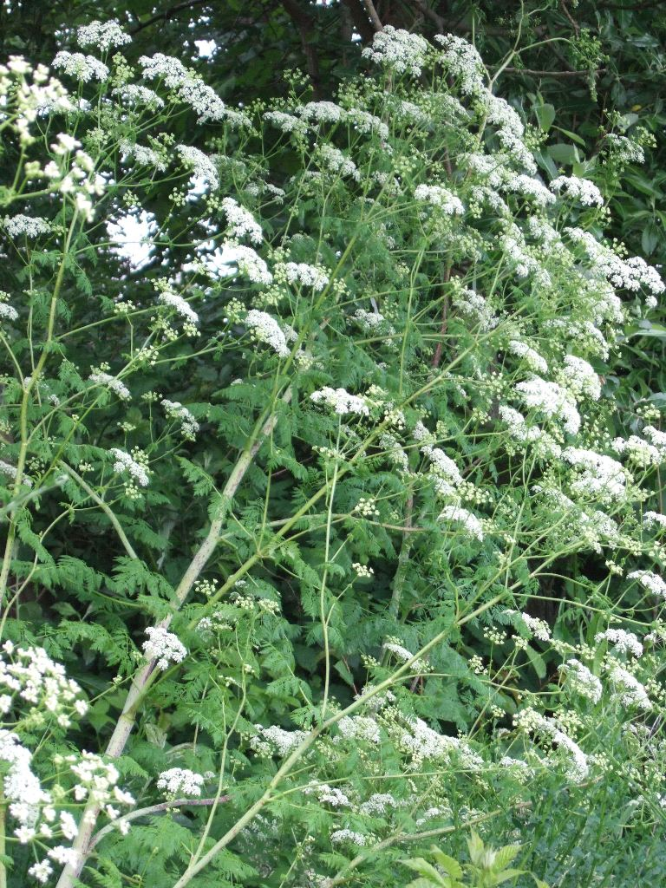
Bernie
What famous Greek philosopher was killed by this plant
What is the toxin
How does it work

Slide 3
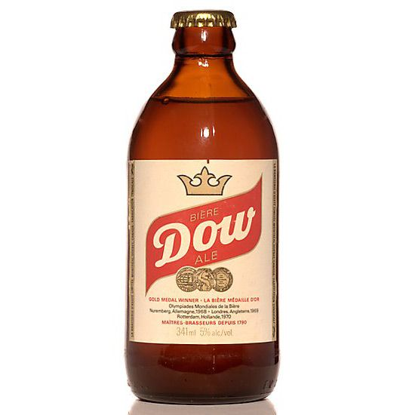
Jin
What is the additive in this product
What is a more recent source of iatrogenic poisoning from this substance
What are the effects of this substance

Slide 4
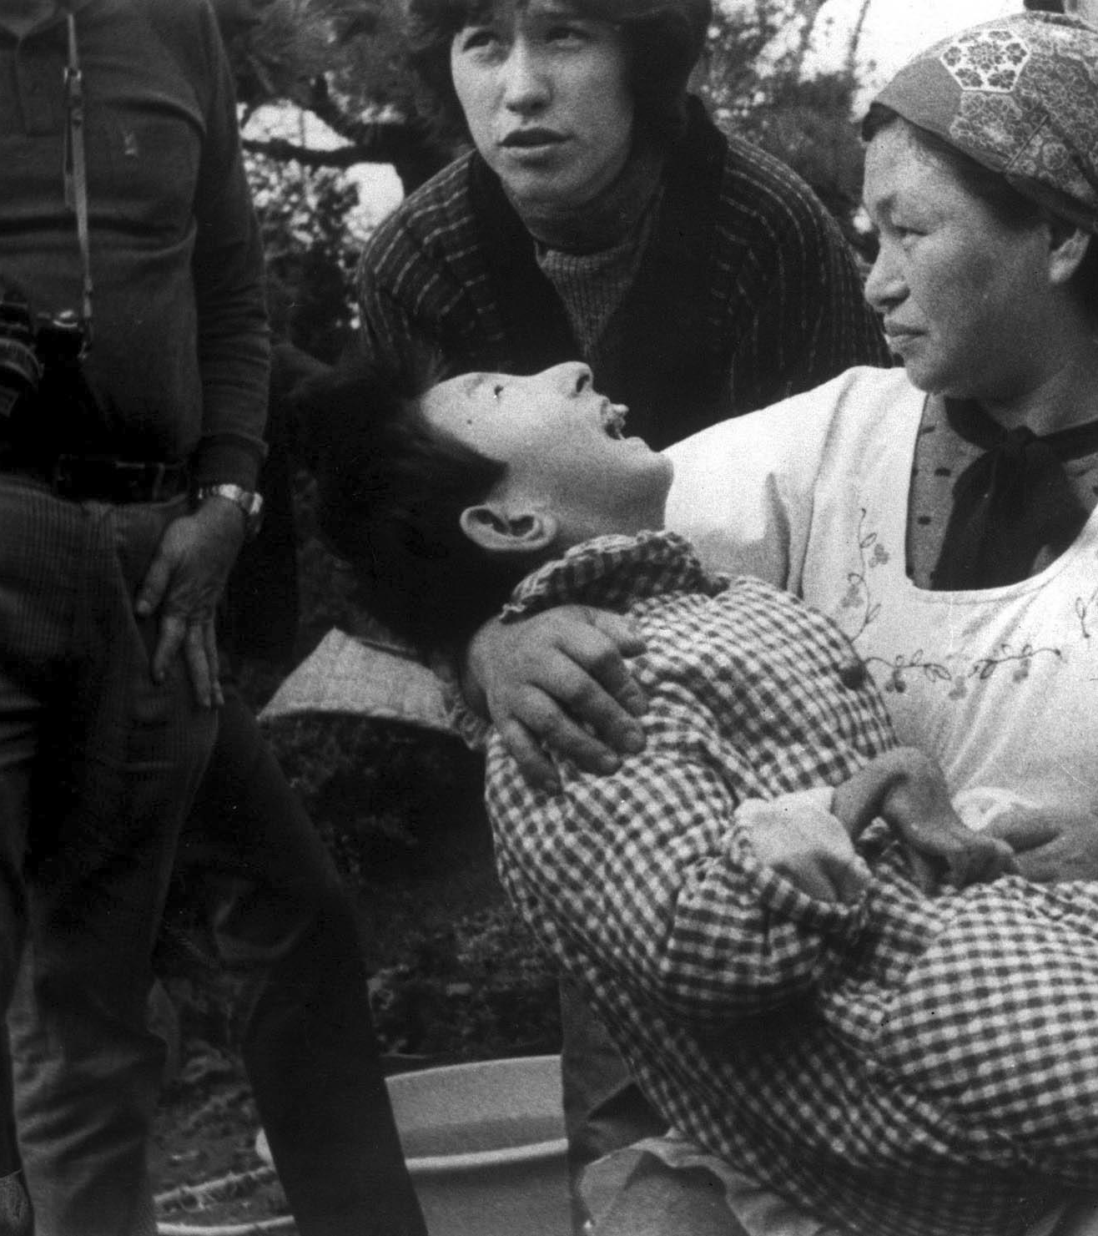
Tim
Where is this picture referring to?
What is the toxin?
What is another example of a large toxicity from this toxin?

Slide 5
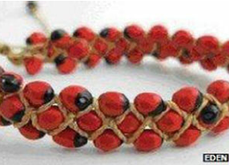
Kaitlyn
What are these seeds, classically used to make rosaries?
What is the toxicity?
What is another plant-based toxin that functions similarly

Slide 6
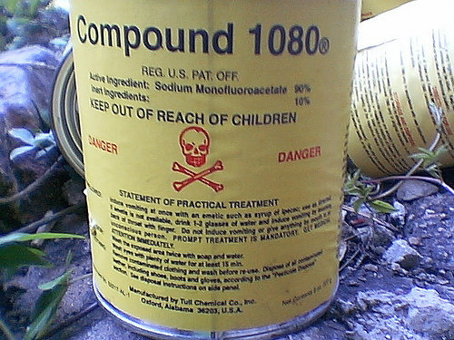
Neo
What is the mechanism of toxicity of this product
What is the antidote

Slide 7
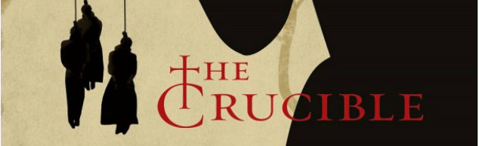
Audrey
What toxin is potentially associated with the event described in this play
Where does this toxin come from
What is the mechanism

