Slide 1
Visual Stimuli 1/11

Slide 2
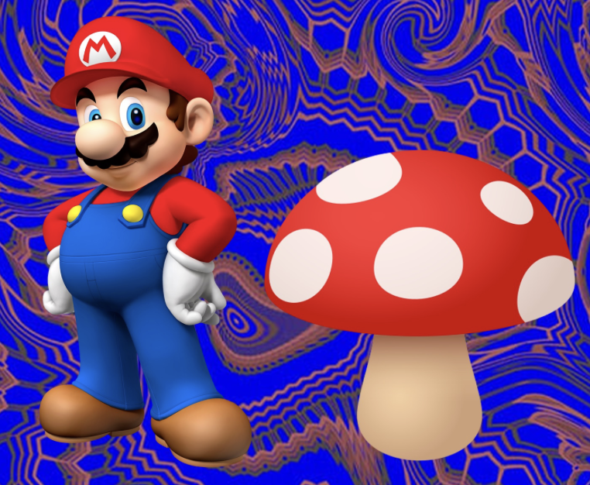
What mushroom does this look like?
What are the main toxins in that mushroom?
What is the different effect between kids and adults?

Slide 3
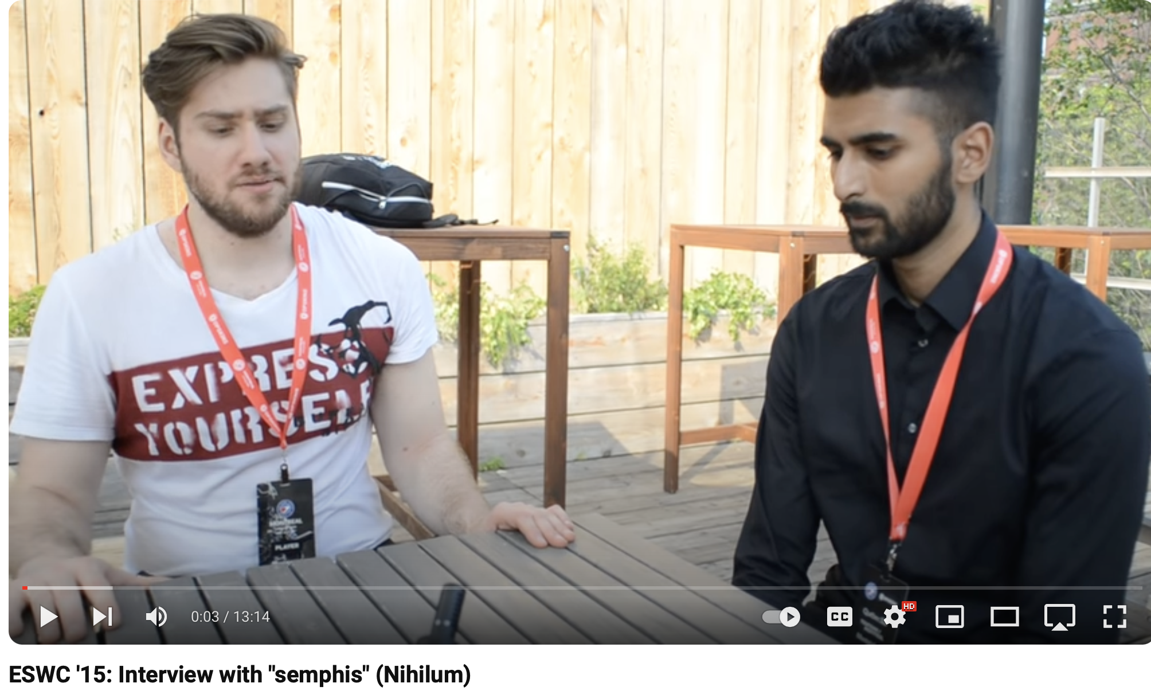
Who is this person?
What is the tox connection?
What other drugs might make sense for this?

Slide 4
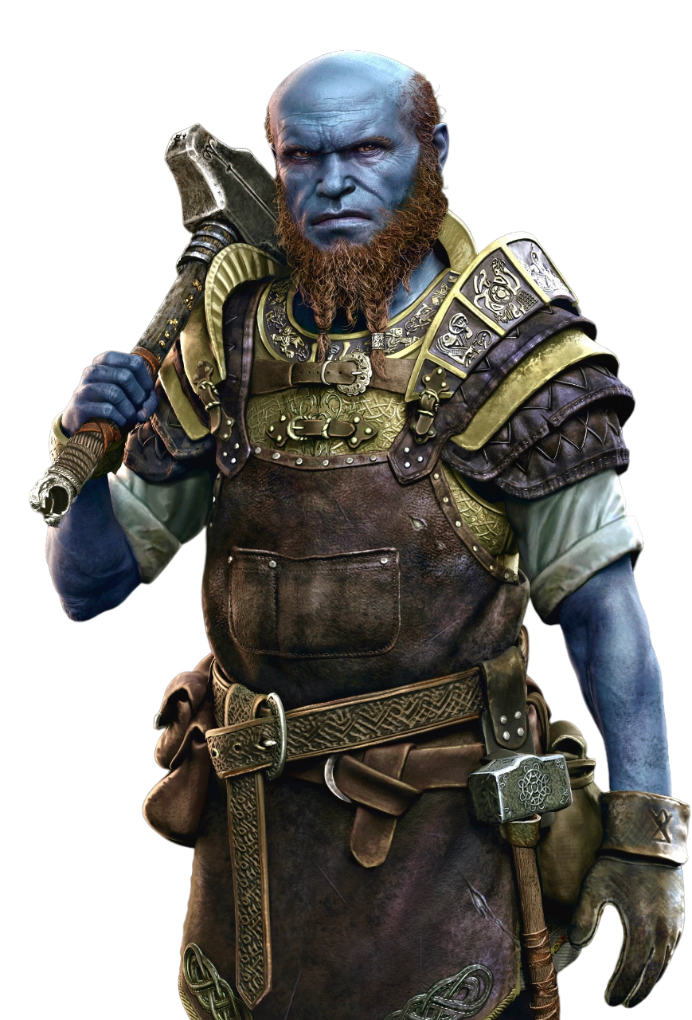

This character is a blacksmith in the God of War series.
How would you propose he developed his blue complexion?

Slide 5
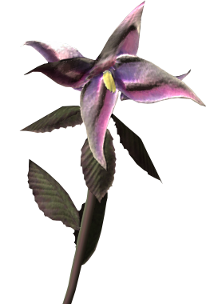
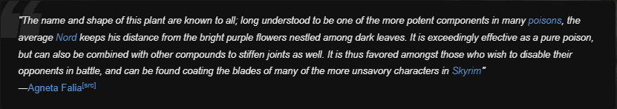
This plant is found in The Elder Scrolls: Skyrim and Oblivion and is used as an alchemical ingredient.
What plant is that and what is its toxicity.
Name some other plants that produce this toxidrome

