Slide 1
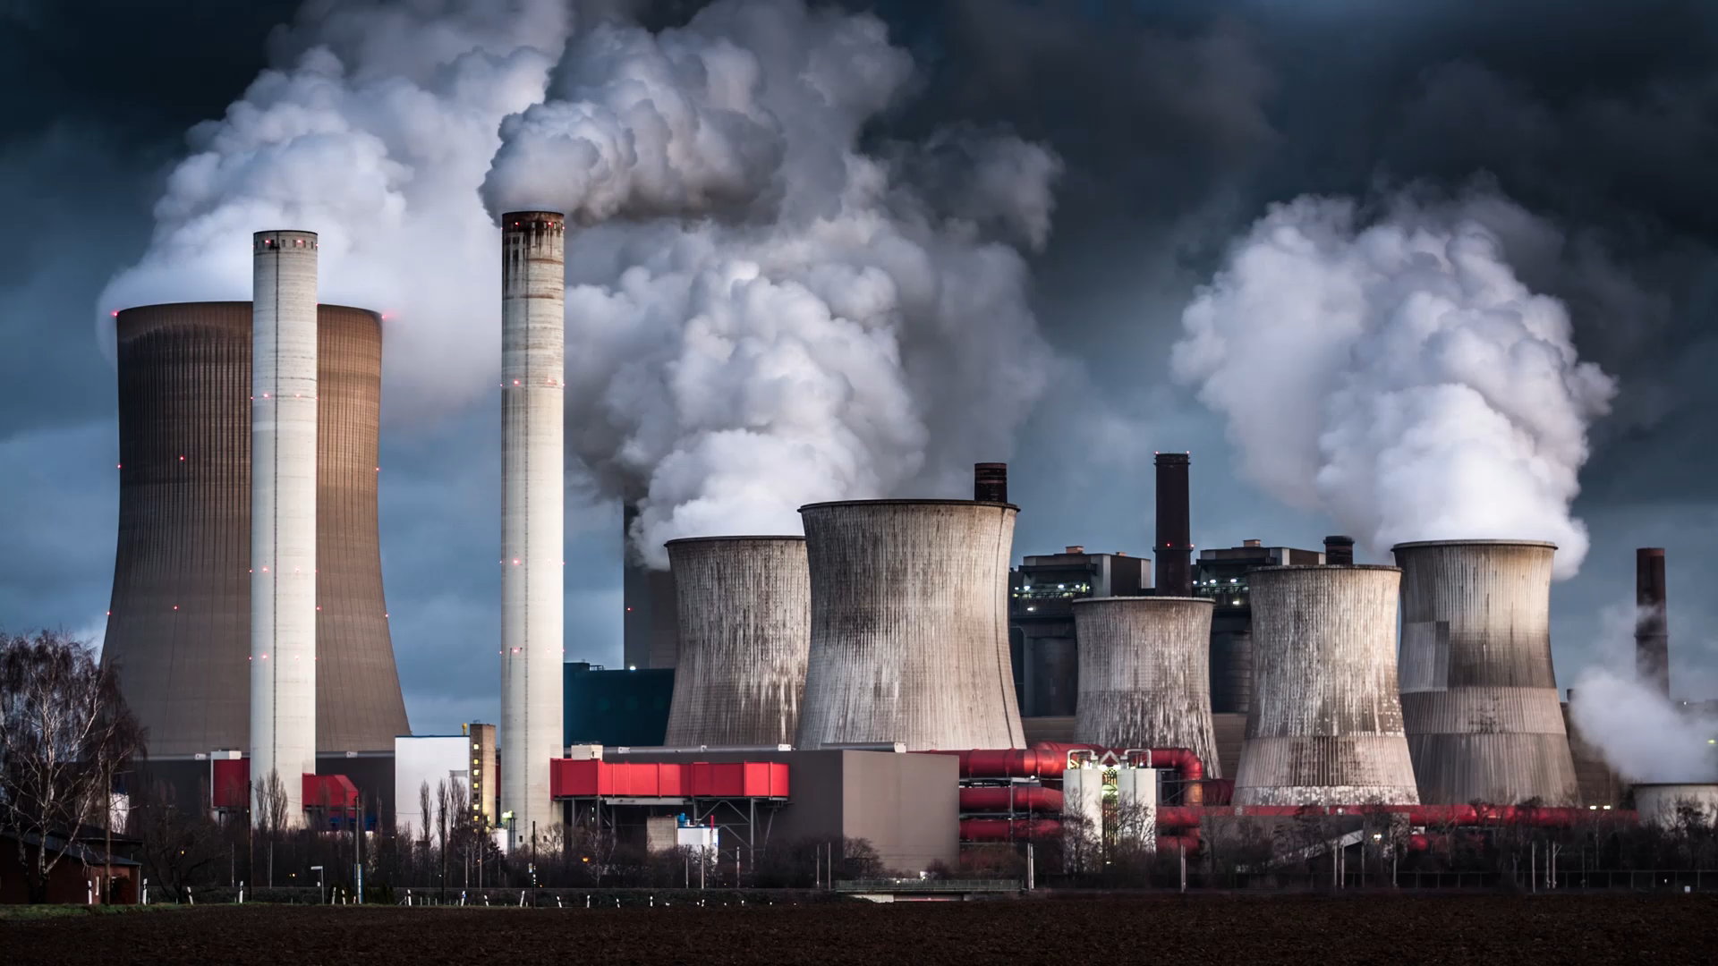
Famous Toxicology Cases
Alex Rogers MD
Mike Keenan MD

Slide 2
Here are some questions I want you to consider when reviewing these articles:
What was the toxin?
What is the mechanism of toxicity?
What effects are typically seen?
Are there any treatments?
Any noteworthy changes that came from these cases?

Slide 3

Kaitlyn Conley-The Murder of Mary Yoder
Local to CNY- July 22, 2015
https://www.syracuse.com/news/2017/05/kaitlyn_conley_trial_closing_arguments_prosecution.html
Notes:
What was the toxin?
What is the mechanism of toxicity?
What effects are typically seen?
Are there any treatments?
Any noteworthy changes that came from these cases?

Slide 4

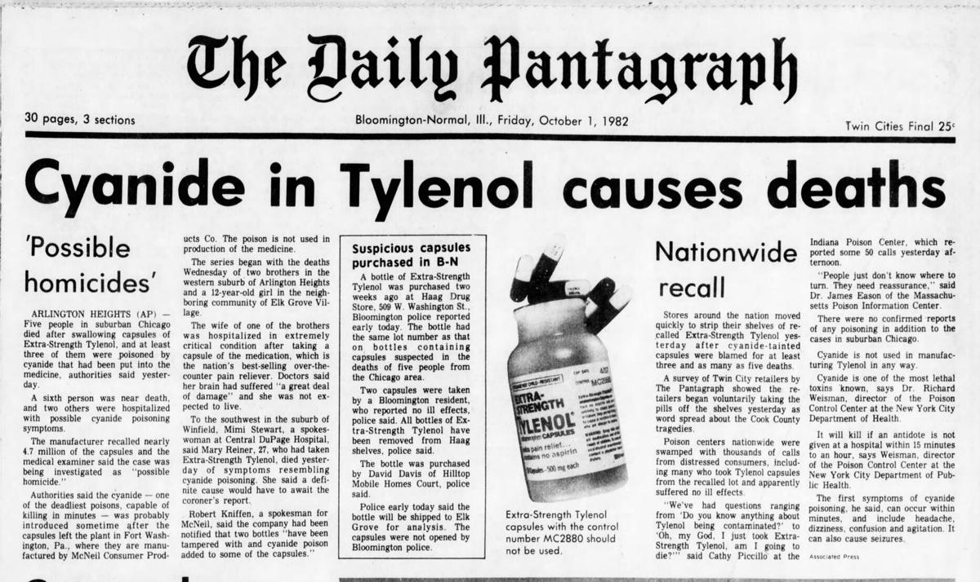
Chicago Tylenol Murders
October 1982
https://www.chicagohistory.org/tylenol-murders/
Two major laws were passed in response to these murders
Notes:
What was the toxin?
What is the mechanism of toxicity?
What effects are typically seen?
Are there any treatments?
Any noteworthy changes that came from these cases?

Slide 5
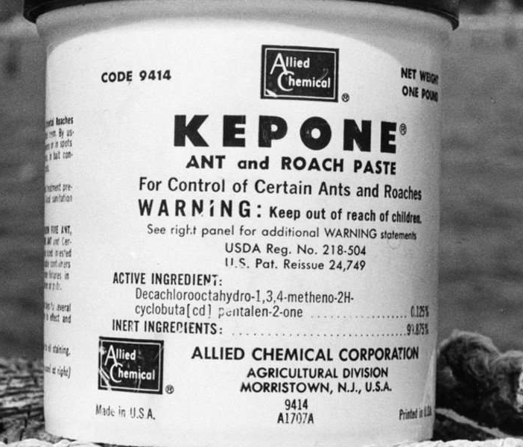
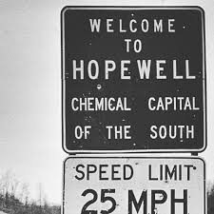
The Kepone Shakes
1975
https://richmondmagazine.com/news/kepone-disaster-pesticide/
Several laws and regulations stemmed from this disaster, please describe them
Notes:
What was the toxin?
What is the mechanism of toxicity?
What effects are typically seen?
Are there any treatments?
Any noteworthy changes that came from these cases?

Slide 6
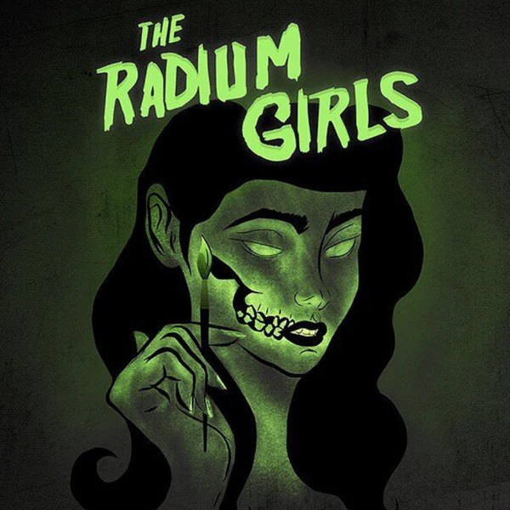
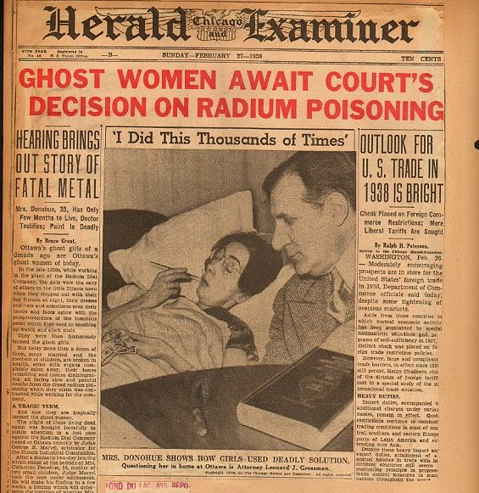
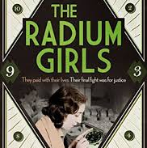

The Radium Girls
1910s-1920s
https://www.britannica.com/story/radium-girls-the-women-who-fought-for-their-lives-in-a-killer-workplace
Name some of the laws and regulations that improved in the workplace after these cases and the subsequent lawsuits
Notes:
What was the toxin?
What is the mechanism of toxicity?
What effects are typically seen?
Are there any treatments?
Any noteworthy changes that came from these cases?

