Slide 1

TOXICOLOGY IN THE

Slide 2
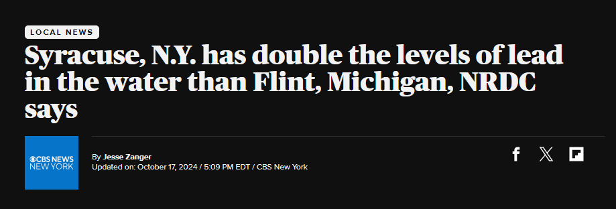
The Problem
https://www.cbsnews.com/newyork/news/syracuse-ny-lead-in-water/
Notes:
If anyone owns/rents a home, they likely got a letter in the mail about just this issue, stating that it was unclear if their pipes could potentially pose a threat to their health
The city claims that the lead levels were retested in all of the homes with positive findings and al of them except 2 passed without intervention

Slide 3

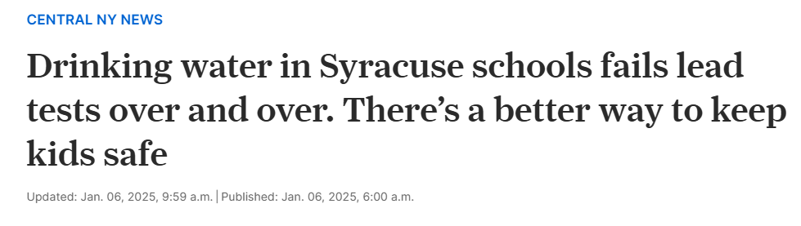
The Problem
https://www.syracuse.com/news/2025/01/drinking-water-in-syracuse-schools-fails-lead-tests-over-and-over-theres-a-better-way-to-keep-kids-safe.html
Notes:
If anyone owns/rents a home, they likely got a letter in the mail about just this issue, stating that it was unclear if their pipes could potentially pose a threat to their health
The city claims that the lead levels were retested in all of the homes with positive findings and al of them except 2 passed without intervention

Slide 4
Classic Journal Articles-Chelation (Double Click Article to Open)
Thruttle et. Al- Succimer Monotherapy
TLC Study

