Slide 1
Visual Stimuli 5/8/25 Disaster Edition

Slide 2
The pictures are hints. Use the pictures to identify the disaster and answer the questions
Some of the pictures are straight forward. Others are play on words to get to the answer

Slide 3

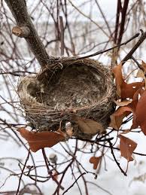
What toxin was involved in this disaster?
What is the result of exposure to this toxin?
What was the result of this disaster long term?

Slide 4
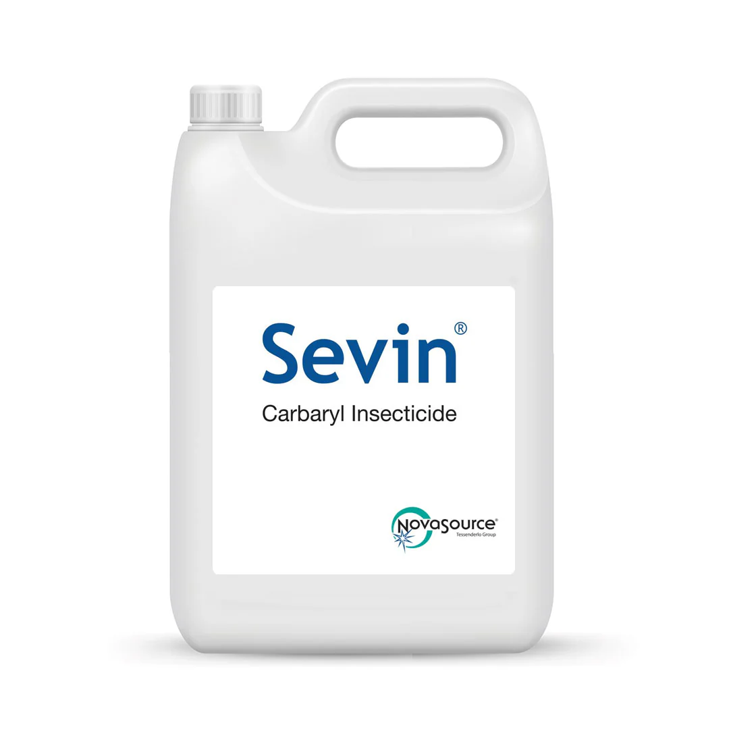
What was the exposure in this disaster?
What occurs with exposure to this substance?
Why did this disaster occur?

Slide 5
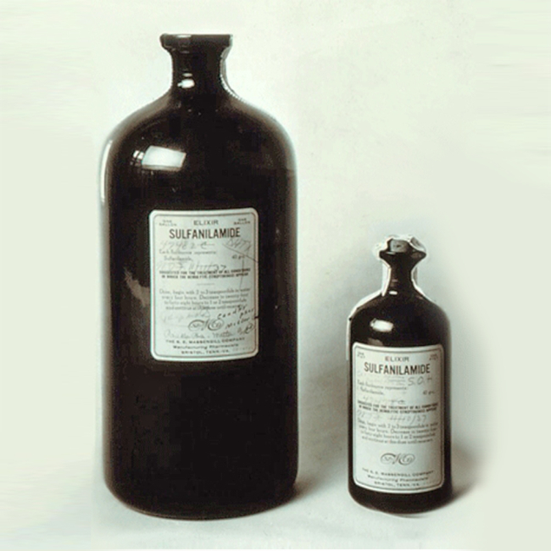
What was the toxin?
What occurs with this toxin?
What was the result of this disaster?

Slide 6

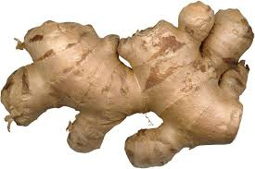
What is the toxin?
What occurs with exposure?
Why did the exposure occur?

Slide 7


What toxin is referenced?
What type of toxin is it?
What is it’s beneficial history?

