Slide 1

Upstate Golisano Children’s Hospital
Open Forum
January 29, 2026

Slide 2

Agenda
Welcome and Overview
Review UGCH Strategic Plan
Biobehavioral Health Unit Presentation
Announcements

Slide 3
UGCH Strategic Plan

Slide 4
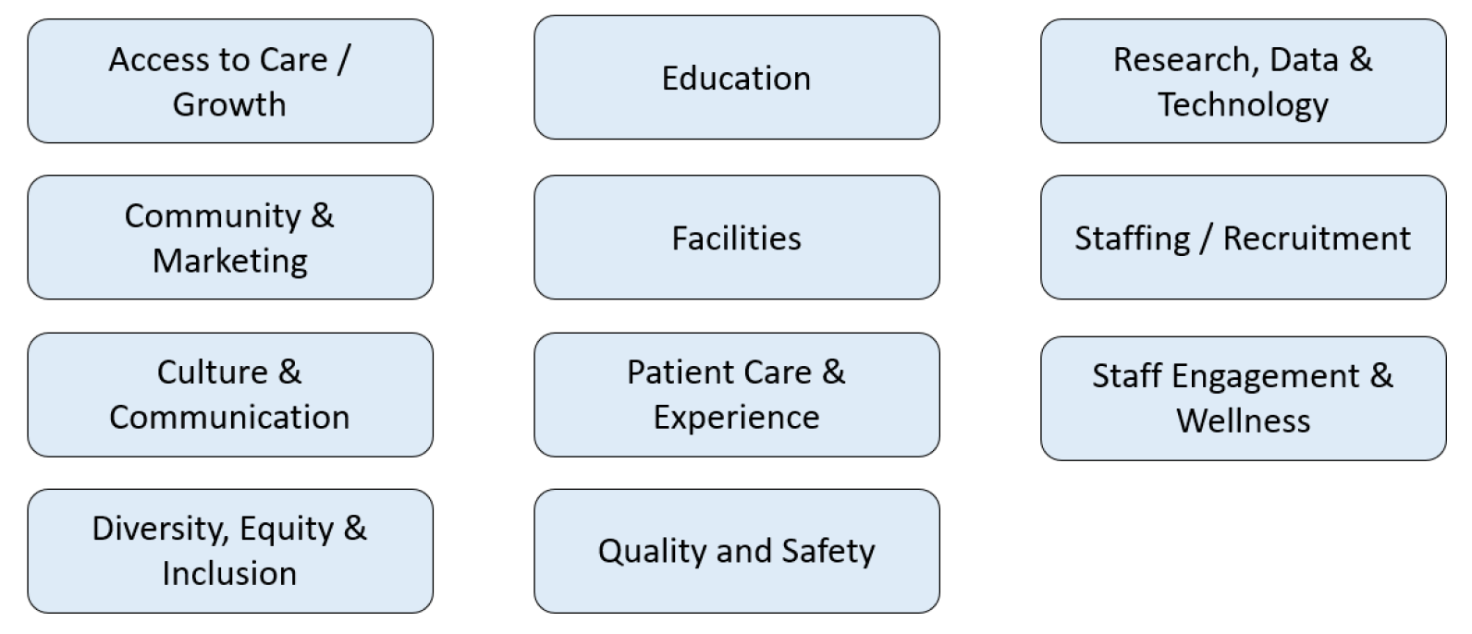
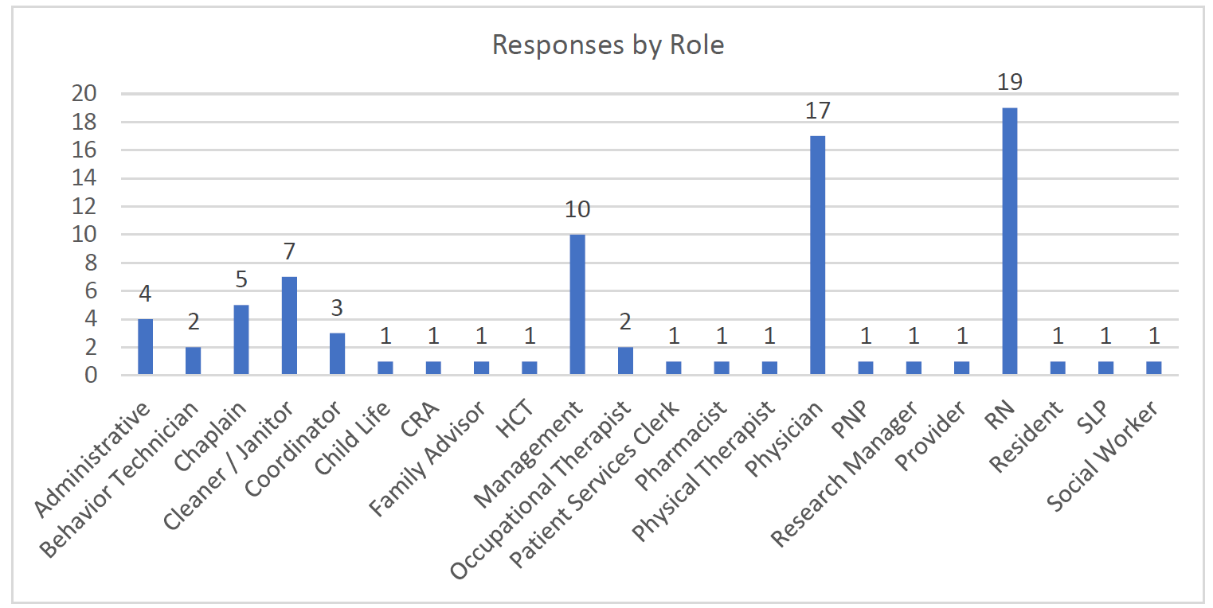
Background
Logistics
Staff survey conducted December 2024
85 responses from various departments and roles
Individual and group discussions also conducted with Medical Directors and managers across the Children’s Hospital
Themes
Key opportunities emerged through the survey and conversations:
Goal is to create an adaptive plan that will help guide us going forward and will change with us
Pillars are modeled off Upstate strategic pillars

Slide 5
Innovation
Goal 1: Increase education for staff and the community
Initiative: Educate primary care providers to help expand psychology services
Initiative: Increase clerical and nursing education
Initiative: Provide preventive care in the community
Goal 2: Develop new and expand existing residency programs
Initiative: Apply for GME funding for pediatric neurology residency program
Initiative: Create Med Peds residency
Initiative: Increase pediatric residency by 1-3 residents per year
Goal 3: Adopt advanced technology to assist in patient care
Initiative: Establish virtual nursing for pediatrics (11E pilot 12/1/25)
Initiative: Expand drone program for UGCH
Goal 4: Create new and unique programs
Initiative: Develop dedicated pediatric sedation teams
Initiative: Establish additional in-house child abuse services
Initiative: Become active partners in Golisano Children’s Alliance

Slide 6

Quality of Care
Goal 1: Eliminate preventable harm in Upstate Golisano Children’s Hospital
Initiative: Implement additional tools to prevent harm for patients and staff
Initiative: Further secure Children’s Hospital for patient and staff safety
Goal 2: Continue to build Safety Culture in partnership with Solutions for Patient Safety
Initiative: Develop safety coach program
Initiative: Implement revised Error Prevention training
Initiative: Increase use of and optimize process for Proactive Safety Plans
Goal 3: Obtain highest level accreditations and certifications
Initiative: Grow UGCH Transport Team
Initiative: Maintain all current accreditations and certifications
Initiative: Prepare for Level 1 Children’s Surgery Verification
Goal 4: Improve data integrity and reporting systems
Initiative: Improve UGCH ambulatory and inpatient dashboards

Slide 7

Sustainability and Growth
Goal 1: Expand existing programs
Initiative: Establish a pediatric surgical center with representation from all subspecialties
Initiative: Expand behavioral health services
Initiative: Grow palliative care program
Goal 2: Improve patient access
Initiative: Decrease autism diagnostic waitlist
Initiative: Improve third next available appointment
Goal 3: Launch and grow pipeline programs
Initiative: Grow Golisano Center for Special Needs psychology internship program
Goal 4: Expand physical space
Initiative: Expand Golisano Center for Special Needs suite
Initiative: Find opportunities for additional Pediatric Cancer Center capacity

Slide 8

Upstate Experience
Goal 1: Improve communication and collaboration
Initiative: Improve relationships amongst care teams
Goal 2: Upgrade physical spaces needing improvement
Initiative: Complete assessment of current space and plan for renovations as needed
Goal 3: Improve patient and family experience
Initiative: Launch pediatric discharge hospitality center
Initiative: Relaunch patient experience committee for Upstate Golisano Children’s Hospital
Goal 4: Improve staff experience
Initiative: Launch additional staff recognition and wellness initiatives
Initiative: Strengthen Upstate Golisano Children’s Hospital brand and identity

Slide 9
BBHU Presentation – Dr. Hank Roane

Slide 10
Announcements
Awards and Recognitions
Congratulations to 12E (Gold) and 12F (Silver) for receiving the Beacon Award! Please join us for a celebration in March. More details to come.
We are looking to submit surveys to U.S. News & World Report in March for Behavioral Health, Endocrinology, General Pediatrics, and Pulmonology.
Communication
We will be launching a OneUp community for UGCH in February and an updated UGCH website is coming soon.
We will be holding a UGCH T-shirt sale this spring. Please be on the lookout for an email to order yours.
Events
Radiothon for Kids will be held on February 10th and 11th!
Dr. Soultan will lead Walk with a Doc on April 11th at 9am at the Baldwinsville YMCA.
Renovations
Renovations will be happening throughout the hospital this year:
Updated family waiting rooms on 11th and 12th floors
Updated family sleep room on 12th floor

Slide 11
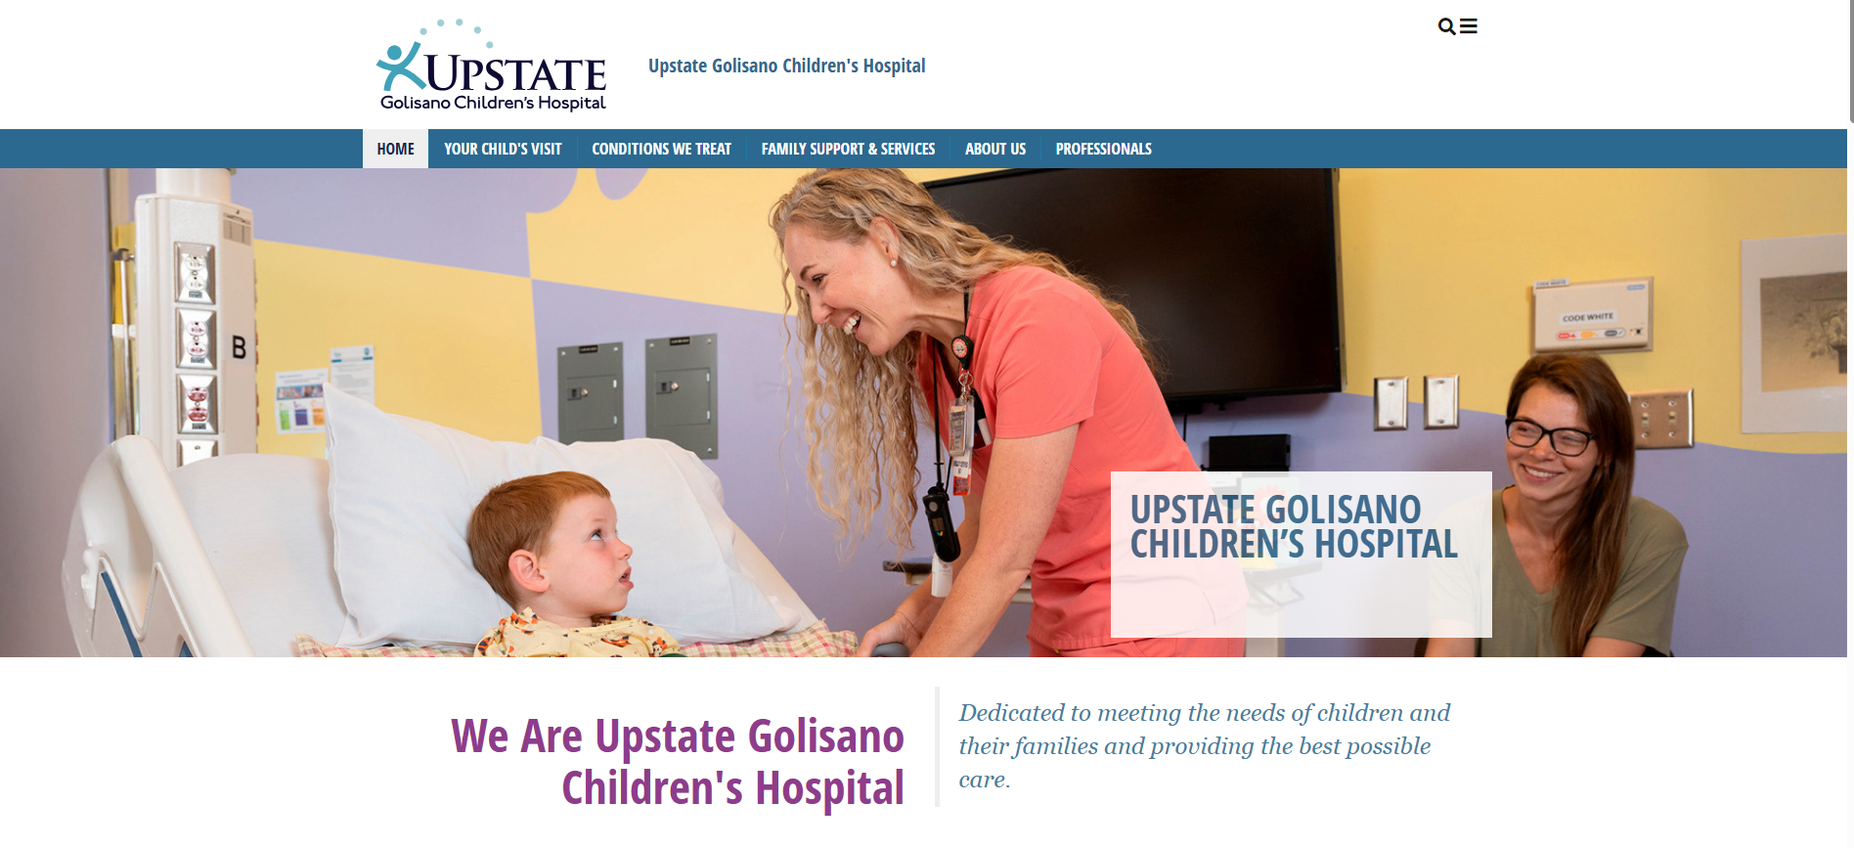

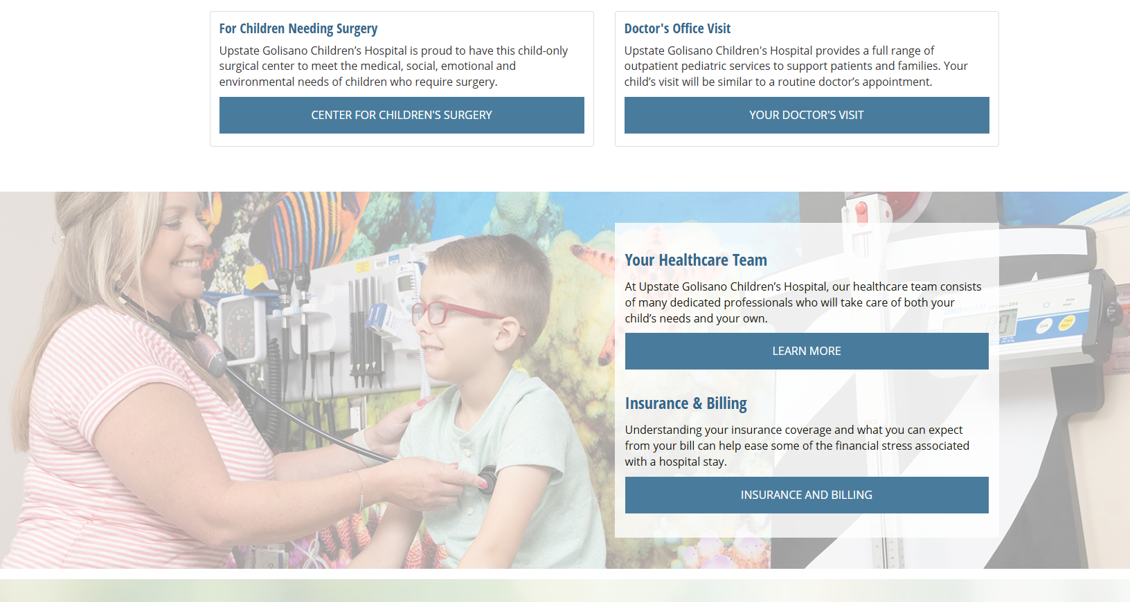
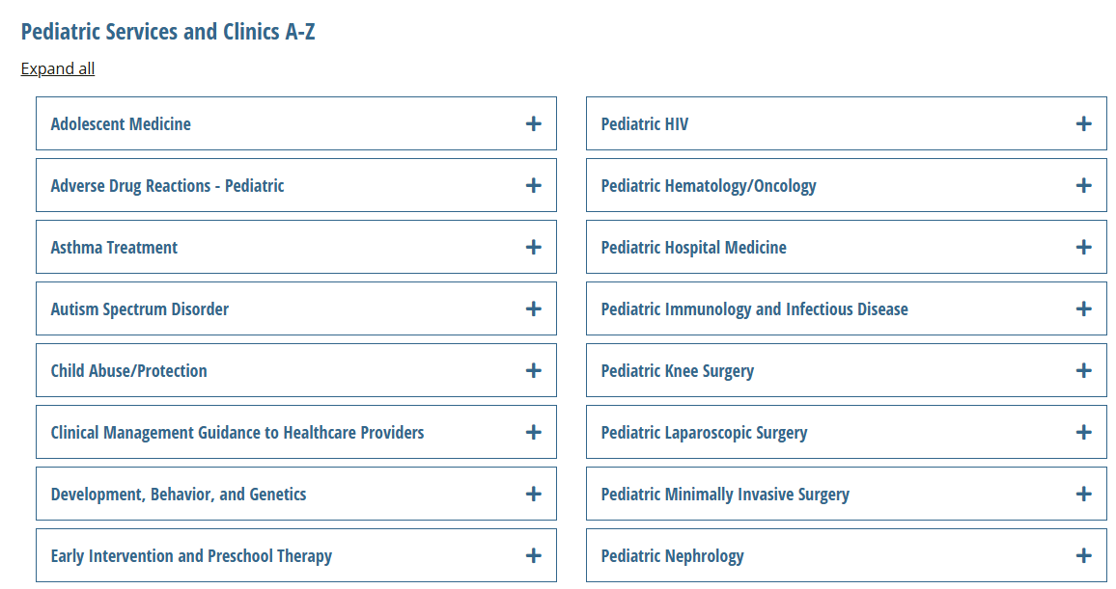

Slide 12
Next Meeting: April 30th at 8am
Notes:
We will provide updates on our strategic plan progress. The Pediatric Transport Team and Center for Surgery Verification team will be presenting on their efforts.

Slide 13
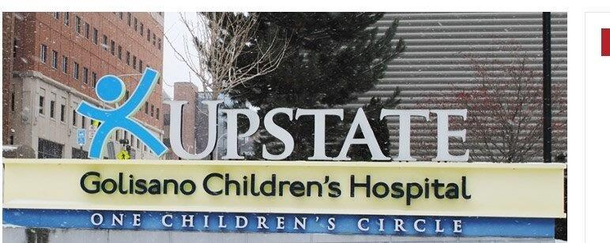
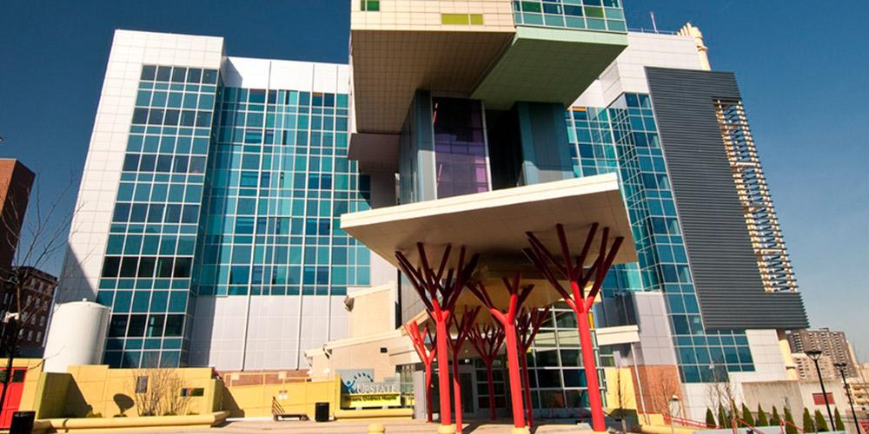
Questions?

