Slide 1
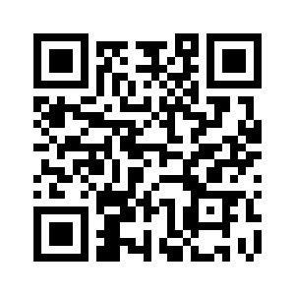

Welcome to UNYOC / MLA 2025
Tue. 7 Oct. 2025
9:30 am – 12:15 pm Conference Program, Day 1
1:30 – 3:00 pm UNYOC Membership & Business Meeting
Wed. 8 Oct. 2025
9:30 am – 12:00 pm Conference Program, Day 2
1:15 – 4:15 pm Continuing Education
Thu. 9 Oct. 2025
9:30 am – 2:15 pm Conference Program, Day 3
Detailed Conference Schedule: https://unyoc.wildapricot.org/Conference-Schedule

